Slide 1
Discussion of
‘The Kinks of Financial Journalism’
Paper by:
Diego Garcia (UNC)
Discussion by:
David Solomon (USC)
UC Davis Information and Asset Prices Conference
December 11th 2014

Slide 2
The Big Picture
The complicated relationship between media and asset returns
Firm A
Information
Firm A
Returns, Volume

Slide 3
The Big Picture
The complicated relationship between media and asset returns
Firm A
Information
Firm A
Returns, Volume
Standard asset pricing:
Information gets disclosed, incorporated into prices

Slide 4
The Big Picture
The complicated relationship between media and asset returns
Limited Attention
Costly Processing
Firm A
Information
Firm A
Returns, Volume
Hirshleifer, Lim and Teoh (2008), Della Vigna and Pollet (2009), many others…

Slide 5
The Big Picture
The complicated relationship between media and asset returns
Limited Attention
Costly Processing
Firm A
Information
Firm A
Returns, Volume
Media
Media as information dissemination

Slide 6
The Big Picture
The complicated relationship between media and asset returns
Limited Attention
Costly Processing
Firm A
Information
Firm A
Returns, Volume
Media affects firm volume via information transmission:
Barber and Odean (2008), Engelberg and Parsons (2011)
Media
Media as information dissemination

Slide 7
The Big Picture
The complicated relationship between media and asset returns
Limited Attention
Costly Processing
Firm A
Information
Firm A
Returns, Volume
Media affects firm returns via information transmission:
Fang and Peress (2009), Peress (2014), Hillert, Jacobs, and Müller (2014)
Media
Media as information dissemination

Slide 8
The Big Picture
The complicated relationship between media and asset returns
Firm A
Information
Firm A
Returns, Volume
Media

Slide 9
The Big Picture
The complicated relationship between media and asset returns
Firm A
Information
Firm A
Returns, Volume
Media
Incentives of Firms to Manipulate Media

Slide 10
The Big Picture
The complicated relationship between media and asset returns
Firm A
Information
Firm A
Returns, Volume
Firms manipulate their media coverage:
Solomon (2012), Gurun and Butler (2012)
Media
Incentives of Firms to Manipulate Media

Slide 11
The Big Picture
The complicated relationship between media and asset returns
Firm A
Information
Firm A
Returns, Volume
Firms manipulate their media coverage:
Solomon (2012), Gurun and Butler (2012)
Media coverage decisions in turn affect returns
Media
Incentives of Firms to Manipulate Media

Slide 12
The Big Picture
The complicated relationship between media and asset returns
Market
Information
Market Returns
Media

Slide 13
The Big Picture
The complicated relationship between media and asset returns
Market
Information
Market Returns
Media
Media directly affects markets

Slide 14
The Big Picture
The complicated relationship between media and asset returns
Market
Information
Market Returns
Media decisions on what to write affect returns:
Tetlock (2007), Dougal, Engelberg, Garcia and Parsons (2012), Garcia (2013)
Media
Media directly affects markets

Slide 15
The Big Picture
The complicated relationship between media and asset returns
Market
Information
Market Returns
Media

Slide 16
The Big Picture
The complicated relationship between media and asset returns
Market Returns (Information)
Media

Slide 17
The Big Picture
The complicated relationship between media and asset returns
Market Returns (Information)
Returns themselves affect media coverage:
This Paper
Media
Market Returns in Turn Affect Media

Slide 18
The Big Picture
The complicated relationship between media and asset returns
Interesting because:
Sheds light on the incentives of media as an organization
Market Returns (Information)
Returns themselves affect media coverage:
This Paper
Media
Market Returns in Turn Affect Media

Slide 19
The Big Picture
The complicated relationship between media and asset returns
Interesting because:
Raises the possibility of media and returns feeding back into each other
Market Returns (Information)
Media
Market Returns in Turn Affect Media

Slide 20
This paper
Main finding: Media content reacts more strongly to negative returns than to positive returns
  Slope of tone on lagged returns steeper in losses than gains
  Steeper for intermediate returns (-1,1) than extremes (-3,-1) and (1,3).
  Little difference between mid-sized +ve and large +ve
Relationship stable across time, authors, though structure of the media is not
  Claim is that the pattern doesn’t depend on media-side variables

Slide 21
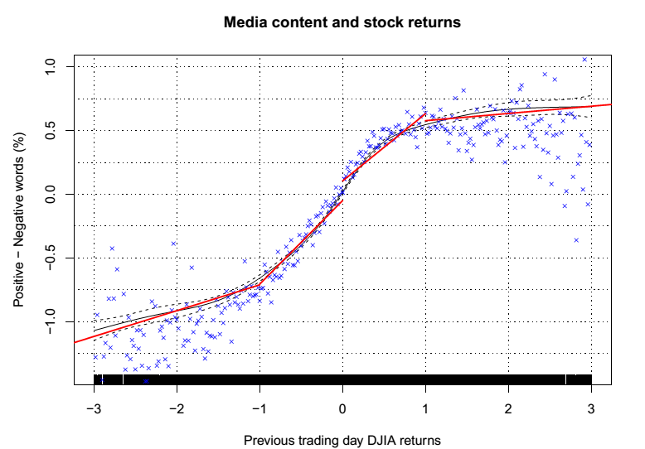
This paper

Slide 22
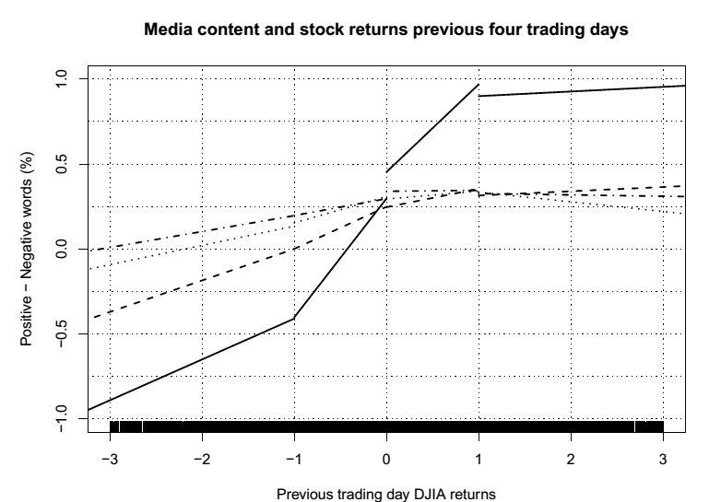
This paper

Slide 23
The Main Result
Interesting main finding!

Slide 24
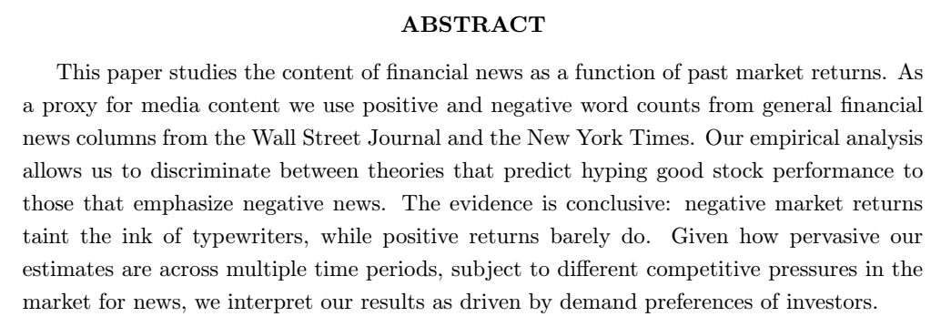
The Main Result
Interesting main finding!
A few quibbles with some claims:

Slide 25
The Main Result
Interesting main finding!
A few quibbles with some claims:
Large positive returns don’t, but positive returns in general do

Slide 26
The Main Result
Typewriter ink being tainted
Positive Returns

Slide 27
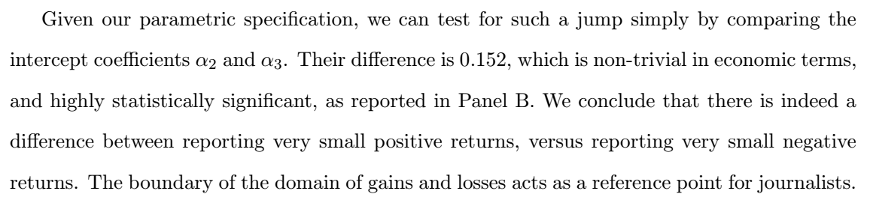
Quibble #2
Paper makes some note of the discontinuous shift at zero

Slide 28
Quibble #2
Paper makes some note of the discontinuous shift at zero
But most of this is by construction – the function is allowed to have a kink at zero, but not at most other points
This doesn’t necessarily mean zero is special, just that zero is the intersection between two regions with potentially different slopes by design

Slide 29
Discontinuous at zero?

Slide 30
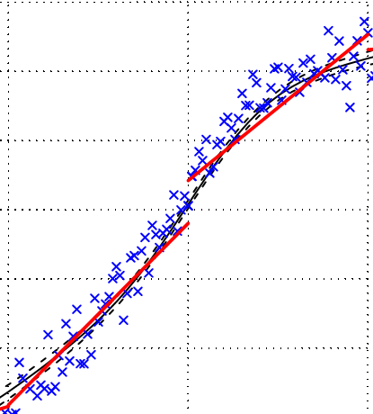
Discontinuous at zero?

Slide 31
Discontinuous at zero?
Would be nice to see additional evidence that discontinuity at zero is not an artefact of the specification

Slide 32
Discontinuous at zero?
Would be nice to see additional evidence that discontinuity at zero is not an artefact of the specification
The good news? It works with splines

Slide 33
Discontinuous at zero?
Would be nice to see additional evidence that discontinuity at zero is not an artefact of the specification
The good news? It works with splines
The bad news? Discontinuities show up at other less salient places when changes in slope are allowed there, suggesting some mechanical effect

Slide 34
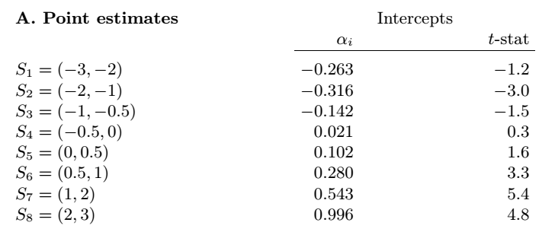
Discontinuous at zero?

Slide 35
Discontinuous at zero?
Strong discontinuities at other points when slope is allowed to change there

Slide 36
Discontinuous at zero?
Strong discontinuities at other points when slope is allowed to change there
Discontinuity at zero is not nearly as significant either

Slide 37
Discontinuous at zero?
Possible saving grace: all the examples given have shifts at round numbers that may actually be reference points
One suggestion – Try putting in placebo breaks at other non-round numbers and see if that has the same effect

Slide 38
The Null Hypothesis
Main result is believable – more focus on bad news
Two big related questions though:
What should our null hypothesis be?
What do the results tell us about the media and investors?

Slide 39
The Null Hypothesis
Should an article about today’s returns simply be a deterministic linear transformation of returns into tone?
  If so, why not just report the return? Why write a column?
Main value of column versus the S&P500 is forward-looking analysis useful to readers
So are positive and negative returns today equally important for things investors care about?

Slide 40
Negative Returns and Investor Interest
Entertainment
  Financial car crashes just like real car crashes
  If so, does coverage depend on other variables correlated with entertainment, like volume or volatility?
Preferences over returns
  Investors may worry more about negative news, such as due to prospect theory preferences, and want more descriptions and information when news is bad
Relevance for future events
  Bad news may be more relevant for outcomes
  Especially true if readers include debt-holders

Slide 41
Negative Returns and Investor Interest
One test of informational relevance – does the same pattern hold true when forecasting next day’s returns?

Slide 42
Negative Returns and Investor Interest
One test of informational relevance – does the same pattern hold true when forecasting next day’s returns?
Negative returns somewhat less informative for next day’s returns

Slide 43
Negative Returns and Investor Interest
On the other hand, increased slope between (-1,1) versus (-3,-1) and (1,3) is true for returns

Slide 44
Theories of Investor Interest
Not always possible to tell these theories apart, particularly with only time-series market data
Could do more with a panel of firms (e.g. does more firm debt make the focus more negative for a given level of earnings news?), but needs extra data

Slide 45
Conclusion
Neat Paper documenting an interesting asymmetry in media coverage
Try to think more about testing different theories of investor demand for negative coverage

