Slide 1
Discussion of “Mispricing and Anomalies: An Exogenous Shock to Short Selling from the Dividend Tax Law Change?”
Paper by:
Yufeng Han (UNC Charlotte) Yueliang Lu (UNC Charlotte)
Weike Xu (Clemson)
Guofu Zhou (Wash U.)
Discussion by:
David Solomon (Boston College)
Finance Cavalcade, May 26th 2021

Slide 2
The Anomalous History of Anomalies
How many factors drive expected returns?
Factors
Time

Slide 3
The Anomalous History of Anomalies
How many factors drive expected returns?
Factors
???
Pre 20C
Time

Slide 4
The Anomalous History of Anomalies
How many factors drive expected returns?
Factors
Graham & Dodd (1934) Valuation Factors?
5-10?
1900 - 1960
Time

Slide 5
The Anomalous History of Anomalies
How many factors drive expected returns?
Factors
CAPM: Only β
Treynor, Sharpe, Lintner, Mossin
1
1961 – 75ish
Time

Slide 6
The Anomalous History of Anomalies
How many factors drive expected returns?
Factors
Anomalies accumulate:
B/M, D/P, P/E, Size, PEAD…
7?
1975-92
Time

Slide 7
The Anomalous History of Anomalies
How many factors drive expected returns?
Factors
Fama and French (1992): Mkt, ME & B/M
3
1993
Time

Slide 8
The Anomalous History of Anomalies
How many factors drive expected returns?
Factors
97? 400?
“Anomalies” no longer anomalous
Time
Now

Slide 9
An Embarrassment of Riches
Two responses to so many anomalies:
Need another great consolidation to reduce the number of puzzling facts
Fama and French (2015), Novy-Marx (2013), Hou Xue and Zhang (2015), Stambaugh and Yuan (2016), Daniel Hirshleifer and Sun (2016)
BUT Jacobs and Muller (2015) – 42 out of 161 significant
Need to start thinking about anomalies as a whole
McLean and Pontiff (2016), Engelberg, McLean and Pontiff (2017), this paper

Slide 10
The Eternal Question: Risk or Mispricing?
So are these returns driven by risk or mispricing?
Several ways to approach the issue
Are there really 97 independent drivers of returns?
If so, we’re done. There aren’t 97 separate risk factors
Key insight: if high returns vary with short sales constraints, more easily explained with mispricing than risk
The problem: Half of “Short sales constraints” variables measure firm size (e.g. institutional ownership), the other half measure overvaluation (e.g. short rate, short interest)

Slide 11
The Solution
Passage of JGTRRA (2003) meant that taxable investors should (and do) withdraw securities lending before dividend
Otherwise just paying higher taxation on the dividend
Nearly everyone else has just focused on the mean return around this period
Crazily strong identification – manages to have both an overall time series (before and after law) and a recurring, within-firm time series (monthly cycles for dividend firms)
Mispricing worse after dividend months, especially after 03
Driven by the short side of the portfolio
Really cool finding!

Slide 12
Doing more with the within-firm aspect
Most results use panel regressions with triple interactions
Dividend month has both cross-sectional (do you pay a dividend) and within-firm time series (do you pay this month) aspects
Add firm fixed effects to strip out cross-sectional aspects
Alternative: Construct calendar time portfolios using only dividend paying firms, regress on standard factors
All variation is now within dividend-paying firms
Long each firm 4 months per year, short 8 months at half the weight
Used in Hartzmark and Solomon (2013) to show high returns in months with an expected dividend

Slide 13
Abnormal Returns

Slide 14
Abnormal Returns

Slide 15
Abnormal Returns

Slide 16
Abnormal Returns

Slide 17
Loadings on Risk Factors

Slide 18
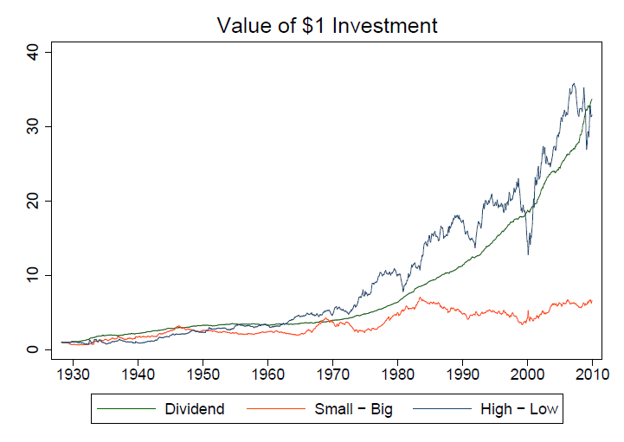
Loadings on Risk Factors

Slide 19
How to integrate with main test
Main test then becomes a double difference portfolio, done entirely within dividend-paying firms
( (Underpriced, Post Div) – (Overpriced, Post Div)) - ( (Underpriced, Other Months) – (Overpriced, Other Months))
Extra evidence for mispricing comes not just from high returns of this portfolio, but (likely!) zero loadings on other factors
If you’re a value firm in February, you’re a value firm in March
Zero net loading on any firm over the course of the year
Can test before and after 2003 – construct time series of double difference portfolio, regress on a dummy for “post 2003”

Slide 20
Possible Link with Calendar Seasonality
Weird outstanding finding – Heston and Sadka (2008) calendar seasonality. If you have high returns last January, and the January before that etc. you have high returns this January

Slide 21
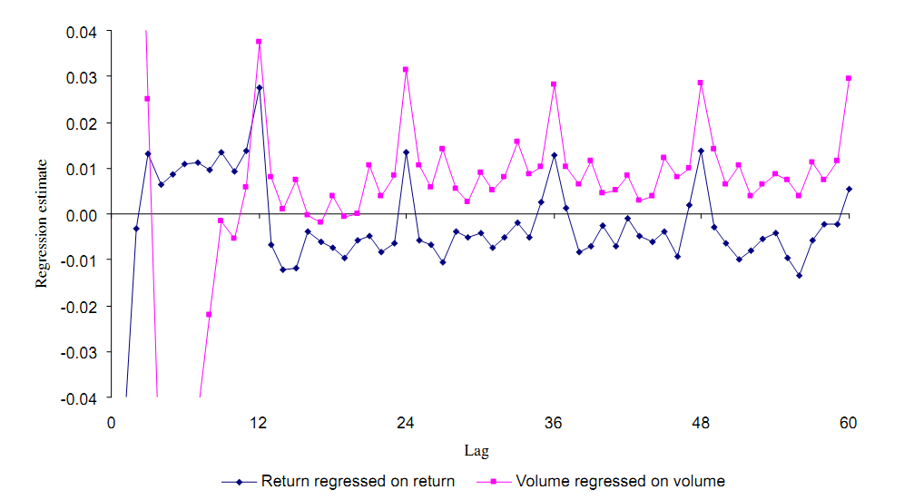
Possible Link with Calendar Seasonality

Slide 22
Possible Link with Calendar Seasonality
Weird outstanding finding – Heston and Sadka (2008) calendar seasonality. If you have high returns last January, and the January before that etc. you have high returns this January
Partial answer – Keloharju, Linnainmaa & Nyberg (2016). If there’s seasonality in underlying factors, then sorting on past returns produces time-varying factor exposure
Somewhat kicks the can down the road – okay, so why is there seasonality in factor returns?
No good answers here

Slide 23
Possible Link with Calendar Seasonality
One angle – different anomalies have different levels of exposure to dividend-paying stocks
Some might have high exposure, and so work very well in some months but lousy in others
Others might have low exposure, and be relatively smooth
This would potentially produce factor seasonality (factors which work well in past Januaries tend to work well this January)
Does this actually happen, in terms of a) differing factor exposure to dividend-paying firms, and b) different seasonal returns?
How much does this explain seasonality in factors overall?

Slide 24
Conclusion
Really cool paper, persuasive evidence of mispricing driving anomaly returns
I was convinced of this already, your mileage may vary
Can get more mileage out of within-firm time series (see Hartzmark and Solomon (2018) for a review)

