Slide 1
Discussion of “Return Expectations, Sentiment, and the Stock Market”
Paper by:
Stefano Cassella (Tilburg) and Huseyin Gulen (Purdue)
Discussion by:
David Solomon (Boston College)
EFA
August 23rd, 2018

Slide 2
The Siren-Song of Sentiment
The Weak Law of Behavioral Finance:
Sooner or later, everyone writes an alpha paper
The Strong Law of Behavioral Finance:
Sooner or later, everyone writes a sentiment paper
Why?
It’s so damn interesting
Every now and again, really weird stuff happens that cries out for an explanation

Slide 3
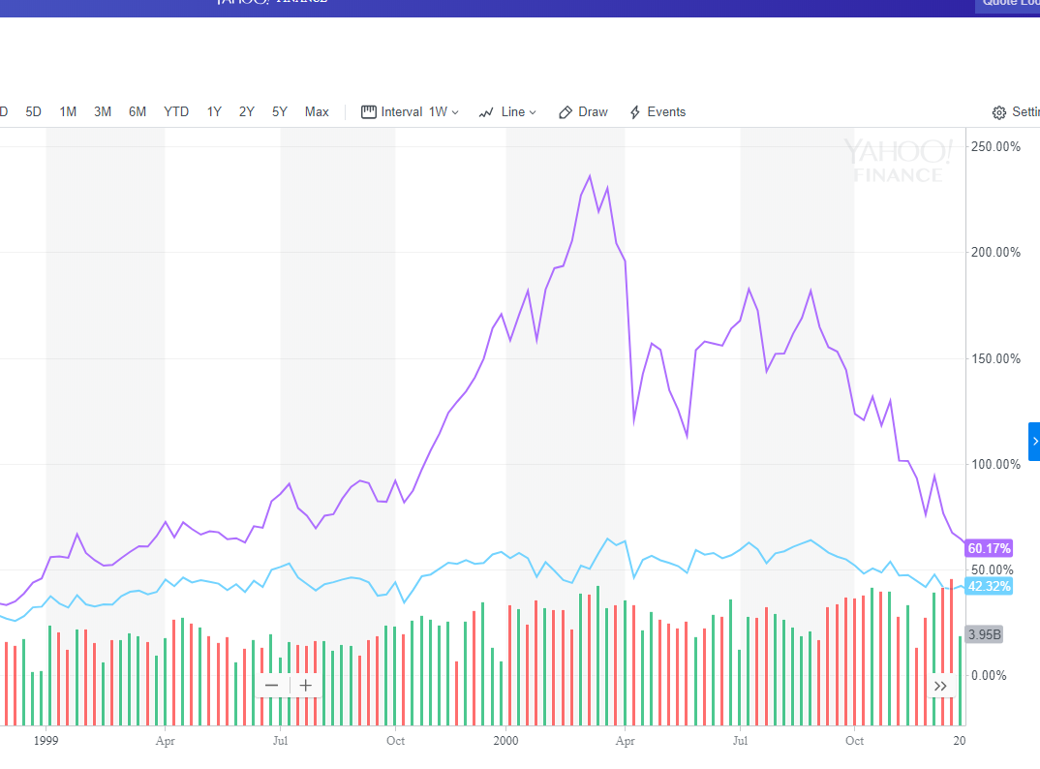
The Siren-Song of Sentiment
Look at me, I’m a bubble!

Slide 4
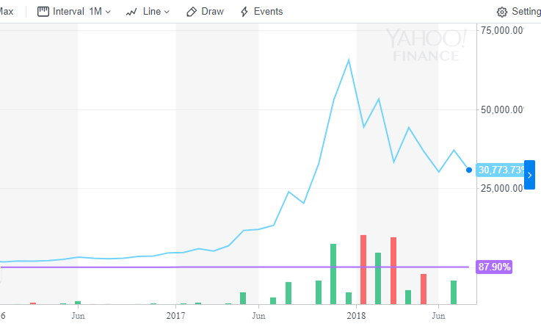
The Siren-Song of Sentiment
I earned 87% since 2013!
That’s cute, you look like a flat line to me
BTC

Slide 5
The Siren-Song of Sentiment
Look at me, I’m a bubble!
I earned 87% since 2013!
That’s cute, you look like a flat line to me
BTC

Slide 6
The Cochrane Critique
“Good behavioral finance starts with psychology”
John Cochrane
Gold standard: Anchoring
(Dougal, Engelberg, Parsons & Van Wesep (2015)
Strong basis in lab experiments. People anchor on salient but uninformative numbers (Tversky and Kahneman (1974))
Sharp prediction that’s difficult to explain under other theories

Slide 7
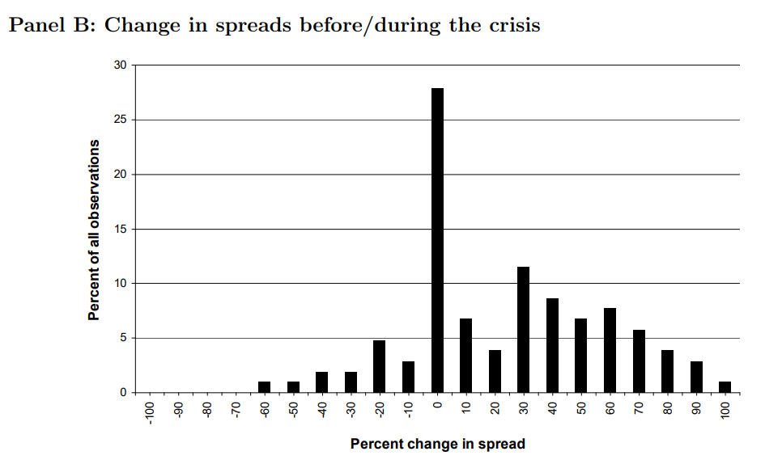
Passing the Cochrane Critique

Slide 8
Failing the Cochrane Critique
Sentiment scores very poorly under this metric
“Common judgment errors made by a substantial number of investors” (Shleifer (2000))
Without further elaboration, no predictions about
Direction
Timing
Magnitude
How do I measure it?
More importantly, how do I falsify it?

Slide 9
“Judgment Errors”
Approach 1: Measure errors, if not judgment
Amalgamate things likely to be errors
Closed end fund discount, share turnover, # IPOs, Share of equity issues, dividend premium(…) Baker and Wurgler (2007)
Principal components, orthogonalize to economic variables
Approach 2: Measure judgment, if not errors
Shleifer and Greenwood (2014), this paper
Measure expectations directly via surveys.
Gallup Investor Optimism for retail investors
Investor Intelligence Survey for institutions
Weight by the equity fraction of retail & institutional investors

Slide 10
“Judgment Errors”
Basic question: is this meant to be erroneous beliefs, or just beliefs in general?
Not clear in the paper
Greenwood & Shleifer (2014) argue beliefs incorrectly follow extrapolative proess
But in that case, why not just model extrapolation component?
Earlier time series already does this (no actual expectation data)
Orthogonalize to economic variables, a la Baker and Wurgler?
Distinguish between fitted value (from extrapolation alone) and residual
Would improve things greatly to take a stand on what the mistake is

Slide 11
Fewer Results, More Intuition
Broke: Too many degrees of freedom means that results have a high risk of just being data-mined
Simple solution: out of sample tests
Woke: Too many degrees of freedom makes it hard to interpret what the results are actually telling you
Two survey measures. Historical values taken from fitted regression. Weighting done by equity share
Are changes coming from beliefs, or shares? Not clear
A little ad hoc, but defensible
What should this matter for, exactly?

Slide 12
Fewer Results, More Intuition
Cross-sectional predictions about “hard to value” stocks
Hard-to-value: Small, high beta, volatile, young, no dividends
Reasonable, BUT
Maybe hard-to-value: Profitability? Intangibles? R&D? Book-to-market? Sales growth? External financing?
Beats me
Some work, some don’t
Why? Should we be surprised? Hard to say.

Slide 13
Sentiment, Sentiment everywhere
Results of EXP differ from results of Baker & Wurlger sentiment using measures of mispricing.
Explanation: Two types of sentiment. “General” and “Speculative”
Which one is which?
Different investor habitats, between institutional and retail, so different stocks are affected differently
Two forms of sentiment interact, so changes in general sentiment can also affect levels of speculative sentiment
82 pages in pdf

Slide 14
Sentiment, Sentiment everywhere
The good news: the authors do a good job trying to give content to what each variable is measuring
Levels vs cross-section, formal model of effects
The bad news: Instead of there being one sentiment measure I don’t really understand, there’s now two
The worse news: They also interact with each other

Slide 15
Sentiment, Sentiment everywhere
The good news: the authors do a good job trying to give content to what each variable is measuring
Levels vs cross-section, formal model of effects
The bad news: Instead of there being one sentiment measure I don’t really understand, there’s now two
The worse news: They also interact with each other

Slide 16
Breaking Through the Confusion
Not really the authors’ fault – sentiment itself is confusing and hard to measure
Encouraging attempt to formalize with model and give psychological content to what each measure is
More would be helpful, especially focus on psychology
Extrapolative aspect reasonably well established. Other parts of beliefs much more opaque
Try to simplify predictions
Add more understanding of what sentiment is, and why it arises
Habitat stuff seemed a bit unrelated (or maybe I didn’t get it)

Slide 17
Conclusion
Interesting new measure tackling a big and hard question
Good attempt to link to psychology, and generate theoretical predictions
More steps towards understand why and how sentiment arises would be very helpful

