Slide 1
Discussion of “Are Mutual Fund Managers Paid for Investment Skill?”
Paper by:
Markus Ibert (SSE), Ron Kaniel (Rochester) Stijn Van Nieuwerburgh (NYU), Roine Vestman (Stockholm)
Discussion by:
David Solomon (Boston College)
2018 GSU CEAR-Finance Conference
April 14th, 2018

Slide 2
The Many Faces of Mutual Funds

Slide 3
The Many Faces of Mutual Funds
#1: The Investor Perspective:
Just another asset to buy

Slide 4
The Many Faces of Mutual Funds
#1: The Investor Perspective:
Just another asset to buy
?
MUTUAL
FUND

Slide 5
The Many Faces of Mutual Funds
#1: The Investor Perspective:
Just another asset to buy
?
MUTUAL
FUND
?
?
?

Slide 6
The Many Faces of Mutual Funds
#1: The Investor Perspective:
Just another asset to buy
?
MUTUAL
FUND
?
>
Lack of diversification,
excess trading
?
>
?
Odean (1999) Barber and Odean (2000)
Equity premium
Mehra and Prescott (1985)

Slide 7
The Many Faces of Mutual Funds
INDEX
FUND
#1: The Investor Perspective:
Just another asset to buy
9 b.p.
>
>
?
MUTUAL
FUND
67 b.p.
?
>
?
>
Jensen (1968), Carhart (1997) Fama and French (2010)…
?

Slide 8
The Many Faces of Mutual Funds
?
MUTUAL
FUND

Slide 9
The Many Faces of Mutual Funds
#2: The Market Efficiency Perspective:
The mutual fund is a fund manager picking stocks
?

Slide 10
The Many Faces of Mutual Funds
#2: The Market Efficiency Perspective:
The mutual fund is a fund manager picking stocks
?

Slide 11
The Many Faces of Mutual Funds
#2: The Market Efficiency Perspective:
The mutual fund is a fund manager picking stocks
?
?

Slide 12
#2: The Market Efficiency Perspective:
General Conclusions:
The average fund underperforms Jensen (1968), Carhart (1997), Fama and French (2010)…
Past fund returns are a weak predictor of future returns Carhart (1997)
Other variables do predict fund returns
Industry Concentration, Return Gap , Active Share, Reliance on Public Information, R² on Indices, Fund Size, Manager Age, SAT Score, Family Wealth, Birth Month…
Kacperczyk Sialm and Zheng (2005, 2008), Cremers and Petajisto (2009), Kacperczyk and Seru (2007), Amihud and Goyenko (2013), Chen, Hong, Huang and Kubik (2004), Pastor, Stambaugh and Taylor (2015), Reuter and Zitzewitz (2015), Wermers (2000), Chevalier and Ellison (1999), Chuprinin and Sosyura (2017), Bai, Ma, Mullally and Solomon (2017)…

Slide 13
The Many Faces of Mutual Funds
#3: The Allocation of Capital Perspective:

Slide 14
The Many Faces of Mutual Funds
#3: The Allocation of Capital Perspective:
Investors allocate capital to talented managers, who allocate it to underlying stocks
?
?

Slide 15
The Many Faces of Mutual Funds
#3: The Allocation of Capital Perspective:
Investors allocate capital to talented managers, who allocate it to underlying stocks
?

Slide 16
The Many Faces of Mutual Funds
#3: The Allocation of Capital Perspective:
Investors allocate capital to talented managers, who allocate it to underlying stocks
?

Slide 17
The Many Faces of Mutual Funds
#3: The Allocation of Capital Perspective:
Investors allocate capital to talented managers, who allocate it to underlying stocks
General Performance Flow Relationship, Convexity
Brown, Harlow and Starks (1996) Chevalier and Ellison (1997), Sirri and Tufano (1998), Zheng (1999), Evans (2010) …
Allocating flows for bad reasons
Frazzini and Lamont (2008), Solomon, Soltes and Sosyura (2014), Agarwal, Gay and Ling (2014)…
?

Slide 18
The Many Faces of Mutual Funds
#4: The Corporate Finance Perspective:

Slide 19
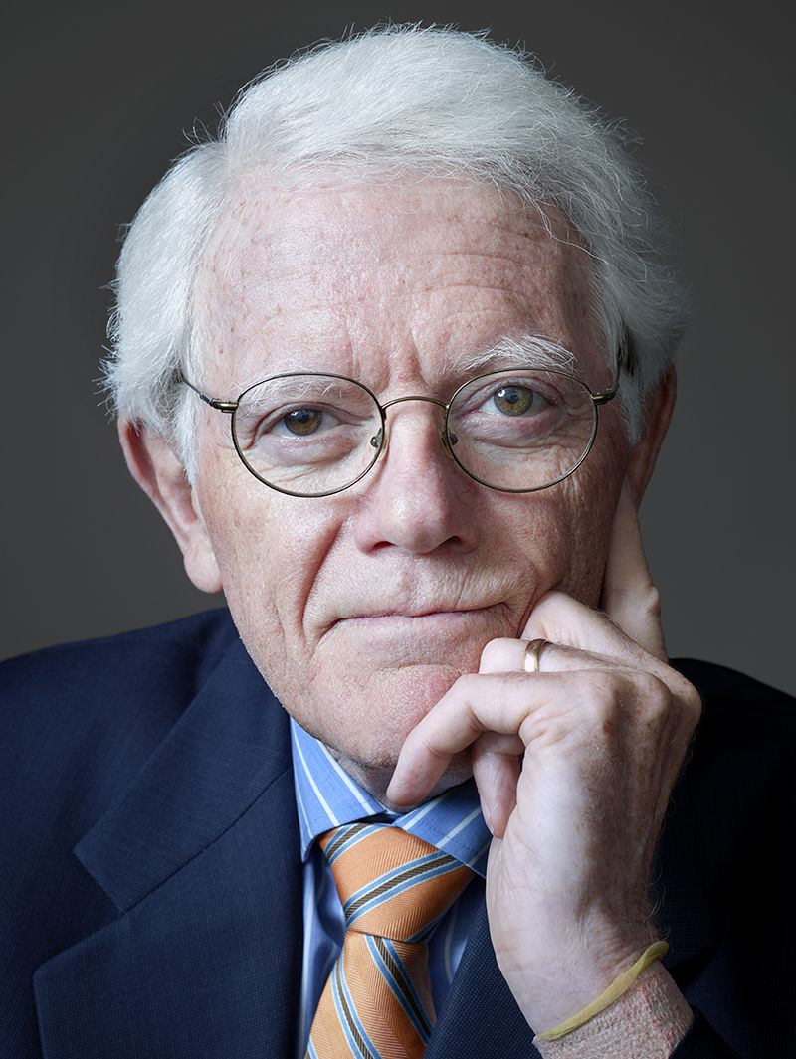
The Many Faces of Mutual Funds
#4: The Corporate Finance Perspective:
A mutual fund company is a business and the fund manager is an employee

Slide 20
The Many Faces of Mutual Funds
#4: The Corporate Finance Perspective:
A mutual fund company is a business and the fund manager is an employee
Firm Cross Subsidization
Nanda, Wang and Zheng (2004), Gaspar, Massa and Matos (2006)…
Promotion and Firing
Chevalier and Ellison (1999)…

Slide 21
This Paper
Examines the financial incentives faced by mutual fund managers in Sweden
Fund managers have a low-ish but quite consistent elasticity of pay to fund revenue (~0.15)
Effect small in $ terms. Revenue doubles ($6.2m), fund manager pay increases by $31,200
Fund managers have smaller and less consistent elasticity of pay to returns
Largely disappears after controlling for fund revenue
Fund manager pay does depend considerably on firm profits, consistent with a firm-wide bonus pool

Slide 22
This Paper
Fascinating dataset, interesting question
Something for everyone to learn
Overturns what seems to be a common presumption in the literature, that pay is entirely for returns
Quantification of the revenue elasticity is important
Thinking about funds as a business is very important
Only missing piece – little on interpretation

Slide 23
Three Big Puzzles
Is this surprising? For most academics, probably yes
1. Why doesn’t pay depend on returns very much?
2. Why doesn’t the manager make very much out of fund revenue?
3. Why does the manager get paid based on firm-wide performance?

Slide 24
Why doesn’t pay depend on returns very much?
If the fund family is a firm, and the manager is an employee, what kind of employee are they?
Standard answer: High skilled labor in selecting the portfolio
Firm is delegating the (primary? sole?) task of portfolio choice
Ability to predict alpha is rare, so talent must be compensated
Research requires hard work, so contracts must incentivize effort provision
Flows modeled as a deterministic function of performance
Investors may have some search frictions or difficulty estimating skill, adding noise to the process

Slide 25
Why doesn’t pay depend on returns very much?
In this view, not paying for returns is very puzzling
Returns are one of the best, if not the best, measure of the combination of skill and effort
Pay for the thing you want more of!
Flows in excess of returns are noise, liquidity constraints, irrationality etc.
Just compensate people for skill, and the flows will come
Analogous to CEOs maximizing earnings, not stock returns
If this is puzzling, perhaps we’ve been thinking about fund families in the wrong way!

Slide 26
The Alternative View of the Fund as a Business
The alternative view: the fund manager is a division manager of a particular product
Increasing fund returns is equivalent to making a better quality product
Marketing the fund on dimensions other than returns is catering to odd/idiosyncratic customer demands
Managing the analysts, traders, salesmen is equivalent to successful personnel management
Generating more flows is equivalent to increasing sales

Slide 27
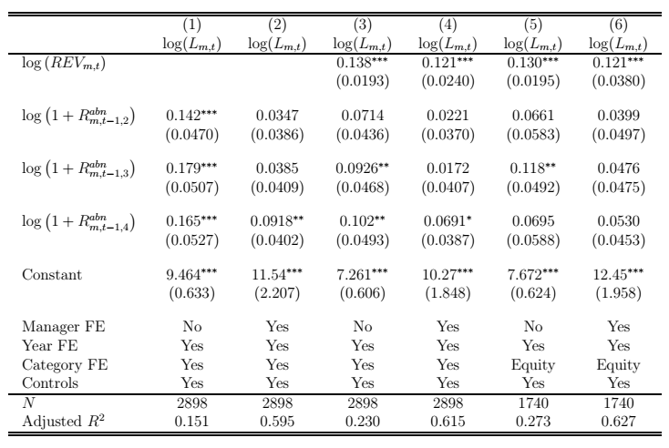
The Alternative View of the Fund as a Business
Paper spends considerable time discussing effect of returns on pay after controlling for fund revenue

Slide 28
The Alternative View of the Fund as a Business
Equivalent to a company not paying a division manager for making a high quality product, after controlling for sales
Only interesting question is the univariate effect of returns on pay
Still low, and manager fixed effects remove a lot (c.f. skill)
One interpretation: family is agnostic on what actually drives sales, and wants to incentivize sales directly

Slide 29
Why Reward Sales Directly?
Maybe investors demand features other than returns
Investors give flows to funds with artificially high dividends Harris, Hartzmark and Solomon (2015)
Investors may prefer fund managers they feel they can trust Genaioli, Shleifer and Vishny (2015)
Investors may want socially responsible investments Hartzmark and Sussman (2017)
Maybe there is a large component of selling and marketing the fund that is unrelated to returns
Marketing is largely a black box
Equally large fee dispersion in passive funds as active ones Hortaçsu and Syverson (2004)

Slide 30
The Puzzle For Rewarding Sales
The hitch: puzzle #2. Fund revenues just aren’t rewarded that much!
Revenue x 2 ($6.2m), fund manager pay increases by $31,200
One possibility: Swedish norms against conspicuously high pay for top employees?
Fairness norms could bite between fund managers and underlings
Could also bite between different managers within the same fund family
Hard to test

Slide 31
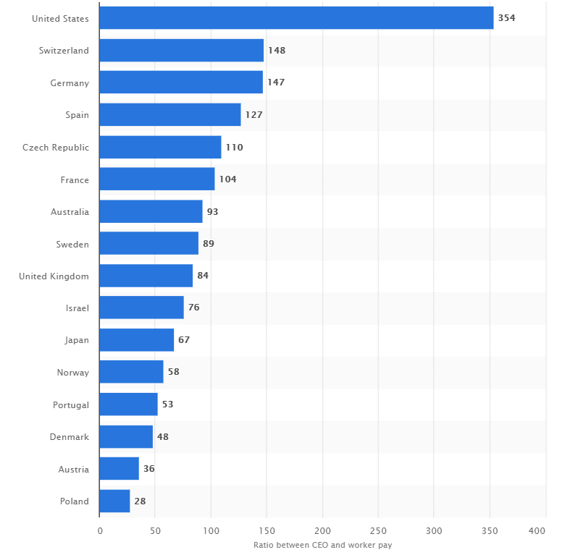
Obligatory Questions About Sweden
Ratio of Mean CEO Pay to Mean Worker Pay by Country

Slide 32
The Puzzle For Rewarding Sales
Solution #2: main disincentive is getting fired, not getting lower pay
Would have been nice to test
Tests on subsequent year pay somewhat related, but don’t directly address the issue
Sticky wages generally may pay cuts difficult to implement
An incompetent manager is undesirable at almost any wage
Low sensitivity of pay to revenues != low incentive to care about revenues

Slide 33
The Puzzle For Rewarding Sales
Solution #3: Increased revenues used to pay other employees
Lots of other employees even within the same fund
Sales, Trading, Analysts, Researchers, Administrative Staff
All probably get some kind of bonus as well
Firm-wide bonus pool requires some profits get cleaved out to pay other managers
Firm proprietors want to get rich themselves

Slide 34
The Puzzle of Firm-Wide Revenue
Puzzle #3. Why does the manager get paid based on firm-wide performance?
Anecdotally, bonus pools are ubiquitous.
It would be amazing if this weren’t true
Early stage funds are like a startup
Lose money early on
Can sometimes pay early employees in equity
Need to survive long enough to get sufficient AUM to break even
Firms are generous when they can afford to be generous

Slide 35
Conclusion
Neat Paper, great use of creepy Swedish data
Should change our perspective on how we think about mutual funds
Managers are not just a single guy incentivized to generate returns
Flows matter much more to funds (as they should!)
Mutual funds are a business

