Slide 1
Discussion of ‘In no (un)certain terms: Managerial style in communicating earnings news’
Paper by: Michał Dzieliński (Stockholm University) Alexander F. Wagner (University of Zurich) Richard J. Zeckhauser (Harvard University)
Discussion by:
David Solomon (USC)
American Finance Association Meetings, January 2017

Slide 2
The Paradox of Text
Finance academics, like Lord Kelvin, are fond of numbers: “I often say that when you can measure what you are speaking about, and express it in numbers, you know something about it; but when you cannot measure it, when you cannot express it in numbers, your knowledge is of a meagre and unsatisfactory kind”
‘4.2c per share’ is mostly just taken as an objective truth
But how should we think about words? Two perspectives
Words are also a representation of true information, particularly information that is hard to quantify numerically
Words are someone’s subjective opinion, which may or may not reflect underlying reality

Slide 3
The Paradox of Text
The finance academic literature has considered both sides:
Text as Information Text as Interpretation Text as Both/Ambiguous
Engelberg (2008) (Tone in Earnings)
Tetlock, Saar-Tsechansky, and Macskassy (2008) (Tone in Earnings)
Hoberg and Phillips (2009, 2012, 2014) (Industry and Product Market information in MD&A)
Hoberg and Maksimovic (2014) (Financial Constraints in MD&A)
Israelsen and Yonker (2011) (Insurance Policies in 10Ks)
…
Tetlock (2007) (Media tone as proxy for sentiment) and others
Dougal, Engelberg, Garcia and Parsons (2012) (Journalist FE)
Gurun and Butler (2012) (Media slant in press releases)
Li (2010) (CEO Pronoun use)
Zhou (2014) (CEO blame attribution)

Slide 4
Interpreting Identification of Interpretation
Information is the default assumption – interpretation needs to be established
Gurun and Butler (2012) – different articles on same underlying earnings announcement
Dougal et al (2012) – Journalist fixed effects and random rotation of journalists
Li (2010) – CEO pronoun use as an economically irrelevant choice (“I did X” versus “We did X”)
Zhou (2014) – CEO attribution of blame to external circumstances

Slide 5
CEO Communication Style
CEO tendency to use uncertainty words is related to lower response to earnings news
Smaller Earnings Response Coefficients
Less Volume
Seems to be linked to CEO linguistic style
Effects stronger for impromptu answers than prepared
Style persists across CEOs who switch firms
Interpretation: Markets respond less when CEOs use vague language which is harder to interpret

Slide 6
Uncertainty about Vagueness
What exactly do these words capture?
“EPS next year is expected to be 4.2c”, vs
“EPS next year is expected to be approximately 4.2c”
Is the difference really about being “vague” versus a “straight talker”?
Why not “nuanced” versus “simplistic”?
Would be helpful to be explicit about what the words capture
Nearly all are modifiers, relating to either probabilities or confidence intervals, not about unclear concepts

Slide 7
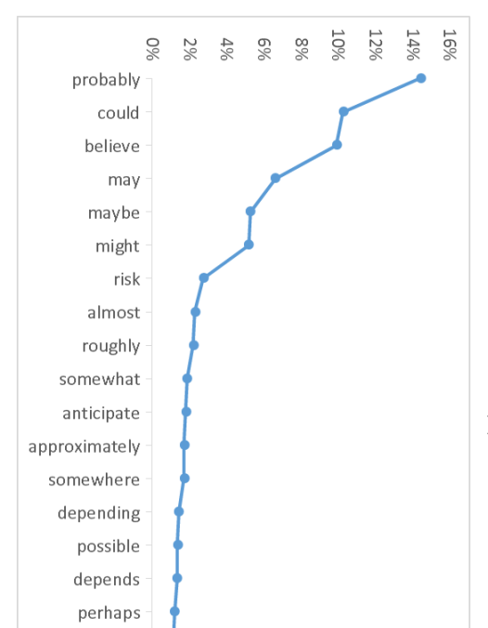
Uncertainty about Vagueness
Themes of uncertain words

Slide 8
Uncertainty about Vagueness
Themes of uncertain words
Probabilities are less than one

Slide 9
Uncertainty about Vagueness
Themes of uncertain words
Probabilities are less than one
The confidence interval on my beliefs is wider than zero

Slide 10
Uncertainty about Vagueness
Themes of uncertain words
Probabilities are less than one
The confidence interval on my beliefs is wider than zero
The quantities I am giving are inexact

Slide 11
Uncertainty about Vagueness
Themes of uncertain words
Probabilities are less than one
The confidence interval on my beliefs is wider than zero
The quantities I am giving are inexact

Slide 12
Uncertainty about Vagueness
Themes of uncertain words
Probabilities are less than one
The confidence interval on my beliefs is wider than zero
The quantities I am giving are inexact
-But CEOs in general overly optimistic Malmendier and Tate (2004)

Slide 13
Uncertainty about Vagueness
Themes of uncertain words
Probabilities are less than one
The confidence interval on my beliefs is wider than zero
The quantities I am giving are inexact
-But CEOs in general overly optimistic Malmendier and Tate (2004)
-But CFOs in general are overprecise, Ben-David, Graham and Harvey (2007)

Slide 14
Interpreting Uncertain Words
So if a CEO describes his company with more uncertain modifiers, what might this indicate?
He knows the same amount, but his uncertainty conveys less than the full amount of information -> The paper’s favored interpretation
He actually knows less about the future of his firm -> Ruled out by comparing presentation vs answers
He knows the same amount, but his uncertainty corrects the overconfidence of other CEOs -> Investors overreact to confidence, or underreact to truth
He knows the same amount, but is talking about different topics -> Investors are asking harder questions

Slide 15
Interpreting Uncertain Words
So if a CEO describes his company with more uncertain modifiers, what might this indicate?
He knows the same amount, but his uncertainty conveys less than the full amount of information -> The paper’s favored interpretation
He actually knows less about the future of his firm -> Ruled out by comparing presentation vs answers
He knows the same amount, but his uncertainty corrects the overconfidence of other CEOs -> Investors overreact to confidence, or underreact to truth
He knows the same amount, but is talking about different topics -> Investors are asking harder questions

Slide 16
Interpreting Uncertain Words
So if a CEO describes his company with more uncertain modifiers, what might this indicate?
He knows the same amount, but his uncertainty conveys less than the full amount of information -> The paper’s favored interpretation
He actually knows less about the future of his firm -> Ruled out by comparing presentation vs answers
He knows the same amount, but his uncertainty corrects the overconfidence of other CEOs -> Investors overreact to confidence, or underreact to truth
He knows the same amount, but is talking about different topics -> Investors are asking harder questions

Slide 17
Interpreting Uncertain Words
So if a CEO describes his company with more uncertain modifiers, what might this indicate?
He knows the same amount, but his uncertainty conveys less than the full amount of information -> The paper’s favored interpretation
He actually knows less about the future of his firm -> Ruled out by comparing presentation vs answers
He knows the same amount, but his uncertainty corrects the overconfidence of other CEOs -> Investors overreact to confidence, or underreact to truth
He knows the same amount, but is talking about different topics -> Investors are asking harder questions

Slide 18
Interpreting Uncertain Words
So if a CEO describes his company with more uncertain modifiers, what might this indicate?
He knows the same amount, but his uncertainty conveys less than the full amount of information -> The paper’s favored interpretation
He actually knows less about the future of his firm -> Ruled out by comparing presentation vs answers
He knows the same amount, but his uncertainty corrects the overconfidence of other CEOs -> Investors overreact to confidence, or underreact to truth
He knows the same amount, but is talking about different topics -> Investors are asking harder questions

Slide 19
Testing Investor Responses
Investors react less to uncertainty, but are they right to do so? Need to know levels.
Post-Earnings Announcement Drift (Ball and Brown (1968) Investors on average underreact to earnings news
Is PEAD larger for firms with uncertain CEOs?
Would suggest investors underreact to uncertain info
Does PEAD reverse for firms with certain CEOs?
Unlikely, but absence rules out overreaction to certain info
Is PEAD the same? Suggests actually less information

Slide 20
Different Answers, or Different Questions?
Two differences between presentation & answers
Unscripted: Get CEO’s personal style. Good!
Analysts choose the subject: Less good
Can you rule out the possibility that “uncertain” CEOs are just getting asked harder questions?
Clear CEOs explain things well in presentation, so get asked about hard, speculative topics in questions
Others explain things poorly, and get asked basics
Prediction: Investors already understand the “clear” firm, and so react less to earnings

Slide 21
Different Answers, or Different Questions?
Good news: not obvious why this is a CEO trait
Unless CEOs affect clarity of presentation section
Can you test this? Examine ambiguity (FOG, sentence length, grade level) of presentations
If uncertain CEOs have more clarity in presentation, consistent with getting harder questions.
Are there measures of horizon of questions?
Frequency of “next quarter”, “next year”, “next 5 years”
Cleanest predictor of greater uncertainty

Slide 22
Other Suggestions
Relationship with volume not obvious
Authors interpret less volume as less information.
But volume more cleanly related to disagreement, which might go up with uncertainty. Need to discuss more
Need to explain other regression coefficients
Why does presentation uncertainty load up negatively in levels for returns, but answer uncertainty only shows up as an interaction with surprise? Never discussed
Uncertainty level effect flips sign with style fixed effects version. Explanation is unconvincing – why shouldn’t the same effect hold with the base tests then?

Slide 23
Conclusion
Neat Paper!
Interesting relationship between CEO language style and earnings informativeness
Taking CEO selection & omitted information seriously is also very valuable
Would be nice to see more discussion of possible interpretations of what uncertain language actually means

