Slide 1
Discussion of ‘Who are the Smartest Investors in the Room? Evidence from U.S. Hedge Fund Solicitation’
Paper by: Philippe Jorion and Christopher Schwarz (UCI)
Discussion by:
David Solomon (USC)
Southern California Finance Conference, October 24th 2014

Slide 2
Why this paper?
It’s amazing what data you can get from the SEC
The problem with hedge fund research: self-reported data (a.k.a. “How rich are you?”)

Slide 3
Why this paper?
It’s amazing what data you can get from the SEC
The problem with hedge fund research: self-reported data (a.k.a. “How rich are you?”)
Solution: SEC requires any hedge funds who solicit from US investors to file Form D
Two big advantages:
Covers much larger space of (nearly all) hedge funds
Can split net flows into both inflows and outflows

Slide 4
The challenge with cool data
A paper with new data vs. A paper about new data
The platonic ideal: Brilliant important question motivates unique data collection, answers it
The reality: Sometimes you get cool data first, then figure out what to do with it

Slide 5
Observing the Full Hedge Fund Universe
First contribution: Most inflows not in HFR/TASS
Covers 24% of funds, 27% of sales, 35% of new investments
Affects inferences about size of fund universe
But is this an important or controversial metric?
Big issue of sample selection is on returns
Do only good funds get reported?
Several papers on this already, using data from holdings (Griffin and Xu (2009), Agarwal, Fos and Jiang (2013)) or fund-of-funds data (Aiken, Clifford and Ellis (2013)

Slide 6
Observing the Full Hedge Fund Universe
Other evidence on determinants of selection
Offshore funds less likely to match with databases (smaller fraction of Form D funds in HFR/TASS)
High Return funds more likely to match (higher fraction of HFR/TASS funds have form D)
Higher total sales and total investors more likely to match (higher fraction of Form D funds in HFR/TASS)
Last one is interesting.
Might just be size - flows don’t show as strong a relation
First 5 tables and 16 pages on sample selection
Somewhat inside-baseball
Talk about later? De-emphasize?

Slide 7
Splitting Flows into Inflows and Outflows
Separating flows is the cooler part of the paper
Inflows are informative, outflows are not
Nearly everything done on Net Flows:
Through Form D, directly observe Inflows:
Impute Outflows from Assets

Slide 8
Splitting Flows into Inflows and Outflows
Differences in performance/flow relationship
Result: Only extremes matter for each type of flow
Right tail of performance matters for inflows
Small losses and large losses look similar
Right tail of performance matters for outflows
Small gains and large gains look similar

Slide 9
Splitting Flows into Inflows and Outflows

Slide 10
Splitting Flows into Inflows and Outflows
A little convex

Slide 11
Splitting Flows into Inflows and Outflows
More convex

Slide 12
Splitting Flows into Inflows and Outflows
Quite convex

Slide 13
Splitting Flows into Inflows and Outflows
Non-monotonic?!?

Slide 14
Splitting Flows into Inflows and Outflows
Concave

Slide 15
Flows and Future Performance
Net Flows, Sales and New Investors positively predict fund returns at 3-6 month horizon
Outflows do not.
They also don’t predict fund death
Conclude that information asymmetry between old investors (who make up outflows) and new investors (who are part of inflows) conveys little advantage

Slide 16
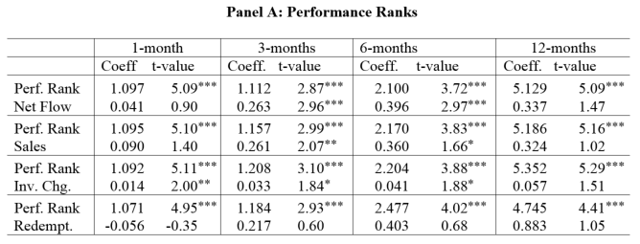
Splitting Flows into Inflows and Outflows

Slide 17
Splitting Flows into Inflows and Outflows
Strong for Net Flows

Slide 18
Splitting Flows into Inflows and Outflows
Marginal for Sales and New Investors

Slide 19
Splitting Flows into Inflows and Outflows
Wrong Way for Outflows

Slide 20
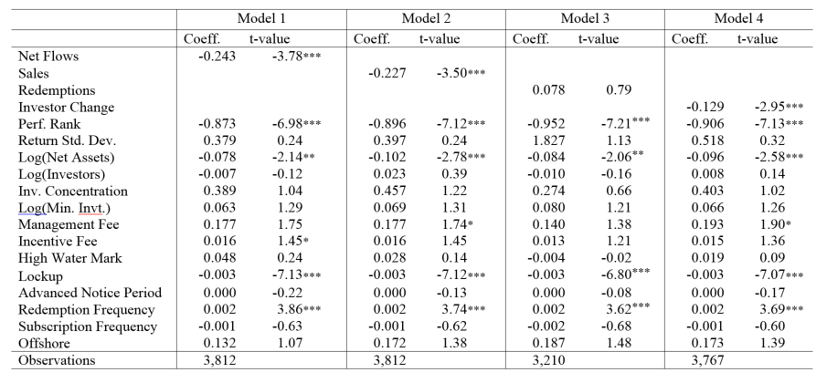
Splitting Flows into Inflows and Outflows

Slide 21
Splitting Flows into Inflows and Outflows
Outflows also don’t predict fund death ?!?

Slide 22
Making Sense of Outflows
So what on earth is wrong with outflows?
Extreme bad timing?
But why do the same investors have good timing on the way in?
Maybe liquidity needs make for poor choices?
Do results vary with restrictions on fund redemptions?

Slide 23
Making Sense of Outflows
So what on earth is wrong with outflows?
Extreme bad timing?
But why do the same investors have good timing on the way in?
Maybe liquidity needs make for poor choices?
Do results vary with restrictions on fund redemptions?
Alternative: Measurement Issues
Inflows are measured, while outflows are imputed

Slide 24
Making Sense of Outflows
“If we assume the inflows occur at the end of the period, we can infer the amount of assets of the fund at the end of the period.”

Slide 25
Making Sense of Outflows
“If we assume the inflows occur at the end of the period, we can infer the amount of assets of the fund at the end of the period.”
A big assumption! If flows were at start of period:
When returns are more positive, end of period assumption makes implied outflows smaller
*(1+Returns_{t})
Outflows_{START} = Outflows_{END} + Inflows*Returns_{t}

Slide 26
Flows and Future Performance
Some evidence that this matters
Alternative crude approximation (ignoring timing)
Inflows - Outflows ~= Net Flows
The gap between this approximation and imputed outflows in the paper is
Often large, and
Correlated with Market Returns

Slide 27
Curious Things About Redemptions

Slide 28
Curious Things About Redemptions

Slide 29
Curious Things About Redemptions

Slide 30
Curious Things About Redemptions

Slide 31
Curious Things About Redemptions

Slide 32
How to fix this
Examine the effect of alternative assumptions for timing of inflows:
Inflows at start of period
Inflows equally spread over the year
Inflows only in months with positive returns
Use performance/net flow relationship, estimate formally
This is important given the centrality of the flow decomposition results

Slide 33
Old vs New, or In vs Out?
Results on predictability presented as distinguishing new investors from old investors
But really about distinguishing outflows (which are only old investors) from inflows (which can be either new or old)
One way to test difference: compare predictive power of inflows for future returns in two cases:
when # investors is constant (only old investor inflows)
when # is increasing (old + new investor inflows)

Slide 34
How much asymmetry is there?
Authors argue at several points that information asymmetry between investors should be large
“[T]here are reasons to believe existing hedge fund investors will have an informational advantage as compared to new investors. Hedge funds are notoriously secretive about their strategies and portfolios, which leads to very little public information about hedge funds.”
But the big asymmetry is between fund investors as a whole and the rest of the public, not necessarily between new and old investors
Anecdotally, potential investors in at least some funds get to meet with fund managers and discuss strategies when pitching the fund

Slide 35
Conclusion
Neat Paper documenting an interesting asymmetry in hedge fund flows
Inflows are informative, outflows are not
Great use of new data to get around sample selection
More examination of outflow measurement would help bolster conclusions

