Slide 1
Discussion of ‘Anomalies and News’
Paper by: Joseph Engelberg (UCSD)
David McLean (Georgetown)
Jeffrey Pontiff (BC)
Discussion by:
David Solomon (USC)
American Finance Association Meetings, January 2017

Slide 2
The Anomalous History of Anomalies
How many factors drive expected returns?
Factors
Time

Slide 3
The Anomalous History of Anomalies
How many factors drive expected returns?
Factors
???
Pre 20C
Time

Slide 4
The Anomalous History of Anomalies
How many factors drive expected returns?
Factors
Graham & Dodd (1934) Valuation Factors?
5-10?
1900 - 1960
Time

Slide 5
The Anomalous History of Anomalies
How many factors drive expected returns?
Factors
CAPM: Only β
Treynor, Sharpe, Lintner, Mossin
1
1961 – 75ish
Time

Slide 6
The Anomalous History of Anomalies
How many factors drive expected returns?
Factors
Anomalies accumulate:
B/M, D/P, P/E, Size, PEAD…
7?
1975-92
Time

Slide 7
The Anomalous History of Anomalies
How many factors drive expected returns?
Factors
Fama and French (1992): Mkt, ME & B/M
3
1993
Time

Slide 8
The Anomalous History of Anomalies
How many factors drive expected returns?
Factors
97? 400?
“Anomalies” no longer anomalous
Time
Now

Slide 9
An Embarrassment of Riches
Two responses to so many anomalies:
Need another great consolidation to reduce the number of puzzling facts
Fama and French (2015), Novy-Marx (2013), Hou Xue and Zhang (2015), Stambaugh and Yuan (2016), Daniel Hirshleifer and Sun (2016)
BUT Jacobs and Muller (2015) – 42 out of 161 significant
Need to start thinking about anomalies as a whole
McLean and Pontiff (2016), this paper

Slide 10
Anomalies and News: Two Great Tastes That Go Great Together
What drives anomalies? Anomaly Returns are:
7 x high on earnings days
2 x high on DJ News Days
Related to analyst forecast errors
Hard to reconcile with risk -> mispricing or data mining
Patterns hold after initial data sample, and are stronger for small firms
More consistent with mispricing than data mining
Interesting, new, believable

Slide 11
Another Puzzle
The most underappreciated paper in asset-pricing
The largest movements in the stock market occur on days without any fundamental news
Probably the strongest evidence of market inefficiency
How many models fit this stylized fact?

Slide 12
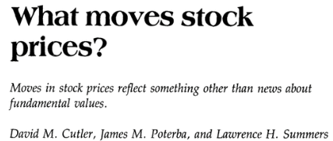
Another Puzzle
The most underappreciated paper in asset-pricing
The largest movements in the stock market occur on days without any fundamental news
Probably the strongest evidence of market inefficiency
How many models fit this stylized fact?

Slide 13
News as Surprises, News as Information
So markets are inefficient because they move with news and because they move without news?
Given how central this is, needs more discussion
Prices should move with information, but which information?
Paper would benefit from describing better exactly what model of risk it has in mind
One factor, linked to macro announcements?
One factor, revealed in stock price movements?
K < N factors? If so, which ones?

Slide 14
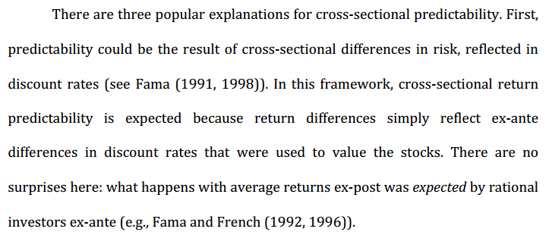
Possible reasons
True! Returns on average shouldn’t be a surprise
Cleanest test: linking with analyst forecast errors
Doesn’t immediately imply that can’t have higher returns on earnings days, if information -> risk

Slide 15
News as Surprises, News as Information
Good news: information on earnings days is mostly idiosyncratic, whereas risk should be systematic
BUT Can there be relevant systematic information?
The largest firms are informative of the market, and perhaps other risk sources too
News may reveal information about factor loadings
If investors can’t diversify, idiosyncratic risk may be priced (though unclear how it works for anomalies)
Bottom line: Needs more explanation of what can and can’t be ruled out

Slide 16
Ruling out other risk explanations
Test 1: Control for returns to an aggregate anomaly factor (to match anomaly variable)
Works if there is one “anomaly” risk variable. But does anyone believe this?
Argue that this controls for increased risk exposure on announcement days, a la Savor and Wilson(2016).
But S&W claim is about an aggregate earnings factor, not an aggregate anomaly factor. Why not test this?
Test 2: Examine returns on macro announcement days (as risk models often linked to consumption)
But if this is the only relevant news, why should prices ever move on other days?

Slide 17
Multi-Factor Risk Explanations
Other Possibility: Different levels of anomaly-specific news coming from earnings. Can you test this?
Idiosyncratic information means that the firm’s own announcement matters
Aggregate information says that the number of announcements from other anomaly firms matters
Does a value/momentum firm have higher returns when there are more value and momentum firms in total announcing earnings?
Helps to rule out risk explanations that don’t impose a one-factor structure

Slide 18
Data-Mining Tests
Tests on Data-Mining are novel and interesting
Quantifying that earnings drive returns in general is important
Using Out-of-Sample Anomalies is convincing
Controlling for ex-post returns in the same regression seems a bit confusing though
What does Net do after controlling for actual returns?
Seems hard to discuss interaction when base effect is difficult to interpret

Slide 19
Data-Mining Tests
Relationship between size and news is interesting, but might have alternative interpretations
In particular, the number of DJ articles is highly skewed by firm size
Big firms have tons, small firms have very few
So a given DJ article is probably a lot more important for a small firm than a big firm
Can control for this, using the number of DJ announcements in that year
Doesn’t apply to earnings, so main result still holds

Slide 20
Other Suggestions (1)
Can you rule out the Frazzini & Lamont (2006) explanation that high volume drives the returns on earnings days?
Claim that forecasts are “too high” for short firms and “too low” for long firms is about levels – are the surprises on average positive or negative?
Regressions seem to just show differences, with forecasts being higher for short firms and lower for long firms. Not quite the same thing

Slide 21
Other Suggestions (2)
Decomposing returns into earnings/non-earnings is interesting, but worth noting that this decomposition isn’t unique
E.g. Can also show “all” the returns are intraday, a la Lou, Polk and Skouras (2016)
Can you clarify what the interaction terms mean in the regressions? Often confuses matters
How should we think about Factor*Eday
How should we think about the negative coefficient on Net after controlling for Monthly?

Slide 22
Conclusion
Neat Paper!
Interesting relationship between anomaly returns and news
Taking data-mining seriously is also very valuable
Would be nice to see more explicit discussion and tests of exactly what the predictions of risk-based models are, and why

