Slide 1
Discussion of “Retail Derivatives and Sentiment: A Sentiment Measure Constructed from Issuances of Retail Structured Equity Products”
Paper by:
Brian J. Henderson (GWU) Neil D. Pearson (Illinois) Li Wang (Case Western)
Discussion by:
David Solomon (Boston College)
American Finance Association Meetings, January 4th, 2021

Slide 2
The Siren-Song of Sentiment
The Weak Law of Behavioral Finance:
Sooner or later, everyone writes an alpha paper
The Strong Law of Behavioral Finance:
Sooner or later, everyone writes a sentiment paper
Why?
It’s so damn interesting
Every now and again, really weird stuff happens that cries out for an explanation

Slide 3
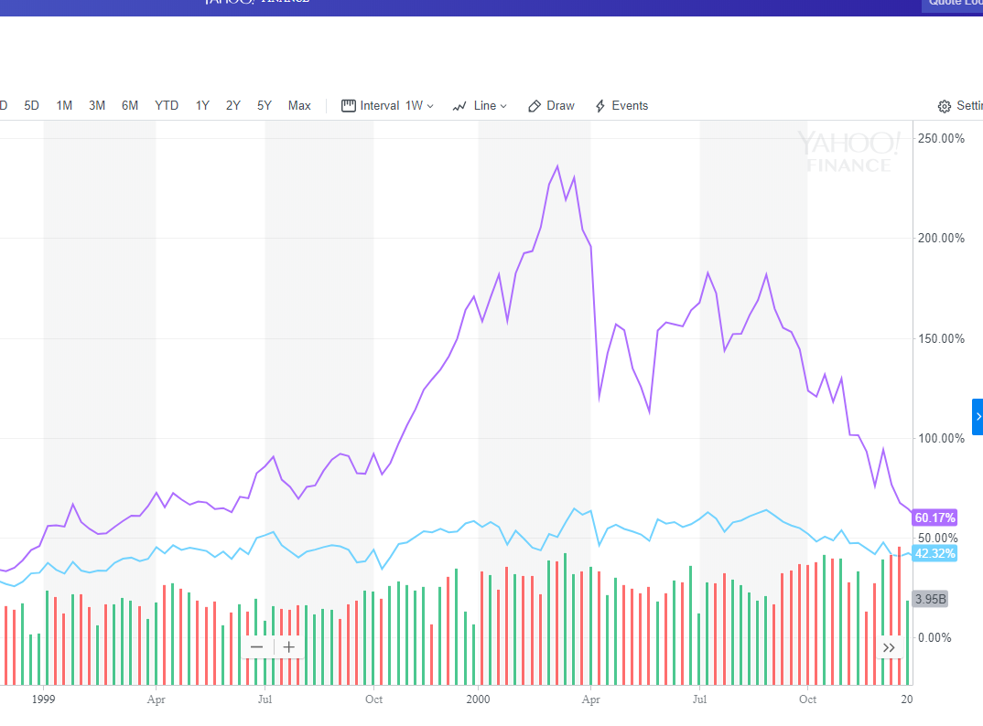
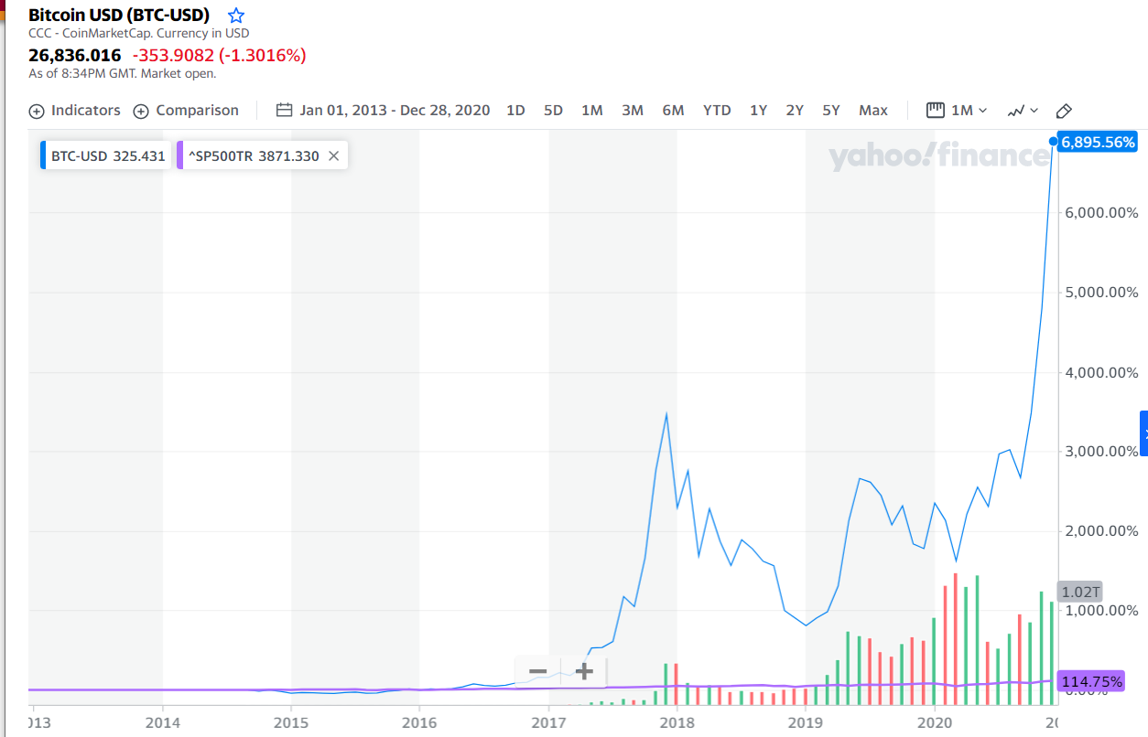
The Siren-Song of Sentiment
I earned 115% since 2013!
Look at me, I’m a bubble!
That’s cute

Slide 4
The Cochrane Critique
“Good behavioral finance starts with psychology”
John Cochrane
Sentiment scores very poorly under this metric
“Common judgment errors made by a substantial number of investors” (Shleifer (2000))
Without further elaboration, no predictions about Direction, Timing, Magnitude, Cause
How do I measure it? How do I falsify it?

Slide 5
“Judgment Errors”
Approach 1: Measure errors, if not judgment
Amalgamate things likely to be errors
Closed end fund discount, share turnover, # IPOs, Share of equity issues, dividend premium(…) Baker and Wurgler (2007)
Principal components, orthogonalize to economic variables
This paper: New source of likely errors via retail structured equity products
Approach 2: Measure judgment, if not errors
Shleifer and Greenwood (2014)
Measure expectations directly via surveys.

Slide 6
Dumb Money on Steroids
Find what the dumbest people are buying: investors in Structured Equity Products for single name stocks
Astonishingly bad value: -8% alpha (Henderson & Pearson 2011)
The problem is the structure, not necessarily underlying stock
The tension: dumb is random (or is it?)
Dumb people find a way to get anti-information?
E.g. Disposition effect leads to negative momentum trades
Dumb trades are random but correlated, leading to overvaluation?
Argued here, but would be good to see direct evidence

Slide 7
Identifying Mistakes vs Understanding Them
Dollar value is small in SEP relative to market cap, so claim is that has to be a proxy
Is this true? How large are these relative to volume?
Do hedging trades for the structure part add to this?
Maybe explain relationship to Option-to-Stock predictability
What does the structure actually produce?
Seems like the really interesting part of SEPs – what are investors chasing relative to the stock itself? How does structure change with past returns of the stock?
Most novel part of the data – make more use of it!

Slide 8
Alphas and Dollars
Alphas are large, statistically significant, using a short time period, recent data, surviving tons of controls
Impressive!
One worry – results only large when using “value-weighted” (really dollar-weighted) stocks
How many stocks are we actually talking about?
When dollar-weighted, what’s the effective number of stocks per portfolio (not an obvious question! Worth pondering)
If returns only come from a very small number of lousy stocks, may explain why they survive controls.
Summary stats would help greatly here.

Slide 9
Conclusion
Interesting new way of identifying retail-based sentiment
Still unclear what it measures
“Structured” part of structured equity is a gold mine worth exploring more

