Slide 1
Discussion of
‘Creative Destruction, Investor Beliefs and the Evolution of Stock Returns’
Paper by:
Aydogan Alti (UT Austin)
Sheridan Titman (UT Austin)
Discussion by:
David Solomon (USC)
UBC Summer Finance Conference, July 30th 2016

Slide 2
The Structural Behavioral Unicorn
Addressing the tech imbalance in asset pricing
Hi Tech
Low Tech
Rational Agents
Biased Agents

Slide 3
The Structural Behavioral Unicorn
Addressing the tech imbalance in asset pricing
Hi Tech
Standard Asset Pricing
Low Tech
Rational Agents
Biased Agents

Slide 4
The Structural Behavioral Unicorn
Addressing the tech imbalance in asset pricing
Hi Tech
Standard Asset Pricing
Behavioral
Asset Pricing
Low Tech
Rational Agents
Biased Agents

Slide 5
The Structural Behavioral Unicorn
Addressing the tech imbalance in asset pricing
Hi Tech
Standard Asset Pricing
Structural Behavioral
Behavioral
Asset Pricing
Low Tech
Rational Agents
Biased Agents

Slide 6
Two Great Tastes That Go Great Together
What does the structure buy you?
Which biases matter more for asset pricing?
  Optimism without overconfidence doesn’t do much
  Overconfidence alone creates mispricing, larger with optimism
How biased do investors need to be to generate mispricing?
  Rational benchmark can’t produce Sharpe ratios
  Plausible bias levels can
Counterfactuals – how large a distribution of Sharpe Ratios might we have observed?

Slide 7
Model Ingredients
Risk-neutral investors, homogeneous expectations
Projects cost k units of capital, pay a*k units per period until terminated at rate λ & pays liquidation α*k
Firms transition through states
  early growth (high profitability, new projects)
  mature growth (low profitability, new projects)
  no growth (low profitability, no new projects)
  death
Schumpeterian Innovation – unobserved arrival rate M, main driver of the economy
  Gives valuable projects to growth firms
  Degrades existing projects at rate λ

Slide 8
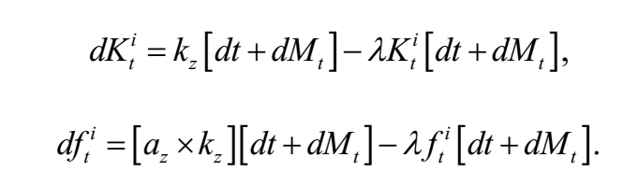



Model Ingredients
Innovation has both transitory and temporary components
μ is the “innovation climate”, slow-moving & persistent
Investors don’t observe μ, but get noisy signal about ω with precision η

Slide 9
Model Ingredients
M increases capital stock of growth firms
by k (innovation)…
Innovation has both transitory and temporary components
μ is the “innovation climate”, slow-moving & persistent
Investors don’t observe μ, but get noisy signal about ω with precision η

Slide 10
Model Ingredients
…but degrades the whole capital stock by λ (destruction)…
Innovation has both transitory and temporary components
μ is the “innovation climate”, slow-moving & persistent
Investors don’t observe μ, but get noisy signal about ω with precision η

Slide 11
Model Ingredients
Innovation has both transitory and temporary components
μ is the “innovation climate”, slow-moving & persistent
Investors don’t observe μ, but get noisy signal about ω with precision η
Similarly for profitability

Slide 12
Model Ingredients
Innovation has both transitory and temporary components
μ is the “innovation climate”, slow-moving & persistent
Investors don’t observe μ, but get noisy signal about ω with precision η
Realized M gets observed by investors

Slide 13
Model Ingredients
Innovation has both transitory and temporary components
μ is the “innovation climate”, slow-moving & persistent
Investors don’t observe μ, but get noisy signal about ω with precision η
But persistent component μ not observed

Slide 14
Model Ingredients
Innovation has both transitory and temporary components
μ is the “innovation climate”, slow-moving & persistent
Investors don’t observe μ, but get noisy signal about ω with precision η
Instead, get signal s about changes in μ

Slide 15
Model Ingredients
More innovation/destruction
  Increases profitability (for all firms)
  Increases destruction of existing capital stock (for all firms)
  Increases capital through new projects (for growth firms)
If innovation/destruction rate goes up:
  High growth firms with low profitability -> Value ↑
  Low growth firms with high profitability -> Value ↓

Slide 16


Model Ingredients
Overconfidence - think signal is more precise than it is
Causes investors to overweight their private signal and underweight publicly observable realizations of M
Overconfidence -> Return predictability
  Several positive realizations of s -> overweight signal,
  too high
  Disappointment in realized μ relative to expectation (negative drift)

Slide 17
Innovation
Model has a single innovation rate causing both innovation and destruction (= λ * innovation)
But innovation itself is largely unobserved
Makes it difficult to calibrate innovation directly
  Key properties of innovation process need to be specified exogenously
  Mean-reversion rate for μ, volatility of μ, volatility for transitory component of innovation, signal precision
Hard to know what “reasonable” values of these are

Slide 18
Innovation
Is there a way to specify innovation such that it could be calibrated from observables?
  # of patents, R&D spending…
Firm state transitions also independent of innovation rates
  No growth firms exhibit degradation of capital stock
  Die at random rates, BUT death not related to capital stock falling too low, OR a high destruction environment
Model also assumes that a dead no growth firm is immediately replaced by a new early growth firm

Slide 19
Innovation
Firm death seems more likely as capital gets more degraded (i.e. levels getting too low)
Firm death also seems to depend on destruction rates
Alternative view – innovation related to firm entry/exit
  More firms arriving -> more innovation
  More firms exiting -> more destruction
In this view, arrival rates and exit rates are separate variables, could be calibrated
If not, how should we think of changing # of firms?

Slide 20
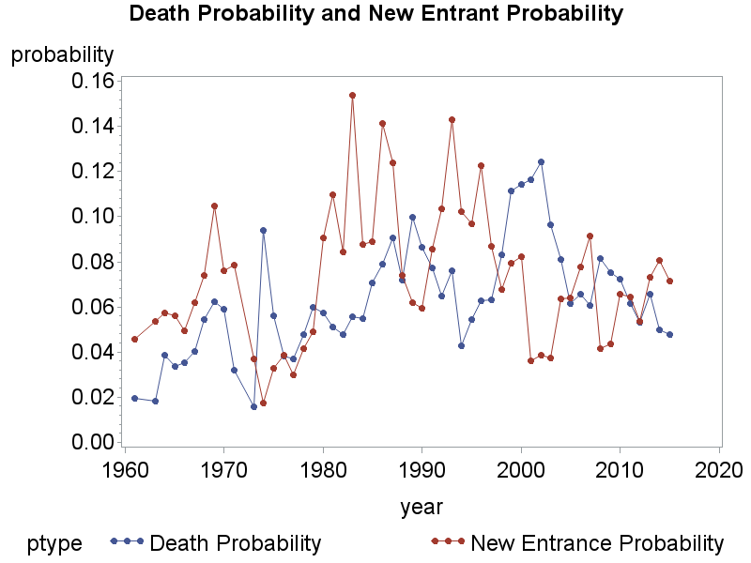
2 Man Enter, 1 Man Leave
Corr = -0.34

Slide 21
Calibration
Ex-post Sharpe Ratios of anomalies really high.
  If they overstate the true expected value, does it make sense to calibrate to the mean? Neat insight!
Alternative – show under reasonable parameters, get Sharpe Ratios this high ~10% of the time
Overconfidence increases variance of observed Sharpe Ratios.
  Doesn’t directly predict that profitable beats unprofitable
  But does mean that observing a high Sharpe ratio in-sample becomes more likely

Slide 22
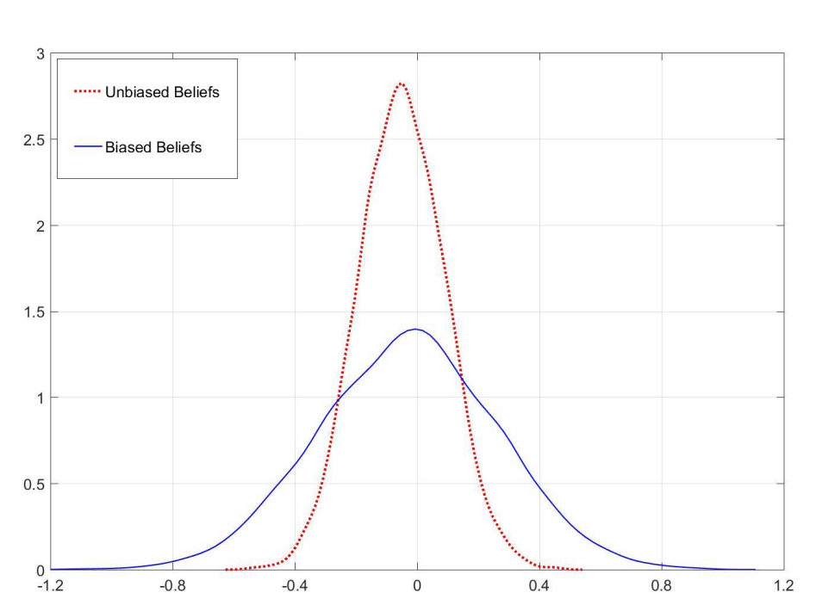
Calibration

Slide 23
Calibration
Interpretation: investors were ex-post disappointed by the level of innovation
  Could just be random, could be due to inherent optimism about innovation (maybe do more here)
Would be nice to link to data mining literature
  Linnainmaa and Roberts (2016) : accounting anomalies are overstated in sample,
  McLean and Pontiff (2016): anomalies partly traded away
  Seems to indicate that ex-ante Sharpe ratios were lower
Calibrate to variance of anomalies around globe?
  Different realizations with same ex-ante distribution

Slide 24
One Anomaly, or Three Anomalies?
In the paper, value, asset growth and profitability all come from one underlying innovation variable
Resulting portfolios are more correlated than reality
Useful perspective- “quant” investor who only observes characteristic returns
Additional calibration – will all signals be marginally informative in a regression setting?
  In the data, they are. Does model fit this fact?
  Nice test for the ‘quant investor’ who doesn’t observe true innovation rate.

Slide 25
One Anomaly, or Three Anomalies?

Slide 26
Cheap Criticisms on Value
Model uses one factor (innovation exposure) to explain returns to value, profitability & asset growth
Value present in lots of markets – currencies, commodities futures, government bonds etc. Asness, Moskowitz and Pedersen (2009)
Is innovation an equity-specific explanation?
  Doesn’t seem parsimonious if it is.
  Could it have an analogue in other markets?
Value premium also correlated across markets
  Is innovation equally correlated? Not obviously

Slide 27
Conclusion
Neat Paper!
Linking Schumpeterian Innovation with Investor Overconfidence
Calibration to plausible tail outcomes, not means – fits with data mining literature
Would be nice to see slightly richer version of innovation

