Slide 1
Discussion of ‘Macro Disagreement and the Cross-Section of Stock Returns’
Paper by Weikai Li (HKUST)
Discussion by David Solomon (USC)
USC Finance PhD Conference, June 19th 2014

Slide 2
Macro Disagreement and the Cross-Section of Stock Returns vs
Macro Disagreement and the Cross-Section of Stock Returns

Slide 3
Macro Disagreement and the Cross-Section of Stock Returns vs
Macro Disagreement and the Cross-Section of Stock Returns

Slide 4
Macro Disagreement and the Cross-Section of Stock Returns vs
Macro Disagreement and the Cross-Section of Stock Returns

Slide 5
The Genesis of the Paper
Miller (1977)
Disagreement + Short Sales Constraints
= Overpricing (Low Future Returns)

Slide 6
Miller (1977)
Pessimists
short-sell
Optimists buy
Mean is unbiased: Normal Returns

Slide 7
Miller (1977)
Pessimists
short-sale
constrained
Optimists buy
Mean is biased
Overvaluation, low future returns

Slide 8
The Genesis of the Paper
Miller (1977)
Disagreement + Short Sales Constraints
= Overpricing (Low Future Returns)
Various Evidence consistent with this:
  High disagreement stocks have low returns
  (assume the short sales constraints)
    Deither, Malloy and Scherbina (2002)
  Short-sales constrained stocks have low returns
  (assume the disagreement)
    Jones and Lamont (2002)

Slide 9
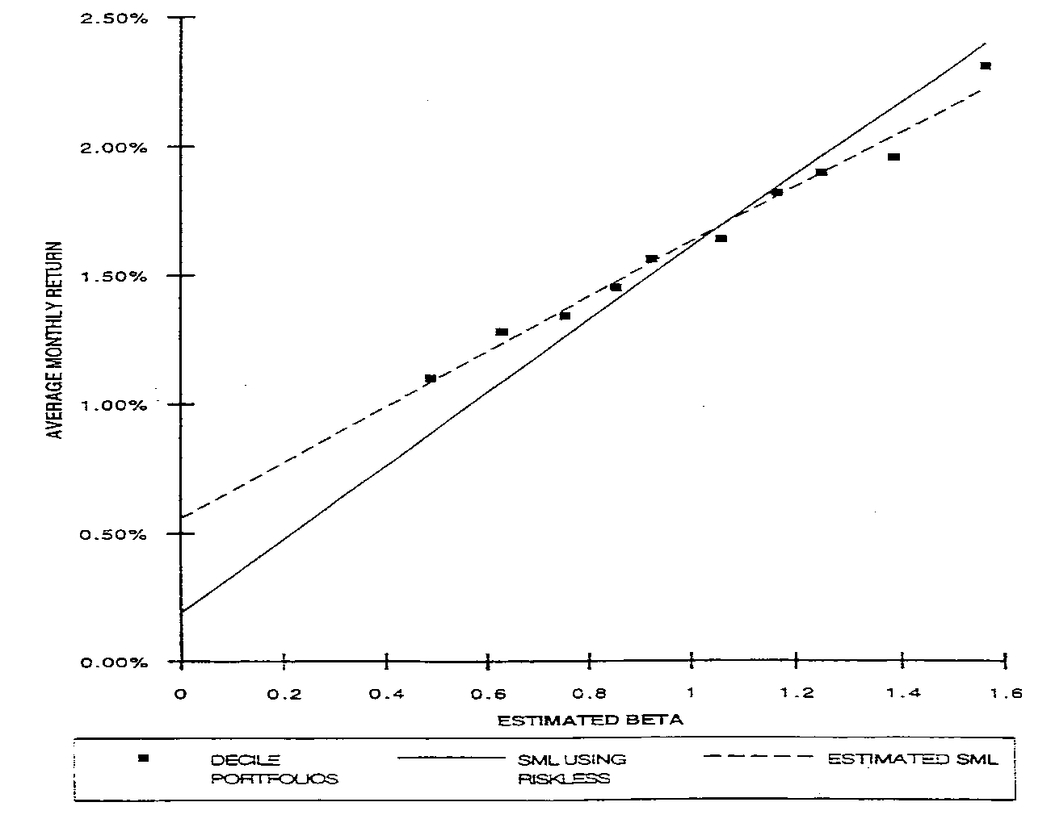
Asset Pricing Puzzles
Low Beta Anomaly - the security market line is too flat
Black, Jensen and Scholes (1972), Frazzini and Pedersen (2014)

Slide 10
Asset Pricing Puzzles
Generally weak relationship between cross-section of expected stock returns and exposure to macro factors
  Chen, Roll and Ross (1986) – exposure to five macro factors drives returns
  Shanken and Weinstein (2006) – depends on how you measure betas and which test assets

Slide 11
Asset Pricing Puzzles
Generally weak relationship between cross-section of expected stock returns and exposure to macro factors
  Chen, Roll and Ross (1986) – exposure to five macro factors drives returns
  Shanken and Weinstein (2006) – depends on how you measure betas and which test assets
Cross-section of returns better explained by “pseudo” macro factors (SMB, HML) or “not really macro factors at all” factors (UMD)

Slide 12
Factor Disagreement and Returns
Hong and Sraer (2012) tackled low beta anomaly

Slide 13
Factor Disagreement and Returns
Hong and Sraer (2012) tackled low beta anomaly
1. Positive Price of Risk:
-> High Beta = High Expected Return

Slide 14
Factor Disagreement and Returns
Hong and Sraer (2012) tackled low beta anomaly
1. Positive Price of Risk:
-> High Beta = High Expected Return
2A. Disagreement about value of factor
-> High Beta = High Exposure to disagreement
+
2B. Miller (1977)
-> High Disagreement = Low Expected Return

Slide 15
Factor Disagreement and Returns
Hong and Sraer (2012) tackled low beta anomaly
1. Positive Price of Risk:
-> High Beta = High Expected Return
2A. Disagreement about value of factor
-> High Beta = High Exposure to disagreement
+
2B. Miller (1977)
-> High Disagreement = Low Expected Return
=
Relationship between beta and expected returns depends on disagreement about factor

Slide 16
Factor Disagreement and Returns
E(R)
E(R)
E(R)
+
=
β
β
β
Standard Risk/Return
Miller (1977),
Low Disagreement
Total,
Low Disagreement

Slide 17
Factor Disagreement and Returns
E(R)
E(R)
E(R)
+
=
β
β
β
Standard Risk/Return
Miller (1977),
Low Disagreement
Total,
Low Disagreement
E(R)
E(R)
E(R)
+
=
β
β
Standard Risk/Return
Miller (1977),
High Disagreement
Total,
High Disagreement
β

Slide 18
Factor Disagreement and Returns
E(R)
E(R)
E(R)
+
=
Total,
Low Disagreement
β
Total,
High Disagreement
β
β
Total,
Unconditional

Slide 19
This Paper
Argues that a similar process explain the low returns to macro factors
When disagreement about a macro factor is high, stocks with high exposure to that factor earn lower returns (sometimes a negative risk premium)
When disagreement is low, macro factors tend to be priced (market works properly)
Time-series returns of macro factors are predicted by disagreement about the factor
Neat idea, neat results!

Slide 20
Results

Slide 21
Results
“Dog Bites Man” (except that it normally doesn’t)
Markets working as theory predicts

Slide 22
Results
“Man Bites Dog” Negative Price of Risk. WTF?

Slide 23
Results

Slide 24
Results

Slide 25
The Big Question
Nearly all the evidence in the paper is from the time-series: comparing periods of high and low disagreement
But what else might changes in macro disagreement be correlated with?
Potentially, lots of stuff

Slide 26
Sentiment
Evidence that sentiment predicts macro factors (Shen and Yu (2014)). Similar procedure to current paper.
Sentiment also predicts returns to anomalies (Stambaugh, Yu and Yuan (2012))
The good news: disagreement survives controlling for sentiment

Slide 27
Results

Slide 28
Sentiment
Mixed news: macro factors are somewhat different:
    Here: Industrial Production Growth, Change in Expected Inflation, Unemployment Rate, Investment Growth, GDP Growth, vs
    Shen and Yu: Industrial Production Growth, Change in Expected Inflation, Labor Income Growth, Market Returns, Market Volatility, Unexpected Inflation, Term Premium, Default Premium, Consumption Growth, TFP Growth.
Run tests on more factors
  Otherwise may look like you’re cherry-picking factors that work for disagreement story

Slide 29
Disagreement about what?
Under Hong and Sraer (2012), disagreement must be about the factor in question
The problem: disagreement is correlated across variables. Is this just measuring some general period of economic uncertainty?

Slide 30
Disagreement about what?

Slide 31
Disagreement about what?
Under Hong and Sraer (2012), disagreement must be about the factor in question
The problem: disagreement is correlated across variables. Is this just measuring some general period of economic uncertainty?
Current regressions only test the effect of disagreement for the variable in question

Slide 32
Results

Slide 33
Disagreement about what?
Suggestion: Run a horse race between disagreement about the variable in question and disagreement about other macro variables
E.g. Under Hong and Sraer (2012), returns to unemployment factor should only be driven by dispersion in forecasts of unemployment
Disagreement about other variables shouldn’t drive out effect of unemployment dispersion (multivariate)
Disagreement about other variables shouldn’t show predictive power after controlling for unemployment dispersion (placebo)

Slide 34
Spurious Predictors
Possibility that time-series predictability regressions generate spurious results (Ferson, Sarkissian and Simin (2003))
  Can find spurious relationships between two trending time-series variables
  This gets worse in the presence of data-mining

Slide 35
Spurious Predictors

Slide 36
Spurious Predictors
Suggestion: Test explicitly for the probability of spurious regressors.
Stambaugh, Yu and Yuan (2014) – simulate a variable with the same persistence as the measure in question. Test whether simulated sentiment predicts anomaly returns
Shen and Yu (2014) – similar process for testing whether sentiment predicts macro returns

Slide 37
Going Further – Using the Cross-Section
Rather than just relying on time-series evidence, examine cross-sectional predictions of the theory
Short-selling restraints should matter – split stocks according to easy-to-short versus difficult-to-short.
Difficult-to-short stocks should show large changes in expected returns when factor disagreement is large. East-to-short stocks shouldn’t.
Can use data on short interest, or (better) data on short lending rates from Engelberg, Reed and Ringgenberg (2014) if they’ll give it to you

Slide 38
What Would Andreas Say?

Slide 39
What Would Andreas Say?
What happens if the price of risk is countercyclical?
Since disagreement about macro factors is related to economic uncertainty, disagreement is likely to affect the slope of the risk-return relationship even without Hong and Sraer (2012) mechanism

Slide 40
What Would Andreas Say?
E(R)
E(R)
E(R)
+
=
β
β
β
Standard Risk/Return
Miller (1977),
Low Disagreement
Total,
Low Disagreement
E(R)
E(R)
E(R)
+
=
β
β
Standard Risk/Return
Miller (1977),
High Disagreement
Total,
High Disagreement
β

Slide 41
What Would Andreas Say?
E(R)
E(R)
?=
β
Probably not
β
Standard Risk/Return, High Disagreement
Standard Risk/Return,
Low Disagreement

Slide 42
What Would Andreas Say?
Hard to rule out. At a minimum, need to discuss this possibility
The good news: countercyclical risk premia seem to predict the opposite relationship
Investors in high uncertainty/disagreement states should demand more compensation for risk, thus making the slope steeper
Hard to explain a flatter line with countercyclical risk
Hard to explain a negative slope with anything

Slide 43
Results

Slide 44
Conclusion
Overall, a very nice paper
Clever mixture of believable behavioral assumptions to resurrect standard economic models of risk and return
Try to beef up evidence on specific mechanism

