Slide 1
Price Pressure from Coordinated Noise Trading: Evidence from Pension Fund Reallocations
Paper by:
Zhi Da (Notre Dame), Borja Larrain (UC), Clemens Sialm (UT) & Jose Tessada (UC)
Discussion by:
David Solomon (USC)
Pontificia Universidad Catolica de Chile, June 24th 2015

Slide 2
The big picture
Do (net) demand curves for stocks slope downwards?
Demand curves for flat screen TVs slope downwards
Price goes up, some drop in quantity demanded
Demand curves for $100 bills (in units of $20 bills) are flat
Price goes up, quantity demanded goes to zero
The number of people willing to buy a hundred dollar bill for 4*$20, or sell one for 6*$20, is essentially infinite
Between these two, where are stocks?

Slide 3
The big picture
Big issue is availability of substitutes
TVs -> few close substitutes
$100 bills -> very close substitutes
Many asset pricing models assume individual stocks have flat demand: bundles of cash flows with risk exposure
Empirical evidence suggests not: changes in demand affect stock prices
Index additions (Shleifer (1986), Wurgler and Zhuravskaya (2002), Greenwood (2005), lots of others)
Dividends (Hartzmark and Solomon (2013)), other predictable corporate events (Bessembinder and Zhang (2015)

Slide 4
This paper
Current paper – (uninformed) shifts in demand for equities as a whole cause temporary price pressure
Co-ordinated switching between equity & bond mutual funds from investors following advisory firm recommendations
Must redeem 10% of equities / 20% of bond portfolio in a few days
Leads to price pressure: 2.5% in equity markets over several days, 30 b.p. in bond markets

Slide 5
Demand and Substitutes
Most previous studies examine demand for individual stocks
Flat demand seems like a more reasonable prior, as most individual stocks have some sort of substitute
But are there close substitutes for the Chilean equity market as a whole? Not so clear
Even if there are, can the AFPs actually hold them?
If not, then price pressure is perhaps less surprising.
Becomes a question of magnitude -> how much uninformed selling is needed to move price
Not sure what priors are here

Slide 6
The Puzzle
If Chilean equities don’t have substitutes and the demand shift is permanent, why is the price change only temporary?
Note that this isn’t true for S&P500 additions
Shift in price is mostly permanent
Suggests that some of the demand is mean reverting. Why?
Not from pension funds (unless recommendation reverses)
One possibility: sluggish response from liquidity suppliers
Takes a few days for marginal investors to realize the shift in prices and start selling
Similar to effects of spike in price from a single limit order – takes time for the limit order book to replenish

Slide 7
The Other Answer
The lazy assumption in asset pricing: if people know about anomaly X, it will disappear, hence no need to study it
Possibly true for anomalies with a fundamental anchor (i.e. Price > Fundamental Anchor), not at all clear for price pressure anomalies
If you know that someone else has to buy a lot of shares tomorrow, what should you do?
a) Wait for them to start buying, short as much as possible and try to prevent the price rising
b) Buy before them, wait for their buying to raise the price, then sell, hopefully without pushing the price back down below
Most people will pick b)!

Slide 8
The Other Answer: Front Running
Mean-reverting demand probably partly coming from other investors front-running the pension funds
Buy before pension funds have to buy, wait for them to push up price, then sell
Everyone says that they’re stuck in traffic, no one says that they ARE traffic
Front running trades also has price pressure. Makes the anomaly worse, not better!
Like a Ponzi scheme, but if you know some investors are forced to come after you, can be optimal to play
Everyone wants to get in first

Slide 9
The Other Answer: Front Running
Works because pension funds have built-in disadvantage: can’t trade more than 5% in a day
Guaranteed to be slower for large shifts
Not true for S&P500 additions, hence harder to front run
Would be nice to see evidence on how profitable this is
Evidence in paper suggests it probably is profitable
Big question #1: how much of the price reaction happens immediately with the opening price?
Big question #2: how much price impact do you have yourself on purchase and sale? Depends on trade size
Can crudely estimate amount of front running: total abnormal volume minus amount of direct redemptions

Slide 10
Who are you calling a noise trader, pal?
Paper argues switching choices are uninformed
Could be co-ordinated changes in risk aversion.
Price pressure market timing question a little tricky: if you’re getting front run by the structure of the market, any large switch puts you at a disadvantage.
Lots of emphasis on ‘uniformed’ given that cumulative returns to switching strategy are positive!
15.8% return on A, 21.0% on E, 26.5% on FyF
Paper argues no real skill, all due to luck in the first switch
Probably true, but not really a fair test to take out the best call.
Less “beginner’s luck”, better described as “anthropic principle”
What if their strategy is deliberately option-like?

Slide 11
Testing Returns
Four categories:
1. Returns on equities when FyF says switch to equities
2. Returns on equities when FyF says switch to bonds
3. Returns on bonds when FyF says switch to equities
4. Returns on bond when FyF says switch to bonds
Main test adds 1 and 4 together, and 2 and 3 together.
Seems confusing. What number does ‘33 basis points in government bonds’ correspond to?
Can understand (1-3) + (2-4) (long-short strategy) (1-2) and ( 3-4) (difference within asset class). or just report all 4 separately.
Also interesting in magnitude of 1 vs 2 and 3 vs 4. Coval and Stafford (2009): “Fire Purchases” bigger than fire sales. True here?

Slide 12
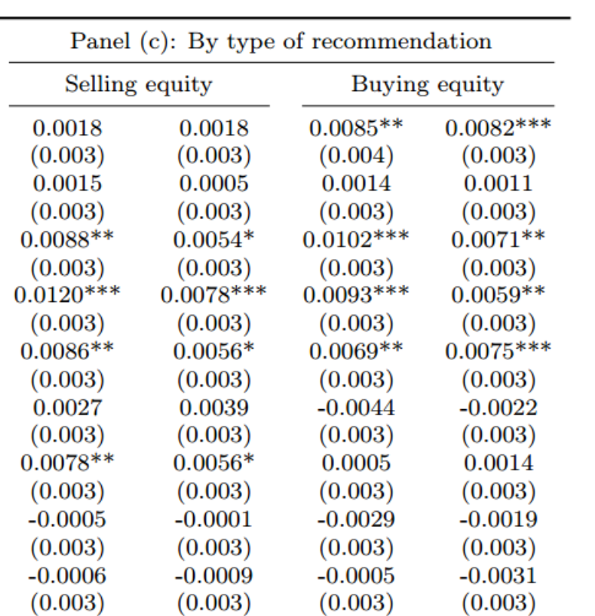
Testing Returns
Univariate returns seem higher after sells than after buys. How does this fit into Table 4?

Slide 13
Placebo Tests
Nice idea: compare returns on otherwise similar days without a recommendation switch
Placebo days require similar returns in earlier period:
“A sell equity event was identified as a day when the two-day cumulated return on equity was -2% or less and the government bond index return was 0.15% or more. “
Why not generate placebo days using fitted values from the predicted determinants of recommendations?
Can use this both in the current period AND the previous period
Selects on otherwise similar prior conditions, which seems more relevant.

Slide 14
Evidence for Mutual Funds Specifically
Paper shows larger effects for big stocks (held by funds) rather than small stocks (less held by funds)
Could you do more here? Why not look at the most recent levels of holdings by pension funds in each stock specifically?
Should have bigger effects for stocks actually held by funds
Funds may choose to hold more liquid stocks deliberately.
Want to know stocks that are overweighted relative to liquidity
Regress fund’s holdings on measures of stock liquidity, take residual (fund holdings in excess of liquidity levels)
Not clear this is a better measure, but might be informative

Slide 15
Conclusion
Neat paper! Interesting experiment, cool results
Big shifts in prices from single, mostly uninformative newsletter
Evidence for downward sloping demand at the level of equity markets
Interesting policy implications
Should switching be made more costly?
Should the ‘can’t trade more than 5% in a day’ rule be ditched?

