Slide 1
Discussion of
“﻿The Hidden Cost of Stock Market Concentration:
When Funds Hit Regulatory Limits”
Paper by:
﻿Lubos Pastor (Chicago)
﻿Taisiya Sikorskaya (Chicago)
Jinrui Wang (Chicago)
Discussion by:
David Solomon (Boston College)
SFS Cavalcade, May 2026

Slide 2
What is this paper about? What could it be about?

Slide 3
What is this paper about? What could it be about?
Short Sales Constraints vs Long Purchase Constraints, and their price effects

Slide 4
What is this paper about? What could it be about?
Short Sales Constraints vs Long Purchase Constraints, and their price effects
Well-intended but sloppy and counterproductive financial regulation

Slide 5
What is this paper about? What could it be about?
Short Sales Constraints vs Long Purchase Constraints, and their price effects
Well-intended but sloppy and counterproductive financial regulation
The catastrophic performance of small value ever since academics started saying “buy small value!”

Slide 6
Long Purchase Restrictions
Lots of restrictions on short selling, but very few on purchasing
Sophistication-based rules, e.g. accredited investor rules, and flow-on affects for Registered Investment Companies
“Safe-for-Grandma” investments, are allowed to buy very freely (without leverage), but not allowed to short at all
DOJ has lots of questions if you make prices go down, far fewer if you make prices go up
Surprise is that 50/5/10 rules bind at all, even if just for some funds and some stocks. Probably an accident!
Price pressure well-established as a general phenomenon, not an isolated one, so these restrictions move prices

Slide 7
Sloppy and Counterproductive Regulations
Is this a good regulation?

Slide 8
Sloppy and Counterproductive Regulations
Is this a good regulation?
﻿”Our suggestive evidence of regulation distorting market valuations merits further study… ﻿A reassessment of regulatory limits or benchmark construction may be needed to ensure that diversification rules continue to protect investors without inadvertently impairing market efficiency.”

Slide 9
Sloppy and Counterproductive Regulations
Is this a good regulation?
﻿”Our suggestive evidence of regulation distorting market valuations merits further study… ﻿A reassessment of regulatory limits or benchmark construction may be needed to ensure that diversification rules continue to protect investors without inadvertently impairing market efficiency.”

Slide 10
Sloppy and Counterproductive Regulations
Is this a good regulation?
﻿”Our suggestive evidence of regulation distorting market valuations merits further study… ﻿A reassessment of regulatory limits or benchmark construction may be needed to ensure that diversification rules continue to protect investors without inadvertently impairing market efficiency.”
“Money Doctors” and the Hippocratic Oath

Slide 11
Sloppy and Counterproductive Regulations
Is this a good regulation?
﻿”Our suggestive evidence of regulation distorting market valuations merits further study… ﻿A reassessment of regulatory limits or benchmark construction may be needed to ensure that diversification rules continue to protect investors without inadvertently impairing market efficiency.”
“Money Doctors” and the Hippocratic Oath
“Further study” will be worse than if done by Lubos Pastor
This is that study! So draw some preliminary conclusions!
Benchmark 1 – Does this reduce investor welfare (hard)
Benchmark 2 – Is it well-designed for the purpose (easier)

Slide 12
Hallmarks of Poor Regulatory Design
First red flag – violates Solomon’s Law of Non-Optimization
  “Any claim that is made entirely with round numbers comes from a crude rule of thumb, not a formal optimization”
What actual purpose is the law trying to solve?
Version 1: Stop managers taking actions that are imprudent and risky relative to the baseline risks of the economy
Version 2: Stop retail investors being exposed to concentrated risk, even if those risks are the baseline risks of the economy
Regulation usually just not thought about very much, so worth debating which version we actually want to prioritize

Slide 13
Stopping Managers Doing Crazy Stuff
Strongest rationale: Stopping mutual fund managers doing crazy stuff like Amaranth, betting the whole farm on natural gas prices and blowing up
Manifestly unsuited to this: forced rebalancing by purely passive funds, who are not making any real choices at all!
  This result is crazy, and not emphasized nearly enough
If this is the aim, regulation should be redesigned around Active Share. If you agree, why not propose this?
At the moment, active share restrictions depend crucially on distribution of passive weights, which themselves change over time. Definition of “crazy stuff” changes a ton, for bad reasons

Slide 14
Stopping Managers Doing Crazy Stuff
Can you document what kind of active share restrictions the current regs applied to each kind of index
  Need to make assumptions about reducing proportionately, reducing only one stock to get below 5% etc.
Originally conceived as preventing excessive positive active share in concentrated positions, but now mandates negative active share
Quantifying how current regulations affect active share, and changes over time, creates discussion – is this what we want? Especially given active share makes more economic sense

Slide 15
Eliminating Even Passive Risks
Alternative Rationale – these concentrated portfolios are too risky for investors, even if they’re passive
First objection – as mutual funds get larger, the partial equilibrium aspect of this regulation becomes more costly
  We can’t all underweight NVIDIA, someone has to be long
  Paper documents that there are expected return costs!
Can you benchmark how large these costs are relative to the idiosyncratic risk of these positions?
These firms don’t really have idiosyncratic risk, they have tech and AI risk. Funds probably buy other tech and AI stocks!
Risk is concentrated because the US economy is concentrated!

Slide 16
Leaning into Regulation Angle vs Price Pressure
One reason to emphasize regulatory aspect: evidence on weight changes is much tighter than evidence on price effects
Weight changes are at the fund-quarter-stock level, around discontinuous thresholds – very tightly shown
  In some sense, less surprising: Funds follow the law
  But not obvious that the law binds on passive funds right now!
Price pressure evidence more circumstantial – fundamentally at stock-quarter level, hard to disentangle from other effects
Valuable to describe which firms this is, in which proportions
  How much of the effect is just “being underweight NVIDIA during a crazy bull run?” Being underweight tech in general?

Slide 17
The Disastrous Performance of Small Value
In 2010, I did a portfolio analysis of which ETFs I should buy in my retirement portfolios, using FF portfolios as proxies
Tangency when you can’t short is 100% small value!
Felt very clever, made it as an assignment for students in my investments class
Probably told this to 3000 students, starting in 2010
Absolutely catastrophic advice. Would have cost them incredible amounts in returns
  Vast amount of US stock returns, since they’ve had any money, have been tech – “large growth”

Slide 18
The Disastrous Performance of Small Value
Is this all the returns in the paper are about? How strongly can we show the underpricing aspects relative to this?
Forget risk versus mispricing. Are value (?) and size (?!?!?) even still facts worth emphasizing? With 300+ anomalies?
Is this because tons of money chases firms that were too small to actually support this amount of investment dollars?
I still do it, but for less and less time each semester
The whole framework is a disaster, and everybody knows it, but we don’t have a better one
Lesson about humility, market efficiency value of financial expertise – alphas are hard, harder than our tests imply

Slide 19
Conclusion
Really cool paper describing surprising effects of bad regulation
For the first time ever, the US government is trying to prevent retail people buying large cap stocks in non-margin ways!
Probably should be fixed
Reasons why concentration is growing so much are very confronting

Slide 20
AI Is Eating the World
Ctrl+F “AI” – Zero hits
Reasonable editorial choice, but important realistic context
“Large Growth” mostly a euphemism for “Tech”, and “Tech” in 2023 and 2024 (when the regulation bound) is mostly a euphemism for AI
Lots of people (me included) making a doomsday bet
  It’s taking over the whole economy
  It may kill everybody, or I might get all my assets expropriated
  But I don’t have to worry about portfolio outcomes in those scenarios, so may as well bet on success
  Only downside is AI/Tech Bust, but probably worth the risk

Slide 21
AI Is Eating the World
Tech in general the same phenomenon, now more so
Between 1990 and 2025, if you held either NASDAQ or NYSE, NASDAQ won in 72% of starting years if you held for 5 years
Almost trite to say, but I don’t know whether it’s better to not say it, in contexts where it’s basically the reason for what’s going on

Slide 22
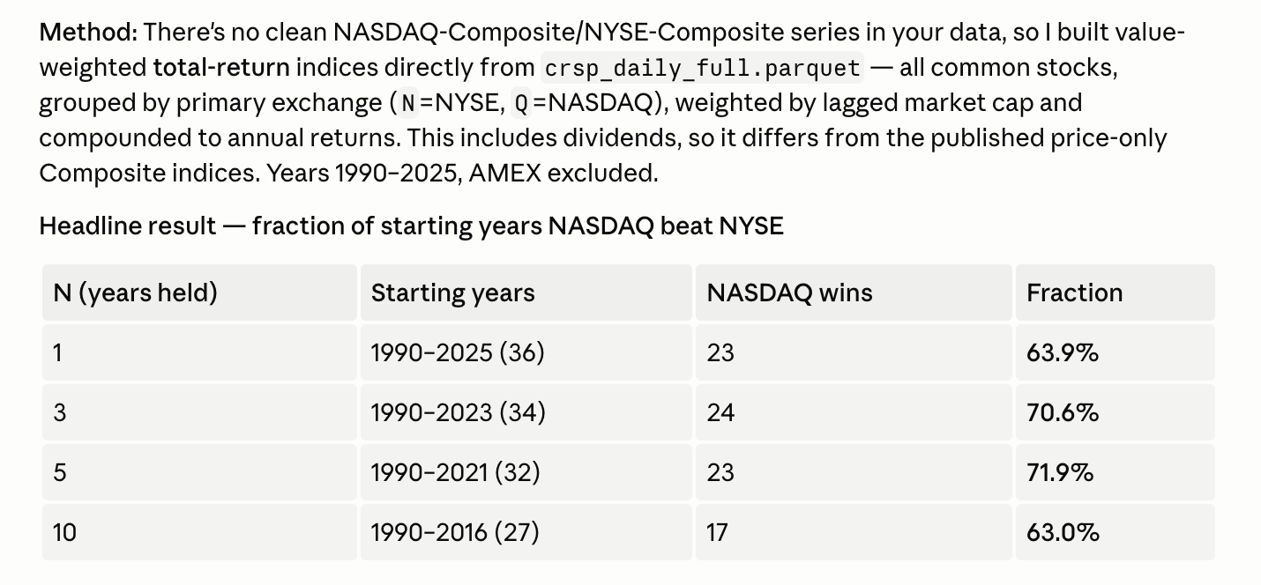
AI Is Eating the World
Tech in general the same phenomenon, now more so
Between 1990 and 2025, if you held either NASDAQ or NYSE, NASDAQ won in 72% of starting years if you held for 5 years
Somewhat trite, but not sure whether it’s better to not say it, in contexts where it’s basically the reason for what’s going on

