Slide 1
Discussion of ‘The Economic Consequences of Investor Relations: A Global Perspective’
Paper by: Andrew Karolyi (Cornell)
Rose Liao (Rutgers)
Discussion by:
David Solomon (USC)
Citrus Finance Conference, April 24th 2015

Slide 2
In the beginning, there was θ
How does information get incorporated into prices?

Slide 3
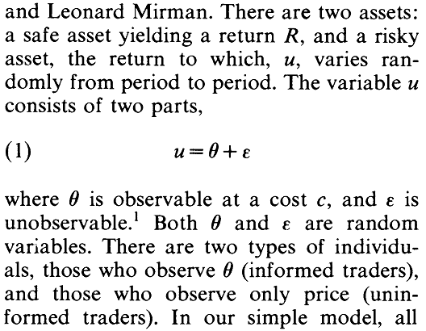
In the beginning, there was θ
How does information get incorporated into prices?

Slide 4
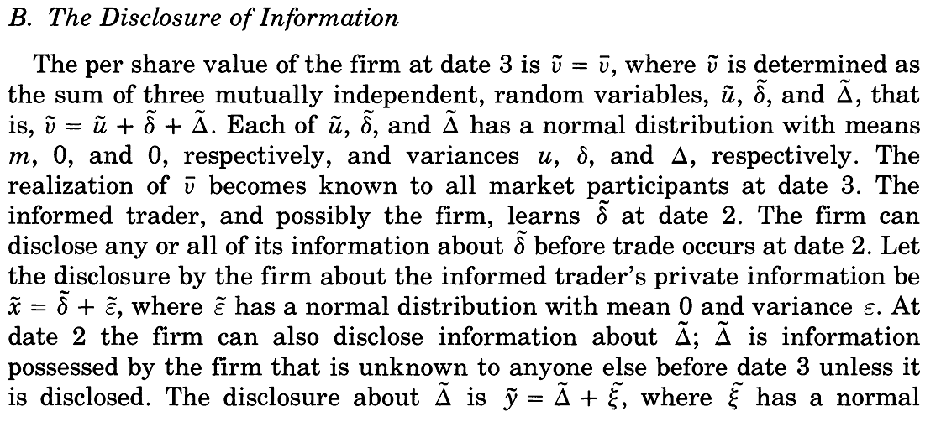
The origins of θ: Firm disclosures
Okay, so where do these signals come from?

Slide 5
Investor Relations, how does that work?
How do these disclosures work in practice?
Investor Relations: managing the disclosures and interactions between firms and market participants “IR integrates a wide range of activities, including managing disclosure strategies, attracting analyst and media coverage, and targeting desired investors” According to the National Investor Relations Institute (NIRI), IR is a “strategic management responsibility that integrates finance, communication, marketing and securities law compliance to enable the most effective two-way communication between the financial community and other constituencies, which ultimately contributes to a company’s securities achieving fair valuation.”
Simple!

Slide 6
Investor Relations, how does that work?
So how do we measures this complex operation?

Slide 7
Investor Relations, how does that work?
So how do we measures this complex operation?
Hiring an external IR firm
Bushee and Miller (2012), Solomon (2012), Kirk and Vincent (2014)
IR magazine & CFA ratings
Lang and Lundholm (1996), Agarwal, Belotti, Taffler and Nash (2014)
IR web page content
Chang, D’Anna, Watson and Wee (2008)
Using English language press-wires
Boulland, Degeorge, and Ginglinger (2012)
Conference attendance
Green, Jame, Markov and Subasi (2013)

Slide 8
Possible effects of IR
So what might this affect?
IR effect on market ‘inputs’
Increased disclosure (reducing information asymmetry)
Increased visibility (advertising to investors)
Increased dissemination (equal for good and bad news?)
IR effect on market ‘outputs’
Increased valuations (Tobins Q, returns)
Increased liquidity
Faster response to information

Slide 9
Disentangling the effects of IR
Big need to disaggregate different parts of IR
This paper: design (!) and conduct a detailed survey of IR activities, and relate it to firm attributes
Disaggregate into conference attendance, one-on-one meetings, global outreach, formal disclosure, media…
More IR associated with higher valuations
Higher Tobin’s Q
Greater and more accurate analyst coverage, lower cost of capital
Instrument for IR levels with peer IR budgets

Slide 10
The Data
Bank of New York Mellon Global Trends in IR Survey
Partnered to design questions
817 completed surveys, 70 questions, 59 countries
Questions regarding:
Use of different brokers
Level of investor engagement
Level of information provision
Social Responsibility
Global engagement
Aggregated into an index of overall IR activity
Great checks for biases in response rates

Slide 11
Aggregation Aggravation
Given the different components of IR use, not clear how best to construct an index
Does it make sense to equal-weight individual questions (as currently done), or broad categories?
Are all the categories measuring the same thing?
CSR questions seem rather different to the rest. Robust to exclusion?
Results robust to using a principal components index. Consider other ways to pick different weights
Principal components chooses weights in components of X that best explain X.
Consider three pass filter of Kelly and Pruitt (2015) – picks weights in X to best explain Y (here, Tobin’s Q)

Slide 12
Aggregation Utilization
Is aggregation really the best use of such rich data?
If we just want one overall measure, why not just use existing proxies?
One possible contribution – test whether current detailed aggregation gives different answers than existing proxies
Can either use external data, or compare with survey responses corresponding to measures in other studies, e.g. external IR firm use
Usefulness for explaining X: how much of overall measure is explained by existing proxies e.g. external IR firm use
How many survey questions do you actually need?
Usefulness for explaining Y: Is the effect on Tobin’s Q different/analyst coverage different for other proxies?

Slide 13
Aggregation Defenestration
Alternatively, disaggregate! Construct multiple measures
Some nice results in paper, would be good to see more
Would also benefit from relating breakdowns more to specific theories of information disclosure
Some of the categories, e.g. ‘Brokers’, not so intuitive
Some possibilities:
One-on-One investor engagement
General disclosure levels
Interaction with intermediaries (analysts, media)
Socially responsible outreach

Slide 14
IR works, but why?
Headline result – IR increases valuations, as measured by Q
Two ways of considering effects:
Through what channels does IR work?
What theories of information disclosure does IR effect support?
Strong results on channels
Increases analyst coverage, analyst accuracy, reduces analyst dispersion, reduces analyst cost of capital, increases institutional and hedge fund ownership
Less of a clear conclusion on what theories of information are supported
How much of this is disclosure vs. promotion/visibility?
Would be nice to see more discussion here

Slide 15
IR works, but why?
Is IR primarily reducing information asymmetry?
If so, should this have an effect on share liquidity? Doesn’t seem to
If the effect is a Merton (1987) visibility story, effects more clearly predicted some components (e.g. media outreach) than others (e.g. number of brokers used).
If this is a cost of capital explanation, are equity returns lower for high IR firms?
Argument in Fang and Peress (2009)
Distinguishes from Q as growth options
Does this preclude other effects of IR?
“Not consistent with findings of insider share liquidity, media manipulation, conference call choreographing”. How come?

Slide 16
Identification
Inevitable question – what else is IR spending correlated with?
Paper tries to instrument for IR outcomes using IR budgets of own firm and peer firms
Old question: are industry averages determined by same correlated variables?
Is IR Outcomes (after controlling for budget) just IR effectiveness?
Two versions of IVs: exclude a lot vs exclude everything
Solid predictor of first stage, lack of clear reason why exclusion restriction should fail, test formally
Brilliantly clever instrument that nobody can even think of a way that exclusion restriction could be violated
I find just the correlations interesting, but then again I’m not a corporate finance referee

Slide 17
Conclusion
Neat Paper!
Cool results, great data set
Would be nice to see more disaggregation of survey measures, particularly for testing different theories of information disclosure

