Slide 1
Discussion of ‘Endowment Effects in the Field: Evidence from India’s IPO Lotteries’
Paper by: Santosh Anagol (Wharton)
Vimal Balasubramaniam (Oxford)
Tarun Ramadorai (Imperial)
Discussion by:
David Solomon (USC)
UC Davis Household Finance Conference, November 17th 2016

Slide 2
Kahneman, Knetsch & Thaler (1990)

Slide 3
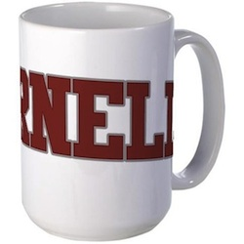
Kahneman, Knetsch & Thaler (1990)
Step 1:
Randomly Endow Item

Slide 4
Kahneman, Knetsch & Thaler (1990)
WTA=$7
WTA=$4.50
WTA=$2
WTP=$6
WTP=$3
WTP=$5
Step 2:
Record Willingness to Pay
& Willingness to Accept

Slide 5
Kahneman, Knetsch & Thaler (1990)
WTA=$7
WTA=$4.50
WTA=$2
WTP=$6
WTP=$3
WTP=$5
Step 3:
Trade at Market Clearing Price

Slide 6
Kahneman, Knetsch & Thaler (1990)

Slide 7
Kahneman, Knetsch & Thaler (1990)
H0: The Coase Theorem
When individuals can bargain and transact at no cost, resource allocation should be independent of initial property rights
WTA=WTP on average
P(Hold Mug at end | Endowed) = P(Hold Mug at end | Not Endowed)

Slide 8
Kahneman, Knetsch & Thaler (1990)
H1: The Endowment Effect
Individuals who (randomly) receive a good will value it more -> Initial allocations matter!
WTA>WTP
Actual # of Trades = 0.2 * Predicted # of Trades

Slide 9
This Paper
The Endowment Effect in the Field
Randomly winning an IPO lottery results in investors being much more likely to hold the share after trading
Really neat finding!
Bazillions of robustness checks

Slide 10
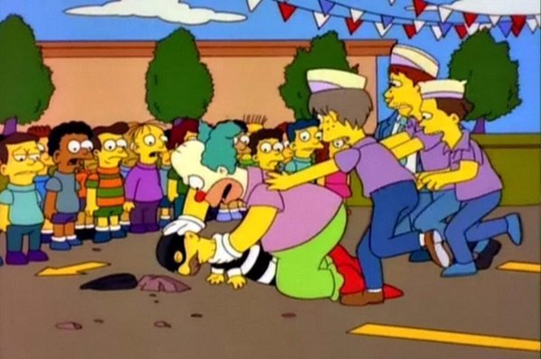
This Paper

Slide 11
This Paper
The Authors
H0, Transaction Costs, Inattention, Wealth Effects, Taxes, Information Costs…

Slide 12
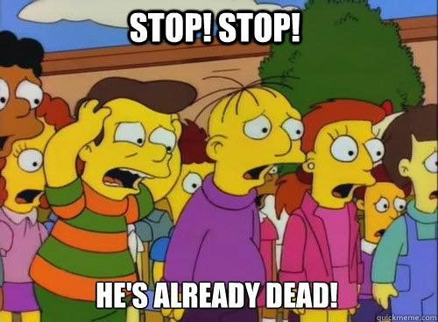
This Paper
The Authors
H0, Transaction Costs, Inattention, Wealth Effects, Taxes, Information Costs…

Slide 13
Almost KK&T(1990), but not quite
The $64,000 Question: = ?

Slide 14
Almost KK&T(1990), but not quite
The $64,000 Question: = ?
Three (not wholly ruled out) differences
is consumed, but is traded
(Before IPO) ≠ (After IPO)
Everyone preferred to cash

Slide 15
#1. is consumed, but is traded

Slide 16
#1. is consumed, but is traded
Mug valued as a consumption item
WTP/WTA reflects owners estimate of the intrinsic utility of using the mug, which is fairly stable
IPO valued only for its ability to generate returns
Shares mostly a means to generating future dollars
A higher WTP is either a belief in more future dollars, or utility over distributions of dollars
If there is an endowment effect for IPOs, is ownership affecting preferences (as in KKT) or beliefs?
If beliefs, are these actually the same phenomenon?

Slide 17
#1. is consumed, but is traded
If an IPO is merely a claim to future dollars, should we expect an endowment effect?

Slide 18
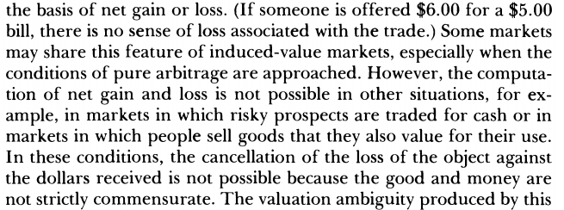
#1. is consumed, but is traded
If an IPO is merely a claim to future dollars, should we expect an endowment effect?
vs

Slide 19
#1. is consumed, but is traded
An IPO has both aspects
Unlike a pure gamble, it can be sold on the market for a fixed and known price, like a dollar bill
Unlike a dollar bill, it is likely to fluctuate in value over time
One interpretation: expected volatility should matter
Useful comparison: List (2003) doesn’t find an endowment effect for experts trading sports cards
Is this because these have stable prices (so are like a dollar bill) whereas IPOs are volatile (and so are like a gamble)?
Would be interesting to discuss this, and other differences with List (2003): why might the results be different here?

Slide 20
#2. (Before trade) ≠ (After trade)

Slide 21
#2. (Before trade) ≠ (After trade)

Slide 22
#2. (Before trade) ≠ (After trade)
This is what you get if you win the lottery

Slide 23
#2. (Before trade) ≠ (After trade)
This is what you get if you lose the lottery and buy afterwards

Slide 24
#2. (Before trade) ≠ (After trade)
This pattern has been known for a long time
e.g. Ritter (1991)
Was definitely common knowledge by the start of the sample in 2007
Talk about this!

Slide 25
#2. (Before trade) ≠ (After trade)
Seems likely that many, if not most, investors are buying mostly for the listing return
30% of investors have sold within the first day!
Pre-IPO share and post-IPO share are totally different
Not just a difference in wealth between the groups
Losers’ WTP (pre-IPO) ?>> Losers WTP (post-IPO)
Doesn’t make sense to talk about the fact that losers who were disappointed can purchase the stock afterwards
What exactly is the puzzle to be explained?
After 1 day, 70% of winners still hold the stock
After 1 day, 0.007% of losers hold the stock

Slide 26
#2. (Before trade) ≠ (After trade)
Seems likely that many, if not most, investors are buying mostly for the listing return
30% of investors have sold within the first day!
Pre-IPO share and post-IPO share are totally different
Not just a difference in wealth between the groups
Losers’ WTP (pre-IPO) ?>> Losers WTP (post-IPO)
Doesn’t make sense to talk about the fact that losers who were disappointed can purchase the stock afterwards
What exactly is the puzzle to be explained?
After 1 day, 70% of winners still hold the stock
After 1 day, 0.007% of losers hold the stock
Not a puzzle at all

Slide 27
#2. (Before trade) ≠ (After trade)
Seems likely that many, if not most, investors are buying mostly for the listing return
30% of investors have sold within the first day!
Pre-IPO share and post-IPO share are totally different
Not just a difference in wealth between the groups
Losers’ WTP (pre-IPO) ?>> Losers WTP (post-IPO)
Doesn’t make sense to talk about the fact that losers who were disappointed can purchase the stock afterwards
What exactly is the puzzle to be explained?
After 1 day, 70% of winners still hold the stock
After 1 day, 0.007% of losers hold the stock
Really puzzling

Slide 28
#2. (Before trade) ≠ (After trade)
Not thinking of this as an IPO paper misses the opportunity to make a big contribution
Alternative title: “Why Do Investors Keep Holding IPO Shares After Listing Despite Their Horrible Expected Returns?”
Endowment effect gives an answer, I don’t know of better ones (BUT I’m not an IPO guy)
Would be useful to think about what other implications the endowment effect has for future returns
Do future returns depend on the fraction of IPO investors who still hold the stock?

Slide 29
#3. Everyone preferred to cash

Slide 30
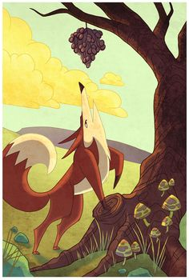
#3. Everyone preferred to cash
KKT: getting endowed with mug or pen equally good ex ante, so no avg difference in disappointment
ABR: Everyone who lost lottery is disappointed
Sour Grapes: Having expressed a desire for a good and finding it unattainable, convince yourself it was undesirable
Related: Buying the stock might make you focus on the lost gains on day 1
Paper finds WTA>WTP, but is this:
WTA ↑, as under endowment effect
WTP ↓, as under sour grapes effect

Slide 31
Sour Grapes
Argument #1: Losers more likely to buy IPO than a matched stock
But sour grapes just says that WTP goes down, not that it ends up low.
We know that WTP for IPO was initially higher than for the matched stock, since they chose to buy it
Argument #2: Losers don’t avoid future IPOs
But the Fox only decides that these grapes are sour, not that all grapes are sour
Bottom line: Can’t rule this out

Slide 32
Conclusion
Great paper!
Really interesting results, shows importance of endowment effect in high-stakes, real-world setting
More focus on IPO and returns aspect would make the interpretation clearer, and could expand the contribution

