Slide 1
Discussion of
“Corporate Disclosure: Facts or Opinions?”
Paper by:
Shimon Kogan (IDC Herzliya and Wharton)
Vitaly Meursault (Philadelphia Fed)
Discussion by:
David Solomon (Boston College)
Northeastern Finance Conference, May 20th, 2022

Slide 2
The Paradox of Text
Finance academics, like Lord Kelvin, are fond of numbers:
“I often say that when you can measure what you are speaking about, and express it in numbers, you know something about it; but when you cannot measure it, when you cannot express it in numbers, your knowledge is of a meagre and unsatisfactory kind”
‘4.2c per share’ is mostly just taken as an objective truth. But how should we think about words? Two perspectives

Slide 3
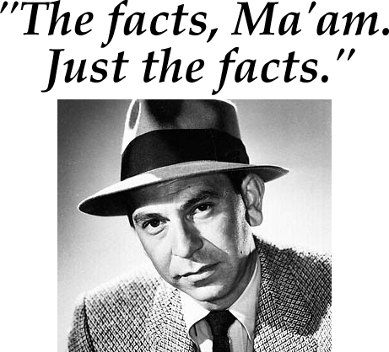
The Paradox of Text
Finance academics, like Lord Kelvin, are fond of numbers:
“I often say that when you can measure what you are speaking about, and express it in numbers, you know something about it; but when you cannot measure it, when you cannot express it in numbers, your knowledge is of a meagre and unsatisfactory kind”
‘4.2c per share’ is mostly just taken as an objective truth. But how should we think about words? Two perspectives

Slide 4

The Paradox of Text
Finance academics, like Lord Kelvin, are fond of numbers:
“I often say that when you can measure what you are speaking about, and express it in numbers, you know something about it; but when you cannot measure it, when you cannot express it in numbers, your knowledge is of a meagre and unsatisfactory kind”
‘4.2c per share’ is mostly just taken as an objective truth. But how should we think about words? Two perspectives

Slide 5
The Paradox of Text
The finance academic literature has considered both sides:
Text as Information Text as Interpretation Text as Both/Ambiguous
Engelberg (2008) (Tone in Earnings)
Tetlock, Saar-Tsechansky, and Macskassy (2008) (Tone in Earnings)
Hoberg and Phillips (2009, 2012, 2014) (Industry and Product Market information in MD&A)
Hoberg and Maksimovic (2014) (Financial Constraints in MD&A)
Israelsen and Yonker (2011) (Insurance Policies in 10Ks)
…
Tetlock (2007) (Media tone as proxy for sentiment) and others
Dougal, Engelberg, Garcia and Parsons (2012) (Journalist FE)
Gurun and Butler (2012) (Media slant in press releases)
Li (2010) (CEO Pronoun use)
Zhou (2014) (CEO blame attribution)

Slide 6
Interpreting Identification of Interpretation
Information is the default assumption – interpretation needs to be established
Gurun and Butler (2012) – different articles on same underlying earnings announcement
Dougal et al (2012) – Journalist fixed effects and random rotation of journalists
Li (2010) – CEO pronoun use as an economically irrelevant choice (“I did X” versus “We did X”)
Zhou (2014) – CEO attribution of blame to external circumstances
Dzieliński, Wagner and Zeckhauser (2017) – Words indicating uncertainty

Slide 7
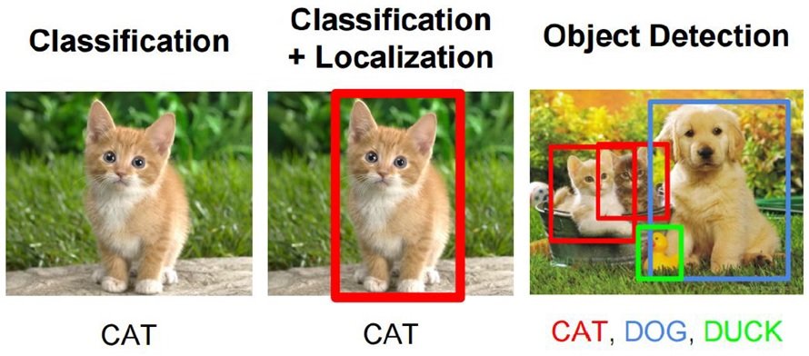
The Iceberg, Not the Tip
Existing information presumption means that lots of opinion gets ignored.
Lord Kelvin didn’t anticipate neural networks! Great use of them
  Classify some set of statements
  Train algorithm to learn what words this maps to.
Relies on binary classification
  Facts vs Opinion

Slide 8
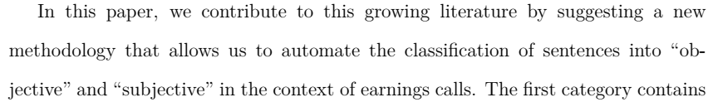
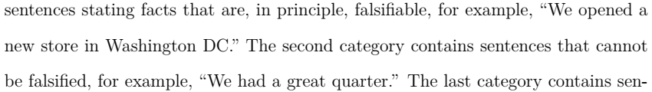
How many categories?

Slide 9
How many categories?
Falsifiability is exactly the right principle!
But is the right number of categories here really two?
  Tradeoff: easier to classify
  Downside: Lose lots of valuable gradations

Slide 10

Two dimensions of falsifiability
First dimension – how much agreement is there on the baseline metric?
Complete agreement
Completely subjective

Slide 11
Two dimensions of falsifiability
First dimension – how much agreement is there on the baseline metric?
Complete agreement
Completely subjective
Facts are known, easy to observe, difficult to dispute
“We opened a new store in Washington D.C.”

Slide 12
Two dimensions of falsifiability
First dimension – how much agreement is there on the baseline metric?
Complete agreement
Completely subjective
Facts are known, easy to observe, but have some wiggle room on inputs
“Earnings per share were 6.8c”

Slide 13

Two dimensions of falsifiability
First dimension – how much agreement is there on the baseline metric?
Complete agreement
Completely subjective
Facts are known, easy to observe, but have some wiggle room on inputs
“Earnings per share were 6.8c”

Slide 14
Two dimensions of falsifiability
First dimension – how much agreement is there on the baseline metric?
Complete agreement
Completely subjective
Facts are knowable and agreeable in principle, hard to observe, and proving them is difficult
“Earnings declined due to competitive pressure on margins / supply chain disruptions”

Slide 15

Two dimensions of falsifiability
First dimension – how much agreement is there on the baseline metric?
Complete agreement
Completely subjective
Facts are knowable and agreeable in principle, hard to observe, and proving them is difficult
“Earnings declined due to competitive pressure on margins / supply chain disruptions”

Slide 16
Two dimensions of falsifiability
First dimension – how much agreement is there on the baseline metric?
Complete agreement
Completely subjective
Facts have inescapable subjectivity and judgment, but in a way that has some agreement
“We had a great quarter”

Slide 17

Two dimensions of falsifiability
First dimension – how much agreement is there on the baseline metric?
Complete agreement
Completely subjective
Facts have inescapable subjectivity and judgment, but in a way that has some agreement
“We had a great quarter”

Slide 18
Two dimensions of falsifiability
First dimension – how much agreement is there on the baseline metric?
Complete agreement
Completely subjective
Facts are pure personal opinion, with no claim to representing anything else
“I’m really proud of our team”

Slide 19
Two dimensions of falsifiability
First dimension – how much agreement is there on the baseline metric?
Complete agreement
Completely subjective
Facts are known, easy to observe, difficult to dispute
“We opened a new store in Washington D.C.”
Facts are known, easy to observe, but have some wiggle room on inputs
“Earnings per share were 6.8c”
Facts are knowable and agreeable in principle, hard to observe, and proving them is difficult
“Earnings declined due to competitive pressure on margins / supply chain disruptions”
Facts have inescapable subjectivity and judgment, but in a way that has some agreement
“We had a great quarter”
Facts are pure personal opinion, with no claim to representing anything else
“I’m really proud of our team”

Slide 20
Two dimensions of falsifiability
Cutoff is reasonable, but is 2 really the right number of categories?
Complete agreement
Facts
Opinions
Completely subjective
Facts are known, easy to observe, difficult to dispute
“We opened a new store in Washington D.C.”
Facts are known, easy to observe, but have some wiggle room on inputs
“Earnings per share were 6.8c”
Facts are knowable and agreeable in principle, hard to observe, and proving them is difficult
“Earnings declined due to competitive pressure on margins / supply chain disruptions”
Facts have inescapable subjectivity and judgment, but in a way that has some agreement
“We had a great quarter”
Facts are pure personal opinion, with no claim to representing anything else
“I’m really proud of our team”

Slide 21
Two dimensions of falsifiability
Cutoff is reasonable, but is 2 really the right number of categories?
Complete agreement
Facts
Debatable
Opinions
Completely subjective
Facts are known, easy to observe, difficult to dispute
“We opened a new store in Washington D.C.”
Facts are known, easy to observe, but have some wiggle room on inputs
“Earnings per share were 6.8c”
Facts are knowable and agreeable in principle, hard to observe, and proving them is difficult
“Earnings declined due to competitive pressure on margins / supply chain disruptions”
Facts have inescapable subjectivity and judgment, but in a way that has some agreement
“We had a great quarter”
Facts are pure personal opinion, with no claim to representing anything else
“I’m really proud of our team”

Slide 22
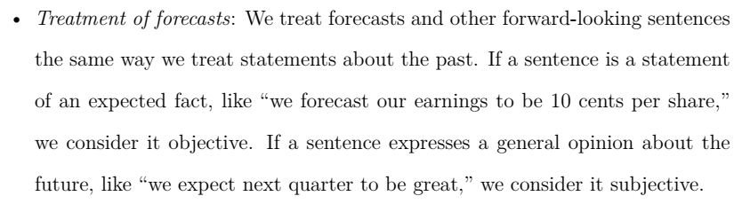
Second Dimension: Time

Slide 23
Second Dimension: Time
This is a huge missed opportunity!
Claims necessarily less falsifiable as they apply to further in the future
  Can only be probabilistic, so hard to tell if you just got unlucky
  Cheap talk – will the person be around to take responsibility?

Slide 24
Second Dimension: Time
Do zero investors care about long term earnings? Unlikely.
Falsifiability goes down with horizon, as does ability to monitor forecasts and hold analysts accountable

Slide 25
Second Dimension: Time
In principle, not difficult to code up different categories (the past, the present, next quarter, next year, next several years, long run)
  Could even be done with simple text strings, and likely doesn’t need, or even really benefit from, a neural net and a training sample
How do returns differ with horizon for the same factual claim?
  Gives an implicit discount on subjectivity
How does metric agreement (if there is a continuous measure) trade off against horizon?
  Is a statement about likely earnings in 5 years less impactful than a subjective assessment of causality in the previous quarter?

Slide 26

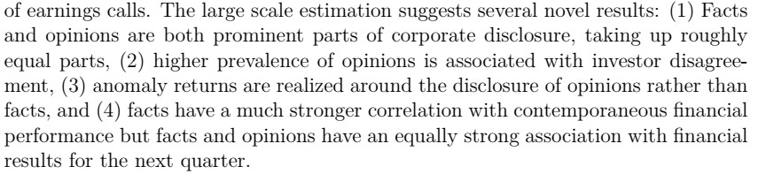
What To Use This For

Slide 27
What To Use This For
Reads like a measure in search of an application
  The danger is that nobody remembers any of the claims
One possible unifying theme: “Why does opinion matter to markets?”
  Causality? Manager’s general subjective assessment? Backward-looking versus forward-looking?
  Which opinions are cheap talk and which aren’t?

Slide 28
What To Use This For
Even if current metrics and tests are kept as the focus, would be very valuable to say what we should learn overall about the categories of facts and opinions
  Which bits are surprising, and why?
Opinion is the most open to interpretation here, and the one where shedding light on what it’s capturing has the biggest value

Slide 29
Conclusion
Ambitious project to better understand types of disclosure
Broad categorization is a great first step, would be nice to see more on types and gradations of opinion, and what they reveal in economic terms.

