Slide 1
Discussion of “The Earnings Announcement Return Cycle”
Paper by:
Juhani Linnainmaa (USC) and Conson Zhang (USC)
Discussion by:
David Solomon (Boston College)
SFS Cavalcade
May 24th, 2018

Slide 2
Asset Pricing: Time-Series vs Cross-Section
Academic asset pricing usually splits returns into ‘time-series’ and ‘cross-section’
Time-Series: Movements in aggregate market returns
Cross-Section: Which stocks have higher returns
Cross-section is not of firms, but firm traits
E.g. Value vs Growth
Split firms into high book-to-market (B/M) and low B/M
Form portfolios of each, analyze properties of portfolio
Firms switch between portfolios as traits change

Slide 3
Better: A Cross-Section of Firms, Not Firm Traits
Alternative is to think about individual firms
AP “Cross-sectional” combines several parts:
Fixed or quasi-fixed attributes – size, B/M
One-off events: momentum, post-earnings announcement drift
Recurring events: this paper
A surprising amount of recurring firm events are associated with abnormal returns
Dividends, earnings, stock splits, 12 month returns…
No unified explanation
Risk tends to be more stable

Slide 4
Dividend Month Premium
Abnormal Returns for Portfolios at Different Horizons Since Dividend Payment

Slide 5
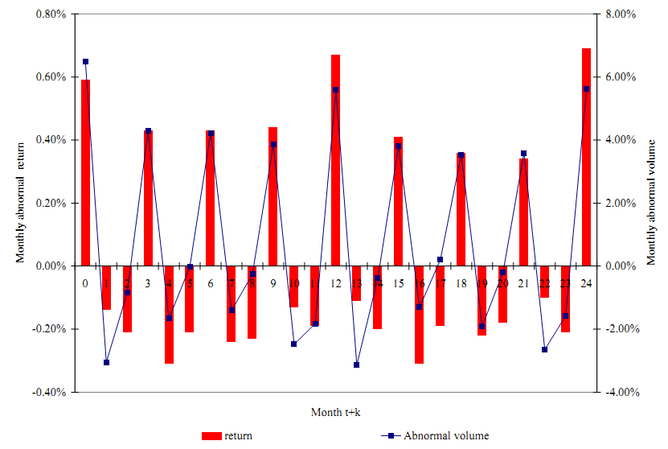
Earnings Announcement Premium
Abnormal returns to portfolio of companies with an earnings announcement n months ago

Slide 6
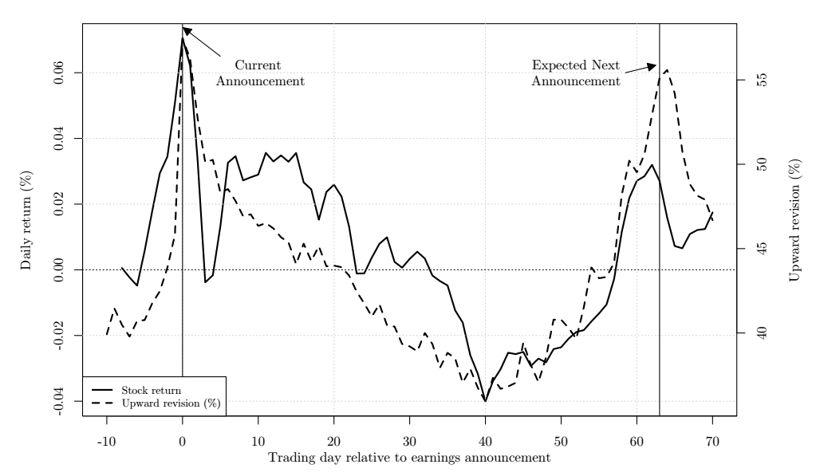
The Paper in One Picture

Slide 7
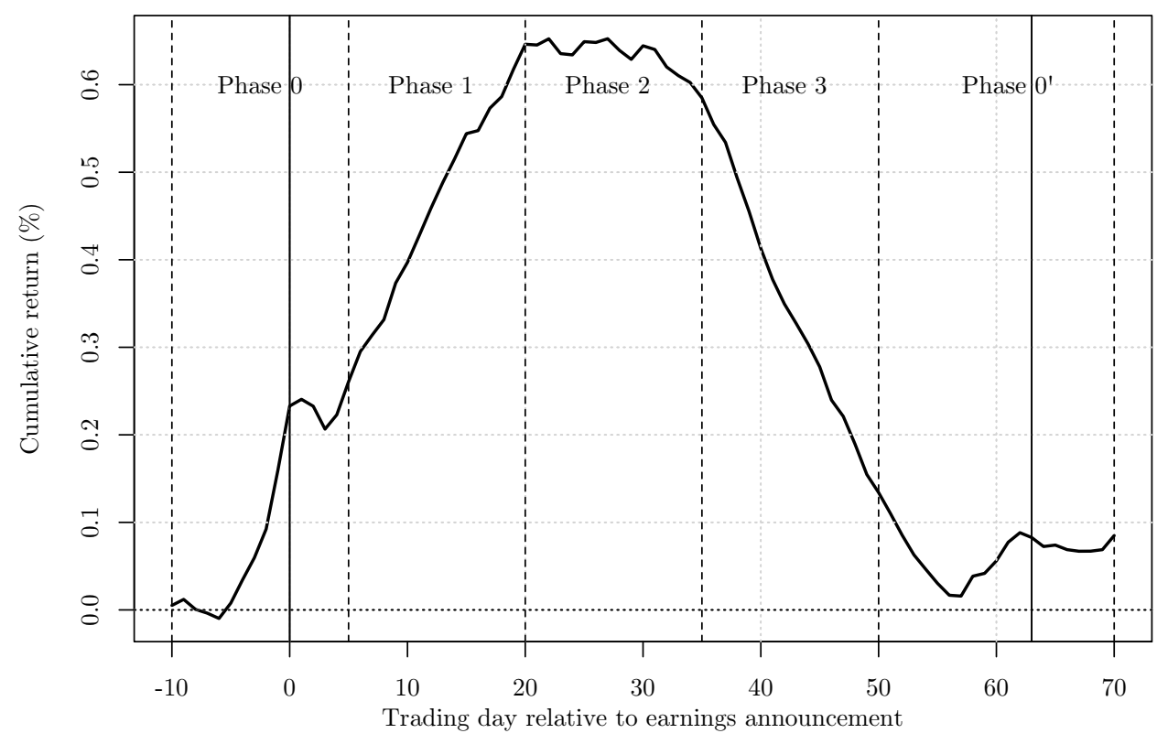
“We could turn that into a trading strategy”
Long
Short

Slide 8
What a difference a day(ly return) makes
Picture looks very different in daily event time!
Neat result worth exploring further
High returns in Phase 0 explored a great deal
High returns in Phase 1 and low returns in Phase 3 much less remarked upon

Slide 9
Do 31 days add up to a month?
How to reconcile Frazzini and Lamont (2006) with Linnainmaa and Zhang (2018)?
Seems like a stretch.
Only holds under the narrow definition in the paper that the EAP covers only t-10 to t+5.

Slide 10
Phased (Fazed) by the EAP Definition
EAP
Long
Short

Slide 11
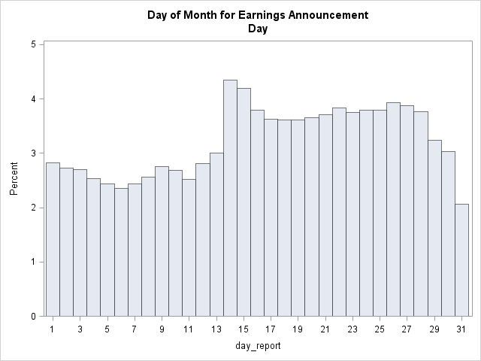
Lots of the monthly EAP happens in Phase 1
Linnainmaa & Zhang (2018)
Frazzini & Lamont (2006)
Result definitely related to monthly EAP as Frazzini & Lamont (2006) define it

Slide 12
A Better Pitch
“We ought to think about the pattern of returns over the whole earnings cycle”
Lots of the returns patterns aren’t close to the announcement
Does it make sense to keep extending out our definition of “announcements”?
High returns after the announcement (Phase 1) aren’t plausibly related to announcement risk (a la Savor and Wilson (2017))
What if the high Phase 1 returns are related to the announcement returns?
We don’t know why the EAP exists in the first place!

Slide 13
Analysts and Optimism
Link between analysts and returns is interesting
Time series correspondence between forecast revisions and returns is persuasive that timing matters
Big question: what are analysts forecast revisions measuring?
Equivalently: why do analysts change their mind around these times?
Paper doesn’t shed any light on this
Without this, not really an explanation

Slide 14
Analysts as Cause, or Analysts as Proxy?
Tests removing analyst upgrades show that analyst timing matters, not that analysts themselves matter
If analysts upgrade mechanically on good news, expect the same result of lower returns due to taking out good news
Important placebo test if analysts matter directly: what are ERC returns for firms with no analyst coverage?
Authors story: returns should be zero, or maybe half of normal
My bet: they’re higher (prove me wrong!)
Even if analysts matter directly, why do they make errors at certain times?
More news flows at certain times? Better news?

Slide 15
Analysts as Cause, or Analysts as Proxy?
Alternative: Firms are managing investor expectations at these times, particularly to beat earnings targets
Prediction: Returns should be cross-sectionally higher for firms with greater incentives to manage earnings
Good news: They are!
Bad news: This is already shown in Kim and So (2016)
Prediction: ERC returns should be higher for large earnings announcements that firms care about more
Seasonal Earnings: Chang, Hartzmark, Solomon, & Soltes (2017)
Good news: They are!
Bad News: This is also in Kim and So (2016)

Slide 16
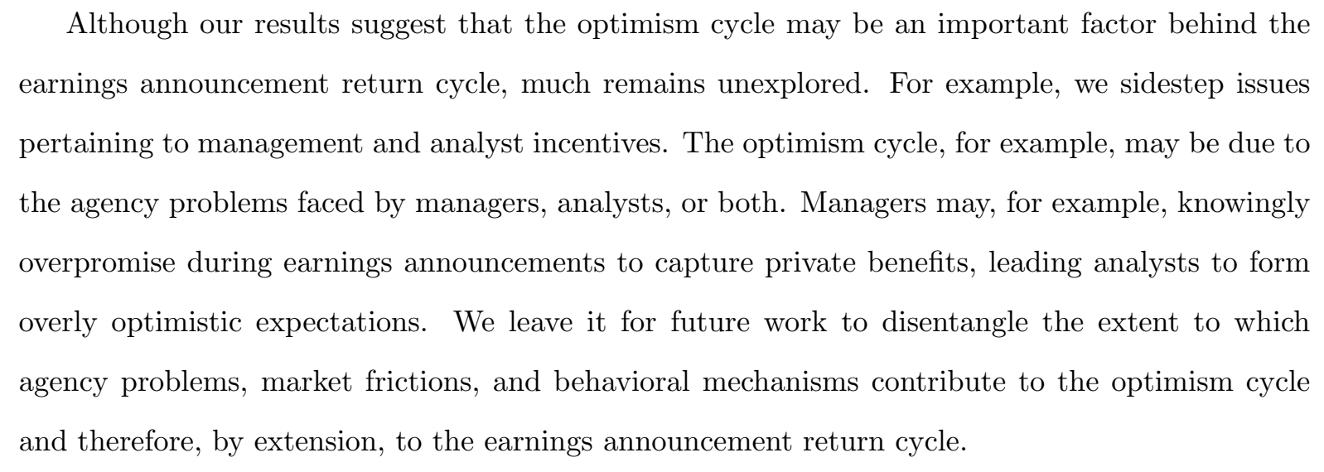
Give Kim and So (2016) More Credit
Lame. This work already exists, and is 2 years old. Cite it properly!

Slide 17
An alternative differentiating factor
A better way to distinguish: Kim and So (2016) story is more about months M-1 and M
No strong predictions about why there should be upgrades in month M+1 (e.g. Phase 1)
This is the real mystery that the paper has uncovered
What’s going on in these months?
Other firm events? Dividends?

Slide 18
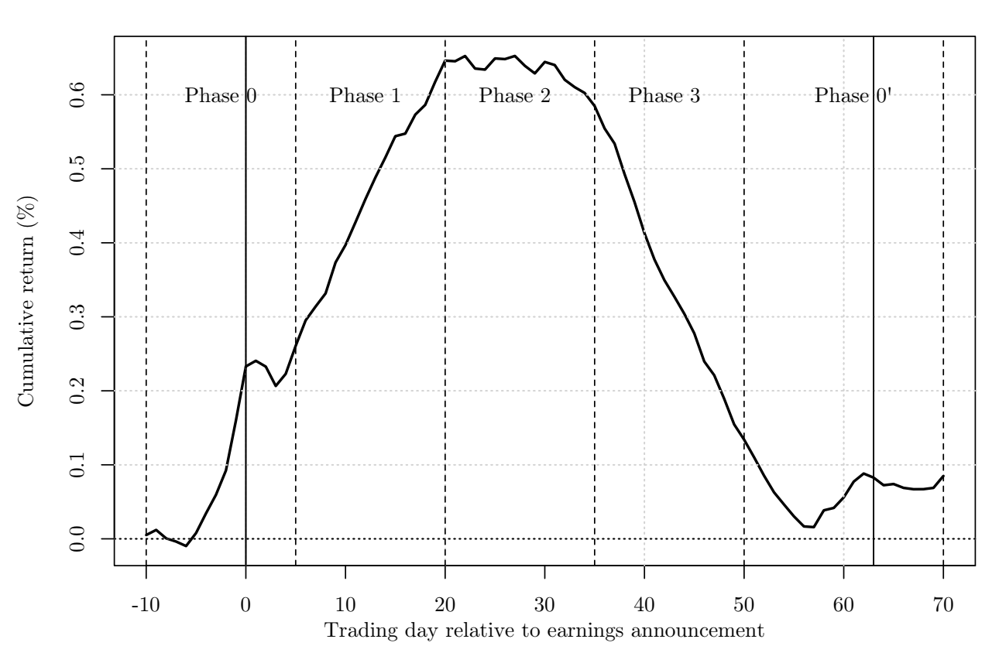
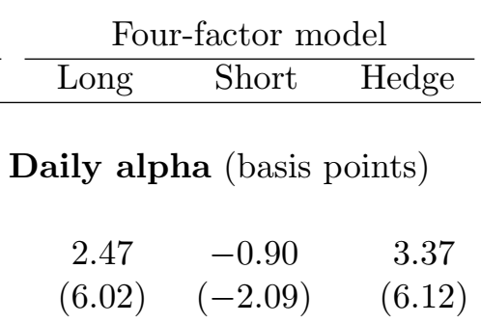
Magnitudes and Compound Returns
A puzzle: magnitudes of long/short returns very different in graph vs calendar time
Short bigger than Long
Long bigger than Short

Slide 19
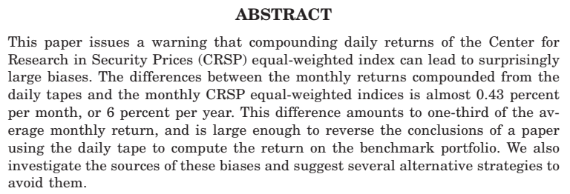
Caveat Compounder
Possible resolution: Short leg returns (or both) screwed up in cumulative graph due to bias in compounding equal-weighted market portfolio

Slide 20
Conclusion
Interesting results, worth exploring further
Dig deeper into why analysts might matter
Do they matter directly?
Why do they screw up when they do?
What’s going on in Phase 1?

