Slide 1
Discussion of “How Do Retail Investors Respond to the Zero Lower Bound?”
Paper by:
Steffen Meyer (Univ. Southern Denmark) Michaela Pagel (Columbia)
Alexander Schandlbauer (Univ. Southern Denmark)
Charline Uhr (Goethe University)
Discussion by:
David Solomon (Boston College)
Future of Finance Conference, May 21st 2021

Slide 2
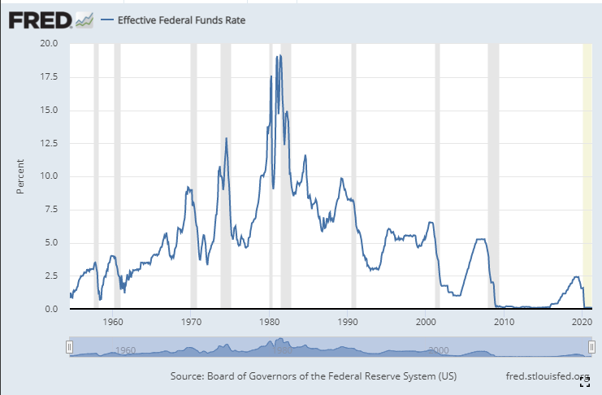
The Strange Path of Interest Rates

Slide 3
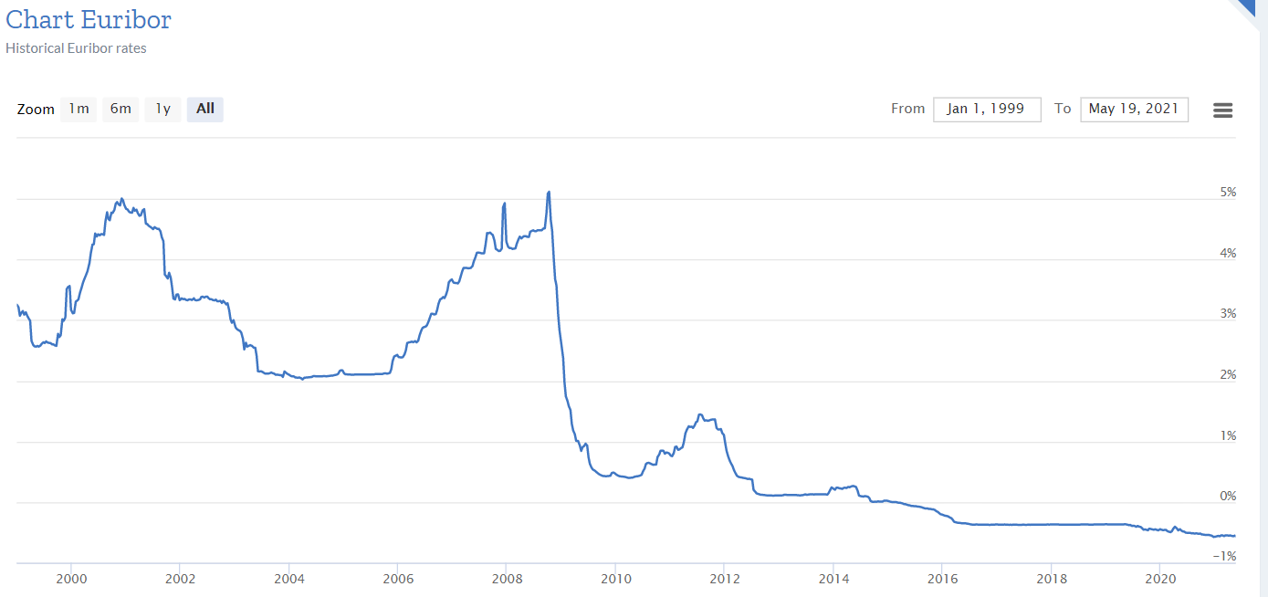
The Strange Path of Interest Rates

Slide 4
The Strange Path of Interest Rates
Interest rates are low, and likely to stay low
Over/under on the first use of the phrase “Zero Upper Bound” in an academic journal
Main obstacle to large negative rates is paper currency, which is increasingly anachronistic
Big open questions as to how people will respond

Slide 5
The Cochrane Critique
Studies “[T]he relationship between the zero lower bound, investors’ rebalancing decisions as a response to the stock market returns, savings, and cash holdings”
Lots of stuff! What concretely is being measured?
Mostly how investors reinvest dividends before and after April 2016 in Germany
Claims:
Investors hoarding cash
More active rebalancing after ZLB
Active rebalancing leads to cash transfers
No change in savings out of salary

Slide 6
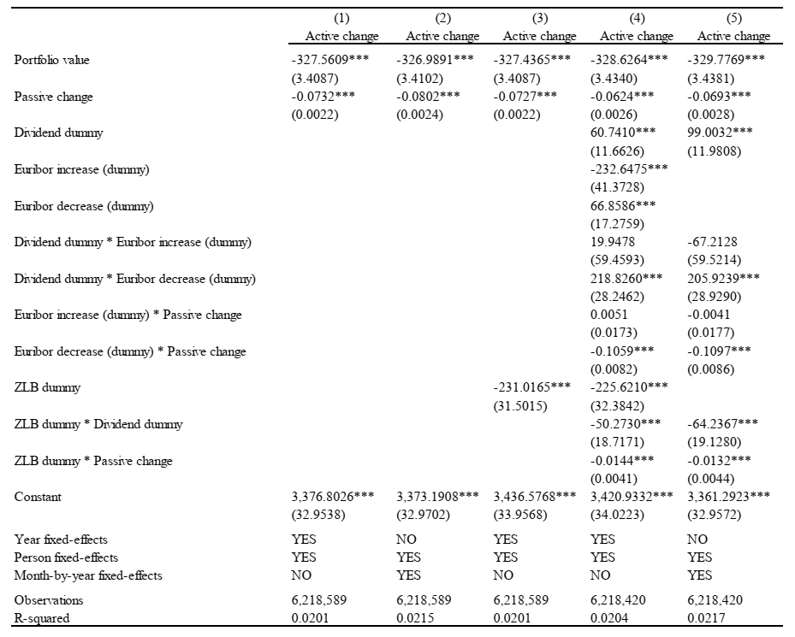
“Judgment Errors”

Slide 7
“Judgment Errors”
(Some) reinvestment of dividends if no change in interest rates AND not at zero lower bound
How should we interpret this in terms of cents in the dollar?

Slide 8
“Judgment Errors”
More reinvestment when rates drop (but also directionally more when rates rise!)

Slide 9
“Judgment Errors”
But less when ZLB reached

Slide 10
Interpreting all this!
Dividend decisions are interpreted as:
Active portfolio rebalancing choices
Asset allocation decisions about cash
Economically, this is all true! But is this how investors think about it?

Slide 11
Active Rebalancing?
Are these active rebalancing choices?
Most brokerages don’t even tell you when you get a dividend. Hartzmark and Solomon (2020)
“Receiving dividend payments increases attention towards the investment portfolio (Graham and Kumar (2006))”
Graham and Kumar (2006) just show you’re more likely to trade that particular stock around dividends. No evidence on the rest of the portfolio
More consistent with investors trading in order to receive the dividend, thinking it’s free money. No concrete evidence of an attention channel.

Slide 12
Daily Alphas Around Announcement Day

Slide 13
Daily Alphas Around Ex-Dividend Day

Slide 14
Are dividends just fungible cash?
Investors generally treat dividends as belonging to separate mental accounts, not as part of a single return (Hartzmark and Solomon 2019)
Doesn’t mean it’s not an asset allocation decision, but not clear how it’s being thought of
Investors generally consume dividend proceeds, rather than reinvest them (Baker, Nagel and Wurlger (2006))
Puzzling, given claim that investors are trying to reinvest more. What’s going on here?
Might explain why results about hoarding cash don’t show any effects on overall savings or other rebalancing choices.

Slide 15
How tightly do effects identify the ZLB?
Interest rates are almost zero for most of the sample. How large should effects be for precisely zero?
Focus on difference between February and April 2016 as a tight test of the timing
What else changes between these months? Lots more German dividends paid in April than in February!
Unusually concentrated relative to US distribution
Dummy doesn’t identify these effects
May just have a different tendency to consume very small dividends, vs amounts that could finance consumption.

Slide 16
The Strange Path of Interest Rates

Slide 17
How tightly do effects identify the ZLB?
Interest rates are almost zero for most of the sample. How large should effects be for precisely zero?
Focus on difference between February and April 2016 as a tight test of the timing
What else changes between these months? Lots more German dividends paid in April than in February!
Unusually concentrated relative to US distribution
Dummy doesn’t identify these effects
May just have a different tendency to consume very small dividends, vs amounts that could finance consumption.

Slide 18
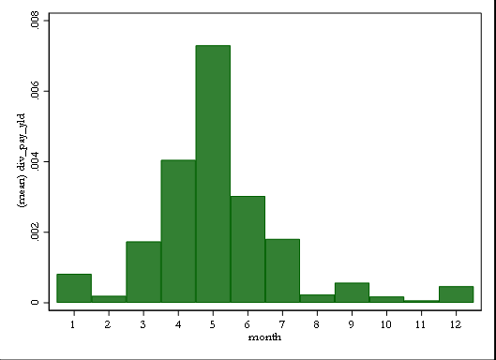
How tightly do effects identify the ZLB?
“In our sample, dividends are paid out in all months throughout the year.”

Slide 19
How tightly do effects identify the ZLB?
“Dividends are known to be sticky because managers are reluctant to change dividend payments. Therefore, it is improbable that dividend payments are endogenous to the zero lower bound.”
Dividends don’t change, but investor demand for dividends changes a ton!
Dividend demand higher in recessions and when the VIX is higher (Hartzmark and Solomon 2013)
Dividend demand is higher when interest rates are lower (Hartzmark and Solomon 2019, Daniel, Garlappi & Xiao (2020)
Neither is about zero interest rates specifically, or what is done with the proceeds. But seems worth thinking about

Slide 20
Conclusion
Interesting puzzle about why investors reinvest dividends differently when interest rates hit zero
Different interpretations based on whether thinking of this as an asset allocation / cash decision, or a dividend-specific decision
Lots to think about

