Slide 1
Fund Flows in Rational Markets
Paper by Francesco Franzoni (Swiss Finance Institute) and Martin Schmalz (Michigan)
Discussion by David Solomon (USC)
UNC Junior Faculty Roundtable, November 22nd 2013

Slide 2
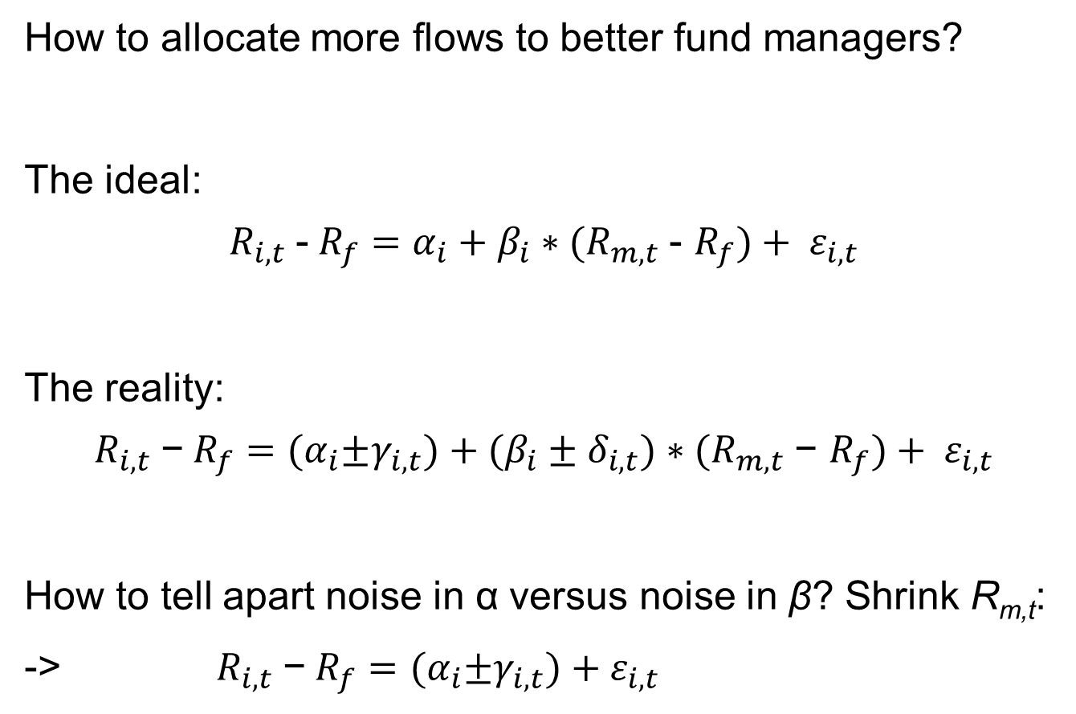
The Broad Problem
How to allocate more flows to better fund managers?
The ideal:
$$R_{i,t} \text{-}{ R}_{f}=α_{i}+β_{i}∗{(R}_{m,t} \text{-} R_{f})+ ε_{i,t}$$
The reality:
$$R_{i,t} \text{−}{ R}_{f}={(α}_{i}±γ_{i,t})+(β_{i}±δ_{i,t})∗{(R}_{m,t} \text{−} R_{f})+ ε_{i,t}$$
How to tell apart noise in α versus noise in β? Shrink R_{m,t}:
-> $R_{i,t} \text{−}{ R}_{f}={(α}_{i}±γ_{i,t})+ε_{i,t}$

Slide 3
What’s beta got to do with it?
The key difference that makes investors react differently based on economic conditions is … uncertainty about beta??
Otherwise we’re back in Berk and Green (2004)
Stated rationales for this are underwhelming…

Slide 4
How much uncertainty about beta is there?
  “Supporting this view, Kacperczyk, Sialm, and Zheng (2008) show that a large amount of portfolio rebalancing between reporting dates is concealed from investors. “
  But this only matters if you’re trying to estimate betas from holdings. Is that really the best way to do it?
  “Also, in contrast to stocks for which quasi-continuous observation of returns allows investors to infer second moments arbitrarily fast (Merton, 1980), mutual fund returns are observed at most daily, which hinder perfect inference of risk loadings.”
  The real obstacle for retail investors trying to estimate fund betas is … lack of intraday data? Really?

Slide 5
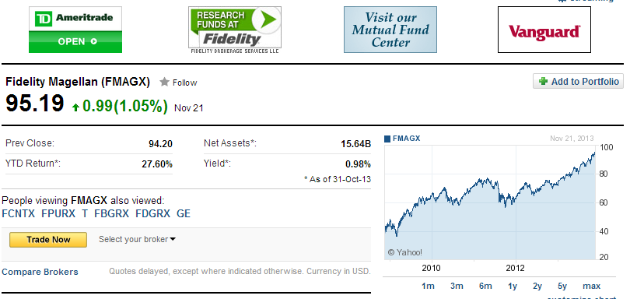
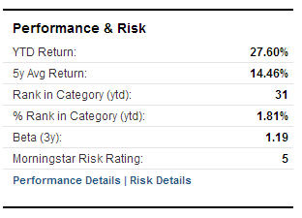
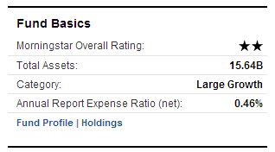
FMAGX
November 2013

Slide 6
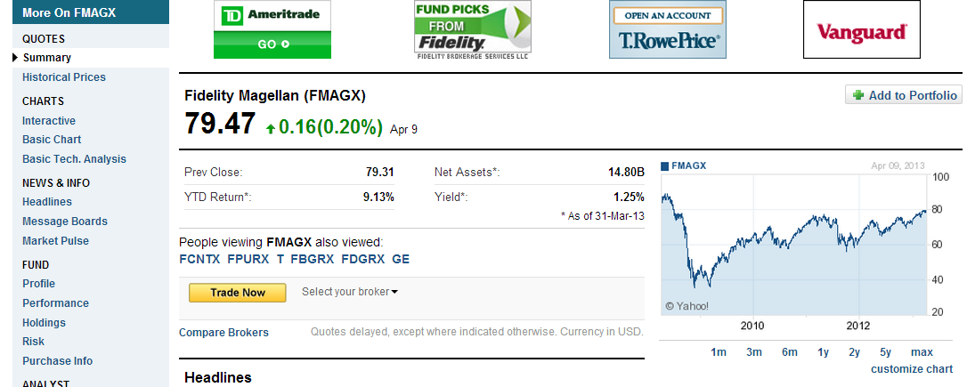
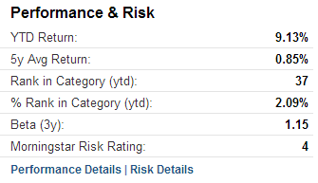
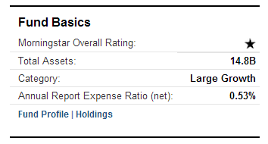
FMAGX
April 2012

Slide 7
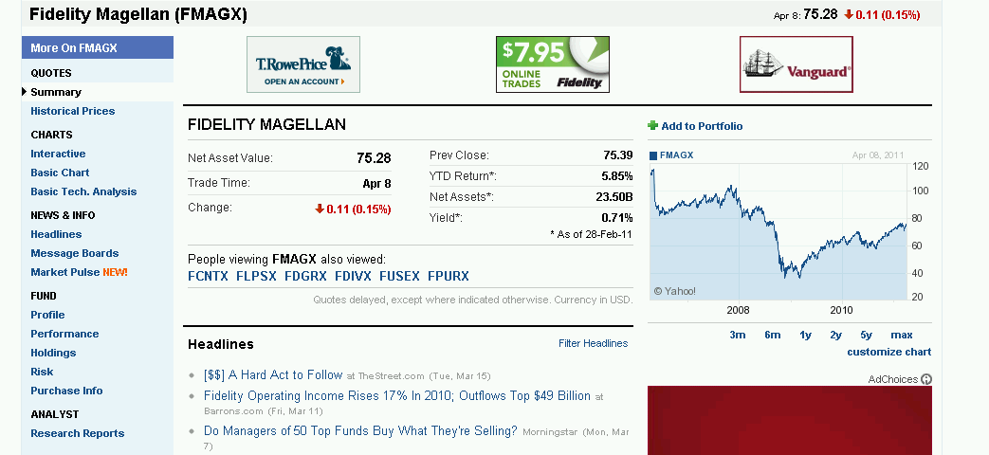
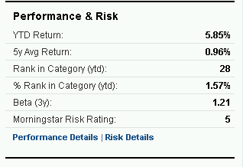
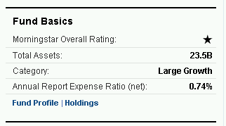
FMAGX
April 2011

Slide 8
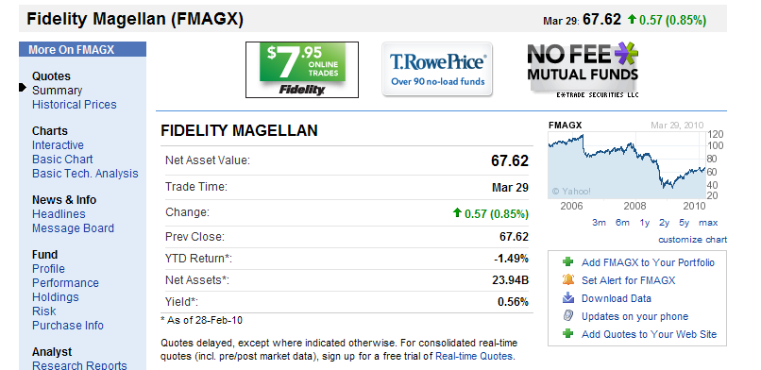
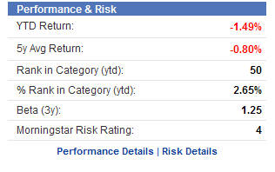
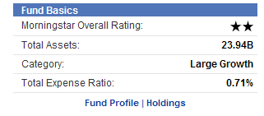
FMAGX
April 2010

Slide 9
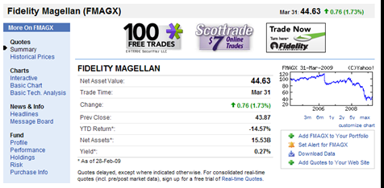
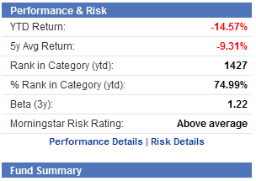
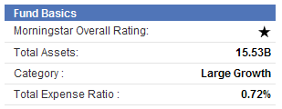
FMAGX
April 2009

Slide 10
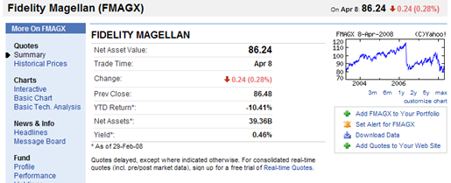
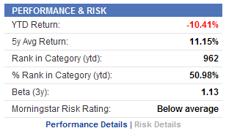
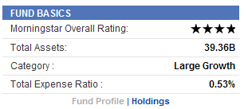
FMAGX
April 2008

Slide 11
Prove me wrong!
If holdings information does matter for estimating β, then this suggests another test of the model based
Funds required to report holdings quarterly instead of semi-annually after May 2004
  Decreases σ_{β} in model
Does FPS increase after May 2004?
Does it increase more for funds who weren’t already disclosing quarterly?

Slide 12
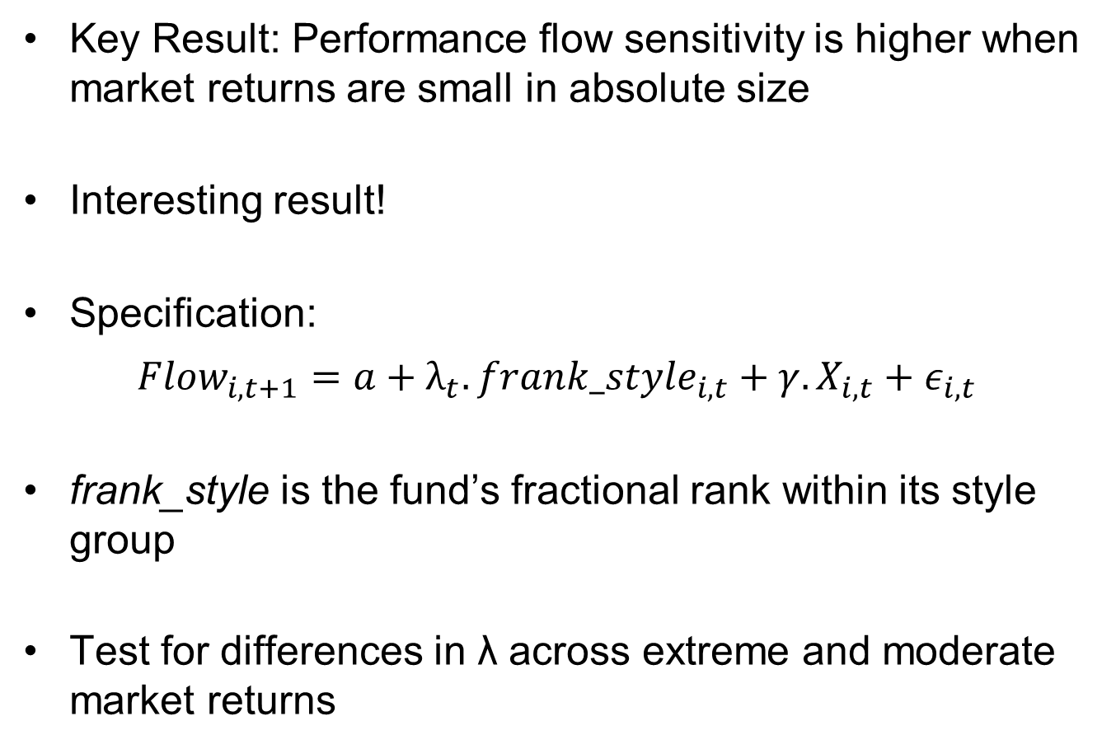
Empirical Results
Key Result: Performance flow sensitivity is higher when market returns are small in absolute size
Interesting result!
Specification:
$${Flow}_{i,t+1}=a+λ_{t}.{frank_style}_{i,t}+γ.X_{i,t}+ε_{i,t}$$
frank_style is the fund’s fractional rank within its style group
Test for differences in λ across extreme and moderate market returns

Slide 13
Specification Matters!
A lot of inference depends on getting the performance / flow relationship correct.
Would be nice to see more robustness on specification
Several choices used here, none of them obvious:
  Use rank of returns instead of levels
  Rank enters linearly into regression
  Use style-adjusted returns instead of raw or market-adjusted
  Use only one lag of returns

Slide 14
Other Variables Matter As Well

Slide 15
Other Variables Matter As Well

Slide 16
Other Variables Matter As Well

Slide 17
Other Variables Matter As Well

Slide 18
Other Variables Matter As Well

Slide 19
Other Variables Matter As Well

Slide 20
Other Variables Matter As Well

Slide 21
Specification Matters!
The current specification launders all effects through ranking of style-adjusted returns
Time-series changes in these other variables may affect the coefficient for reasons other than the model
  E.g. Raw returns obviously lower in downturns. How might this affect things

Slide 22
Which one to use?
Choice 1: Levels versus Fractional Ranks
  Model seems to predict that flows will depend on the level of returns, not percentiles. Lemma 2
Choice 2: Raw versus Style Adjusted
  Are there styles in the model? If not, what’s the argument other than empirical plausibility (and if so, what about other measures)

Slide 23
Which one to use?
Choice 3: Time Horizon
  Why stop at one quarter?
  Returns have persistent effects for several years
  Morningstar Ratings matter too, which are based on several years
Use of different return horizons can also help disentangle other reasons why investors might have a different performance/flow relationship

Slide 24
Which one to use?
Story 1: Volatile market returns reduce FPS because investors find it harder to estimate parameters
  This model
Story 2: Volatile market returns make investors withdraw money regardless of fund returns for some other reason
  risk aversion goes up
  liquidity needs go up
  perceived mispricing changes
  ….

Slide 25
Time Horizons
Lagged returns provide a way to tell apart conditions today from conditions at the time of the returns
Consider an investor at the end of quarter t using information on fund returns in t and t-1 to allocate flows
  If the effects are about risk aversion, liquidity etc. then market returns in t should affect his response to fund returns in both t and t-1
  If the effects are about precision of estimates, then market returns in t-1 (but not t) should affect the treatment of fund returns in t-1

Slide 26
More Econometric Nitpicking
Flow regressions all use Fama Macbeth regressions
Since flows are autocorrelated, this will underestimate standard errors (unlike when LHS variable is returns)
  Petersen (2009)
Fama Macbeth also weights each quarter equally
  Sample is very sparse in 1980s, meaning that each fund/quarter receives a much higher weight
Solution: Use a panel specification with date interactions and double cluster standard errors

Slide 27
More Econometric Nitpicking
Flow regressions all use Fama Macbeth regressions
Since flows are autocorrelated, this will underestimate standard errors (unlike when LHS variable is returns)
  Petersen (2009)
Fama Macbeth also weights each quarter equally
  Sample is very sparse in 1980s, meaning that each fund/quarter receives a much higher weight
Solution: Use a panel specification with date interactions and double cluster standard errors

Slide 28
Conclusion
Interesting finding: investors reward relative fund performance more when market returns are smaller in absolute size
Consistent with skill being harder to estimate in volatile markets
  Try to do more empirically to tease out whether time-series effects are driven by this or something else

