Slide 1
Discussion of
“﻿Self-Inflated Funds”
Paper by:
﻿Philippe van der Beck (HBS)
Jean-Philippe Bouchaud (﻿Ecole Polytechnique)
Dario Bouchaud (Capital Fund Management)
Discussion by:
David Solomon (Boston College)
Notre Dame Investment Management Conference
October 10th, 2025

Slide 2
(Academic) Market Timing
Hardest point to judge is when a hypothesis is about to go from “obviously wrong” to “obviously right”
  Too soon: rejected for being dumb
  Sweet spot, before (or causing) tipping point: A bazillion cites
  Too late: rejected because we already know this
Price pressure somewhat known since at least Shleifer (1986)
  Fire Sales, Index additions
But not widely believed as important (Gabaix and Koijen (2021), since mostly viewed as applying to unusual situations
Since then, big increase in papers showing price pressure in various forms. But implications still need to be worked out

Slide 3
Seemingly Obvious Questions That Aren’t Obvious
The incentives of different parties under price pressure setups are much more murky than often assumed. E.g. Buybacks
Assume that companies didn’t run the risk of regulatory scrutiny for market manipulation
What should be the aim of a share buyback scheme for a firm?
  To buy slowly, trying to not move the price at all, and so acquire the largest amount of shares possible (and the biggest increase in EPS) per dollar allocated?
  To buy quickly, with the intention of increasing the price as much as possible, given estimates of how much that can be sustained?
Not clear!

Slide 4
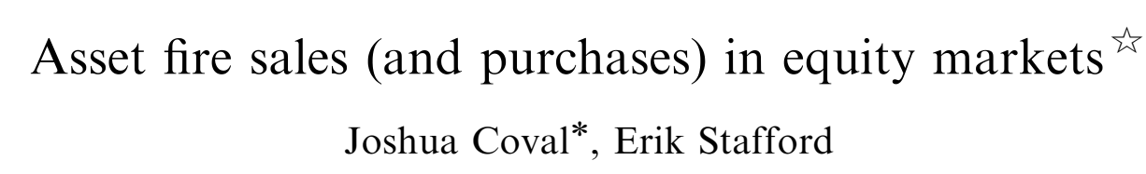
On Fire Sales (Coval and Stafford 2007)

Slide 5
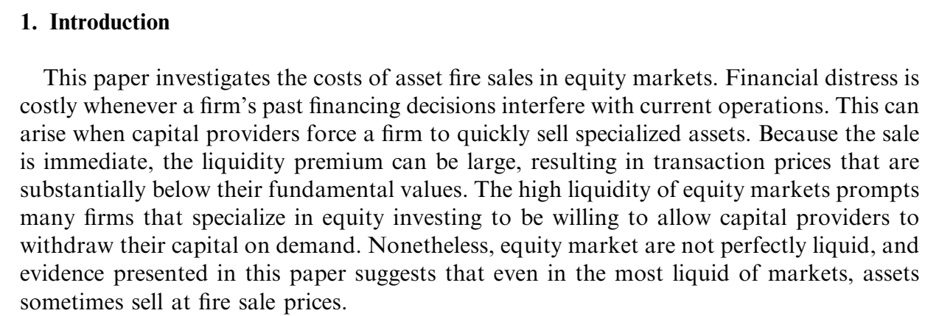
On Fire Sales (Coval and Stafford 2007)

Slide 6
On Fire Sales (Coval and Stafford 2007)
Sales

Slide 7
On Fire Sales (Coval and Stafford 2007)
Sales
Purchases

Slide 8
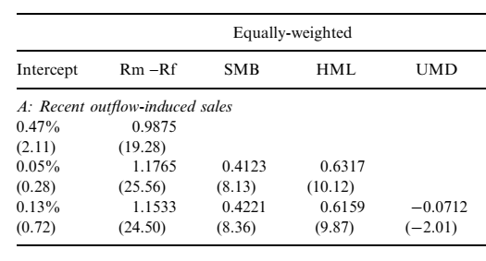
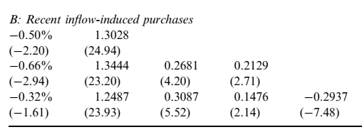
The importance of reading the tables

Slide 9
The importance of reading the tables
No significant alphas for fire sales

Slide 10
The importance of reading the tables
Only actual returns effects are for “fire purchases”
What on earth is a “fire purchase”? If you have excess cash, put it in SPY and trade gradually!

Slide 11
Self-Inflated Funds
The puzzle is not that there are some effects for purchases, but there are only effects for purchases!
Why is it seemingly harder to buy gradually rather than sell gradually? Why do they have different price effects?
  “Fire Purchases” makes no economic sense
Current paper gives one answer – they may want price effects
Pushing up prices through additional inflows benefits the fund
  Flows increase prices, returns increase
  High returns attract more inflows
  Profit!!!
  (Except low returns thereafter)

Slide 12
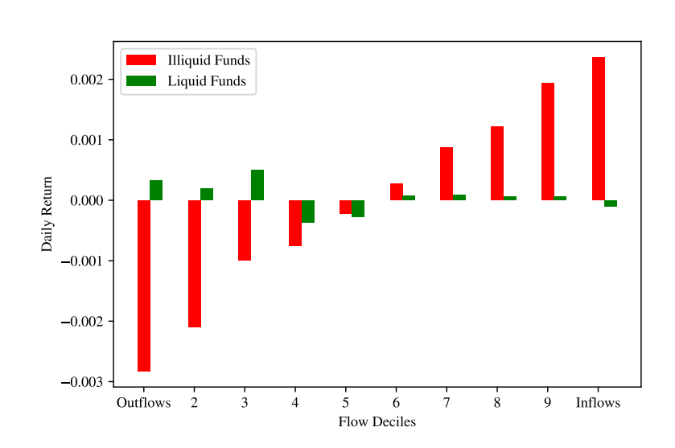
Half an Explanation…
But the current effect, unlike Coval and Stafford (2007), is symmetric:

Slide 13
Asymmetries Due To Horizon
One difference – Coval and Stafford (2007) is measured over months, so funds might have more flexibility to control effect
Current analysis is fairly unclear over whether funds ought to want this effect or not
Big undiscussed piece: fund flows are convex in performance (Sirri and Tufano (1998)), so having positive returns, then equivalent negative returns, is expected to grow AUM!
Can you quantify this effect, even roughly, by measuring
  Size of the initial return increase
  Size of the reversal
  Estimated performance flow/effects

Slide 14
Do we expect funds to manage this risk (if it’s bad)?
What considerations determine portfolio weights?
  Expected returns on that stock (however generated)
  Variance / Portfolio risk considerations
  Liquidity restrictions at a high level
  Estimated price impact from anticipated trades
Here: How the future price impact of flows, if we outperform, might lead to price pressure and overpricing
One view: some funds manage this risk, others don’t
Alternative: Nobody manages this risk, some funds score better just by being naively value-weight
Would be interesting if there’s any way to tell

Slide 15
Would funds even want to manage this risk?
“Co-inflated holdings” have similar effects
Would you actually want prices to be driven by other flows from other funds, as long as it wasn’t you overpaying for the shares?
I suspect most managers would say yes!
Not clear ex-ante that price pressure necessarily reverses (it might, but it doesn’t have to)
Most alphas are larger equal-weighted than value-weighted
  For any given strategy, holding smaller, less liquid stocks probably gets you higher expected returns
  Hard to know how this should be traded off again liquidity cost

Slide 16
Investors Role
Paper claims contribution in showing that investors don’t distinguish real from self-inflated returns
It would have been shocking to me if they did, given:
  Investors assign flows for “beating the S&P 500”, by comparing fund NAV changes to S&P Price Index (Hartzmark and Solomon (2022))
  Investors respond specifically to 5 year returns, and monthly sensitivity drops off a cliff after that (Phillips, Pukthuanthong and Rau (2016))
  Investors respond discontinuously to Morningstar ratings cutoffs (Ben-David, Li, Rossi and Song (2021))
Sophistication needed here is much higher than other tests

Slide 17
ETFs problem even worse
ETFs generally pitched as safe, liquid, low-risk, passive, efficiently priced
This *is* true for SPY!
It is definitely not true for a triple levered inverse VIX ETF
But halo effects from first classification still linger
Whole pitch of ETFs is “prices are efficient because of magic”
  This paper: They really aren’t
  Not the first to show this, but also significant addition to cases of when and why it’s not true

Slide 18
Conclusion
Neat paper providing a potentially large missing piece of the puzzle as to how price pressure and fund flows interact
Big picture incentives fascinating but still murky, because they depend greatly on the permanence of price pressure, and the performance/flow relationship
Asset pricing with price pressure still weird in surprising ways

