Slide 1
Discussion of ‘The Blame Game’
Paper by: Dexin Zhou (Emory)
Discussion by:
David Solomon (USC)
American Finance Association Meetings, January 4th 2015

Slide 2
The Paradox of Text
“I’m not comfortable with having so many numbers in this paper”, said no finance academic ever
‘4.2c per share’ is mostly just taken as an objective truth about the world, and not thought about very much

Slide 3
The Paradox of Text
“I’m not comfortable with having so many numbers in this paper”, said no finance academic ever
‘4.2c per share’ is mostly just taken as an objective truth about the world, and not thought about very much
But how should we think about words? Two perspectives
Words are also a representation of true information, particularly information that is hard to quantify numerically
Words are someone’s subjective opinion, which may or may not reflect underlying reality

Slide 4
The Paradox of Text
The finance academic literature has considered both sides:
Text as Information Text as Interpretation Text as Both/Ambiguous
Engelberg (2008) (Tone in Earnings)
Tetlock, Saar-Tsechansky, and Macskassy (2008) (Tone in Earnings)
Hoberg and Phillips (2009, 2012, 2014) (Industry and Product Market information in MD&A)
Hoberg and Maksimovic (2014) (Financial Constraints in MD&A)
Israelsen and Yonker (2011) (Insurance Policies in 10Ks)
…
Tetlock (2007) (Media tone as proxy for sentiment) and others
Dougal, Engelberg, Garcia and Parsons (2012) (Journalist FE)
Gurun and Butler (2012) (Media slant in press releases)
Li (2010) (CEO Pronoun use)

Slide 5
Interpreting Identification of Interpretation
Information is the default assumption – interpretation needs to be established
Gurun and Butler (2012) – different articles on same underlying earnings announcement
Dougal et al (2012) – Journalist fixed effects and random rotation of journalists
Li (2010) – CEO pronoun use as an economically irrelevant choice (“I did X” versus “We did X”)

Slide 6
CEOs blaming external factors
The current paper: the choice by CEOs to blame poor performance on external factors
Interesting idea! Refusing to accept responsibility fits into CEO hubris a la Roll (1986)
Whom to blame is an actual choice faced by investors (Chang, Solomon and Westerfield (2014))
Firms whose CEO blames economy/industry in conference calls have worse subsequent returns, earnings, and analyst recommendations
Basic results well established
Blame also associated with lower likelihood of CEO turnover after bad performance (i.e. blaming economy ‘works’)

Slide 7
Blame defined
So what, exactly, is being measured by BLAME?
Negative sentences relating to the economy or industry
Watts Water Technologies 2009Q2 “Sales into Eastern Europe has remained depressed due to poor economy conditions, customer credit risk remain a major issue in Eastern Europe.”
Fuel Systems Solutions 2009Q2
“We continue to experience softness in our aftermarket business. We believe this reflects mainly continued weakness in the global economy.”

Slide 8
Blame defined
How should we interpret these sentences?
“Executives blaming negative impacts that are beyond their control is a sign of their attribution bias.”
“direct the focus from potentially persistent problem within the company to relatively transient shocks to economy or industry.”
Whereas the impact of economic and industrial trends inevitably swing corporate performances up and down, these discussions are unlikely to be helpful for investors, since these factors impact all firms in the market or in the sector equally?. Therefore, these discussions are likely to be signs of biases in attribution.

Slide 9
Blame defined
How should we interpret these sentences?
“Executives blaming negative impacts that are beyond their control is a sign of their attribution bias.”
“direct the focus from potentially persistent problem within the company to relatively transient shocks to economy or industry.”
Whereas the impact of economic and industrial trends inevitably swing corporate performances up and down, these discussions are unlikely to be helpful for investors, since these factors impact all firms in the market or in the sector equally?. Therefore, these discussions are likely to be signs of biases in attribution.

Slide 10
Blame turned on its head
What if CEO statements are taken at face value – these companies may really be more affected by macro conditions

Slide 11
Blame turned on its head
What if CEO statements are taken at face value – these companies may really be more affected by macro conditions
Imagine the Jerry Hoberg version of the abstract.
“We document that firms that are more exposed to macroeconomic or industry downturns have a higher cost of capital. Holding constant the level of bad news, when conference calls reveal that news is driven by exposure to bad macro conditions, the price of the firm drops over the next 60 days, consistent with a lower price and a higher cost of capital. Consistent with investors rationally not blaming CEOs for events outside their control, firms whose bad news is due to events outside managerial control are less likely to be fired.”
Can we rule this out?

Slide 12
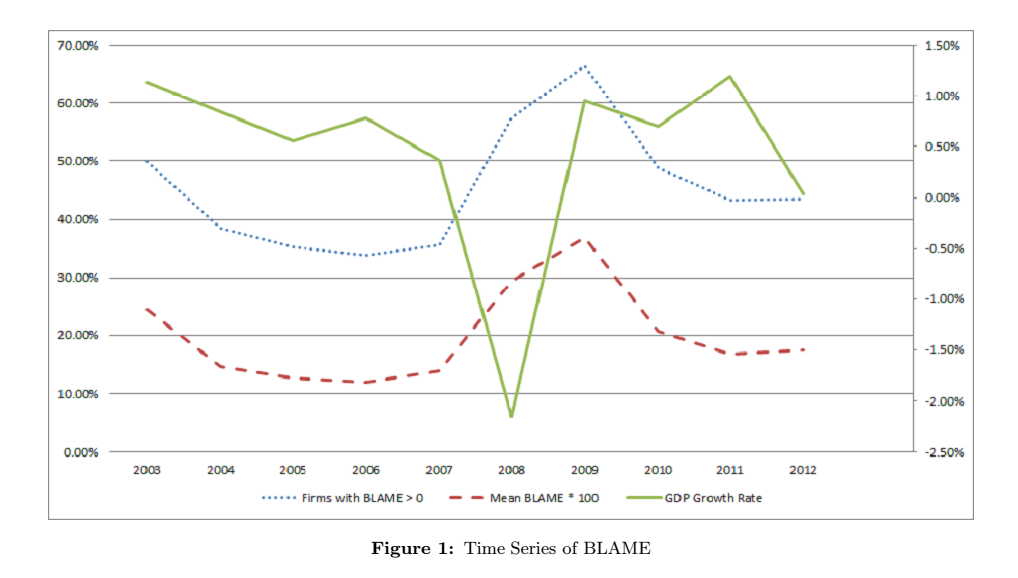
The flip side of blame
The bad news: BLAME does indeed correlate with exposure to economic conditions.
Negatively correlated with GDP growth time series:

Slide 13
The flip side of blame
More bad news: positively associated with cross-sectional exposure:
“The R² (estimated using daily return data with 1-year lag) estimated using the above model is significantly positively associated with the BLAME measure, indicating higher likelihood to mention industry and economy performance when a firm’s exposure to macroeconomic performances is higher. This could also indicate that it is more convincing for executives of firms with higher exposure to systematic risk to blame industry and economy performance.”
William of Occam says that you blame the economy because your results really are due to the economy!

Slide 14
In defense of blame
Past performance doesn’t correlate with positive descriptions of economy
-> Means that there is attribution bias, but may be difference economic exposure as well
Better argument: more macro exposure generally predicts high returns in the future (once adjustment is finished).
Not clear there are high long-term returns (test this!)
Also negative cash flows afterwards (not consistent with discount rate story). Analyst recommendations also not clearly consistent. Talk about this!

Slide 15
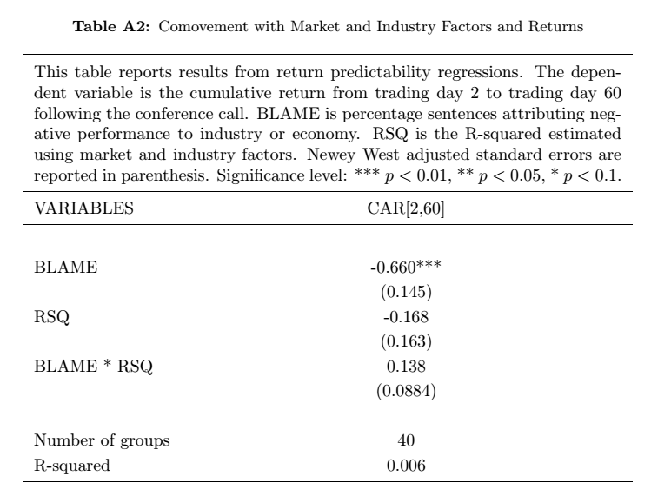
In defense of blame
Measure economic exposure by regressing past returns on industry and macro returns. Take R² from this regression, show blame doesn’t have more effect for high R² firms.

Slide 16
In defense of blame
Not clear that R² is the right measure (β seems more appropriate)
Not clear that interaction between R² and BLAME is the question of interest, as opposed to whether R² drives out BLAME (although here it doesn’t)
Need more work done here to rule out alternative hypotheses, not just one Appendix Table.

Slide 17
Everyone’s a little biased, except for thee and me
Paper argues that blame is evidence of CEO self-attribution bias.
But what are investors doing here? Why don’t they figure this out? This is much more puzzling.
Paper argues ‘inattention’ to bias. But what about simple gullibility?
If investors are gullible, is this evidence of CEO bias at all? Perfectly rational to blame sunspots, aliens, whatever, if a) investors will believe it and b) it increases the likelihood of keeping your job.

Slide 18
Everyone’s a little biased, except for thee and me
Would be nice to see more evidence on the role of investor beliefs.
Is drift attenuated if analysts ask more hostile questions during the call? Or express skepticism about the role of the macro factors
Is drift attenuated if other companies with similar bad returns aren’t blaming the macro factors? This would make the possibility of bias more salient.
If it’s CEO bias, is it correlated with other evidence of bias, e.g. late option exercise as overconfidence proxy

Slide 19
Delayed Reaction & PEAD
The paper shows BLAME is associated with lower announcement and post-announcement returns
But the post-announcement returns would be predicted by announcement and general post-earnings announcement drift
Need more controls for announcement day information

Slide 20
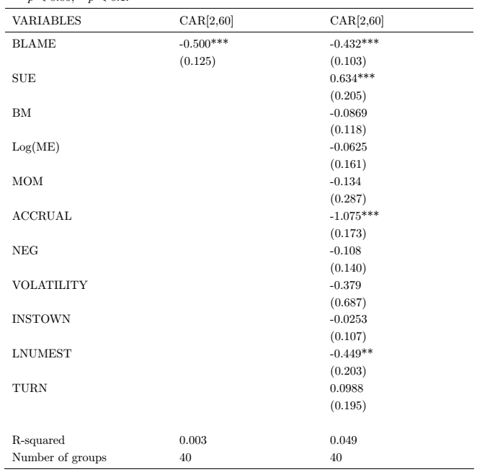
Delayed Reaction & PEAD
Actually Surprise, not SUE
Want to control for actual SUE (see Bernard and Thomas (1990)) and announcement day returns

Slide 21
Conclusion
Neat Paper!
Documents an interesting pattern in returns
Blame is associated with more drift after bad news
Would be nice to see more evidence
Ruling out exposure to macro factors
Understanding role of investors

