Slide 1
Discussion of
“Monetary Policy and Reaching for Income”
Paper by
Kent Daniel Lorenzo Garlappi Kairong Xiao
(Columbia) (UBC) (Columbia)
Discussion by
David Solomon
(Boston College)
Rodney White Conference
March 22nd, 2019

Slide 2
How an Investor SHOULD Think About Dividends
Dividends are irrelevant without frictions (M&M)
Adding costs can break the indifference:
    Taxes on dividends or capital gains, transaction costs
But investors still indifferent after taxes and costs
  Don’t intrinsically care about dividends, just minimizing costs
Positive versus normative
  Is this how people actually think about dividends?

Slide 3



Curious things from consumer markets

Slide 4
Curious things from consumer markets

Slide 5

Curious things from consumer markets

Slide 6
Curious things from consumer markets
Irrelevant Miles? Tax-Disadvantaged Miles? Signaling Miles?

Slide 7

Curious things from consumer markets

Slide 8
People LOVE dividends
People talk as if they really like dividends. But why?
Evidence of demand in financial markets as well
  Companies increase dividends in response to proxies for dividend demand (Catering, Baker & Wurgler (2004))
  Elderly investors more likely to purchase dividend-paying assets (Clienteles, Graham & Kumar (2006))
  Price pressure around dividend-payment (Hartzmark & Solomon (2013))

Slide 9
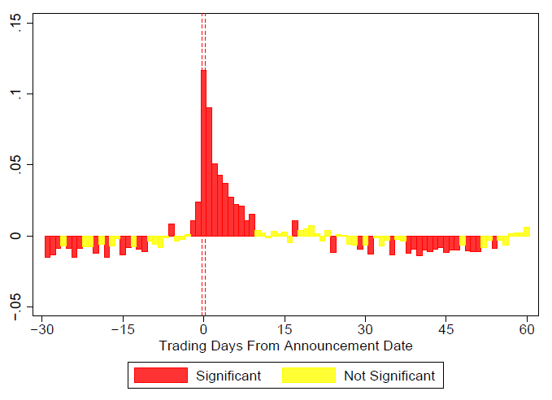
Interim Returns for Dividend Payers
Hartzmark and Solomon (2013)
Hartzmark and Solomon (2013)

Slide 10
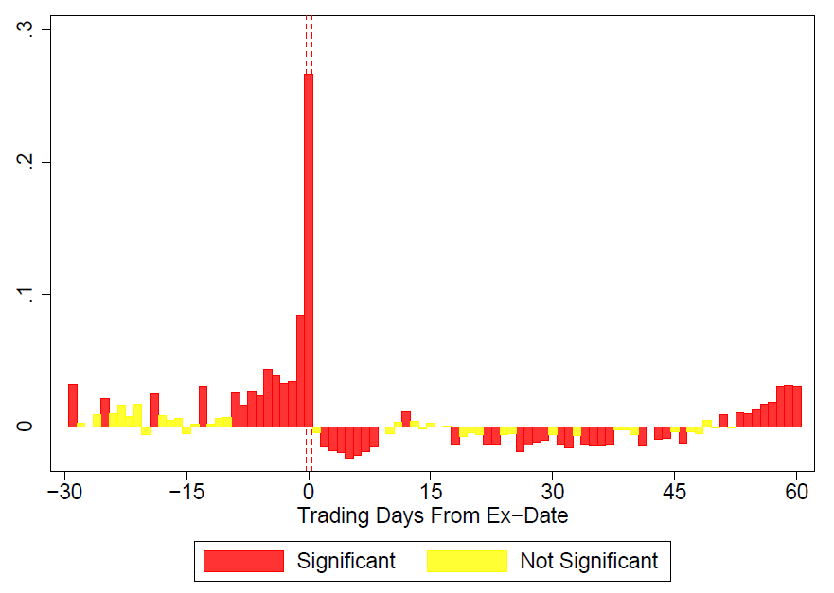
Interim Returns for Dividend Payers
Hartzmark and Solomon (2013)

Slide 11
Interim Returns for Dividend Payers
Hartzmark and Solomon (2013)
Abnormal Return Occurring
After dividend announcement
No uncertainty, risk, information…
Before ex-day
No tax consequences
-> Price pressure from
dividend-seeking investors

Slide 12
Theories of Dividend Demand
Clienteles: “Need for income streams”, elderly. Graham & Kumar (2006)
Free Dividends Fallacy: Investors think dividends are free money
  Hartzmark & Solomon (2017)
Commitment Against Overconsumption
  Shefrin & Statman (1984), this paper
Hedonic Editing: Increased prospect theory value by sometimes combining Div + CapGain, sometimes separating them
  Shefrin & Statman (1984)
Resolve uncertainty in how much to consume
  View dividends as an annuity

Slide 13
Findings
Demand for dividend-paying assets is higher when interest rates are low
  Buy more high-dividend stocks when fed funds rate is low
  Buy more when local deposit rate is low
  Buy more income mutual funds when fed funds rate is low
  High returns on dividend-paying stocks when fed funds rate is low
Demand is higher among retirees with greater needs for income
These actions may be driven by investors following a rule of “live off your income”, including for reasons micro-founded by commitment against overconsumption
  Consume dividends more when retired

Slide 14
Findings
Demand for dividend-paying assets is higher when interest rates are low
  Buy more high-dividend stocks when fed funds rate is low ~Jiang & Sun (2015)
  Buy more when local deposit rate is low
  Buy more income mutual funds when fed funds rate is low Jiang & Sun (2015)
  High returns on dividend-paying stocks when fed funds rate is low
  Hartzmark & Solomon (2013, 2017) , Jiang & Sun (2015)
Demand is higher among retirees with greater needs for income
Jiang & Sun (2015)
These actions may be driven by investors following a rule of “live off your income”, including for reasons micro-founded by commitment against overconsumption
  Consume dividends more when retired

Slide 15
Demand for Dividends & Interest Rates
Are investors buying and holding dividend-paying assets? Or buying the dividends directly?
Big predictable time-series effect in returns of dividend-paying stocks
  High returns only in the month the dividend is paid

Slide 16
Demand for Dividends & Interest Rates
Hartzmark & Solomon (2013) Abnormal Returns & Months Since Dividend Payment

Slide 17
Demand for Dividends & Interest Rates

Slide 18
Demand for Dividends & Interest Rates
Are investors buying and holding dividend-paying assets? Or buying the dividends directly?
Big predictable time-series effect in returns of dividend-paying stocks
  High returns only in the month the dividend is paid
$64,000 Question: Do you define dividend yields as being positive in all months of the year, or only the months with a dividend ex-day?
  Consumption theory predicts general demand in all months
  Thinking that dividends are free predicts demand only for the dividend month itself
  If purchases in all months, shouldn’t expected returns at some point be low?
Would love to know what long horizon returns are for a constant portfolio of dividend-paying stocks

Slide 19




When are dividends perceived as more valuable?
But bond yields today are unusually low…
Another strategy would be to substitute a portfolio of blue-chip stocks with generous dividends for an equivalent high-quality U.S. bond portfolio.
Many excellent U.S. common stocks have dividend yields that compare very favorably with the bonds issued by the same companies.
Burton Malkiel
Dividend Yield: 6%
Bond Yield: <3%

Slide 20
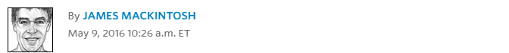
Dividends in the Financial Press
Why would an investor desperate for income want a dividend?
  Dividend not a source of income independent of the price level
  A value maximizing investor just wants to minimize costs
  “The humble dividend is reclaiming its rightful place as the arbiter of stock-market value... To investors desperate for income, the argument for buying equities is, well, duh. Who wouldn't want a higher income? Shares might swing around, but corporate managers go out of their way to preserve the dividend.”

Slide 21
Dividends in the Financial Press
Why would an investor desperate for income want a dividend?
  Dividend not a source of income independent of the price level
  A value maximizing investor just wants to minimize costs
  “The humble dividend is reclaiming its rightful place as the arbiter of stock-market value... To investors desperate for income, the argument for buying equities is, well, duh. Who wouldn't want a higher income? Shares might swing around, but corporate managers go out of their way to preserve the dividend.”

Slide 22
Does any of this even make sense???
Comparison between dividends and bond interest isn’t comparing the same quantities!
  High interest rates at the bank pay you from someone else’s pocket
  High dividend yields pay you from your own pocket
If investors want to commit to just consume a certain amount, why not just buy an annuity?
  They don’t! There’s a whole puzzle about this
If they’re just planning consumption, why buy mutual funds who artificially juice their dividend yield by trading in and out of dividend-paying stocks?
  28% of dividend-paying funds are doing this!
  (Harris, Hartzmark & Solomon (2015))

Slide 23
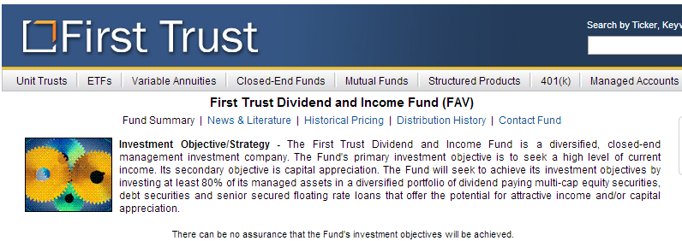
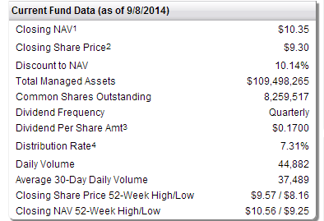
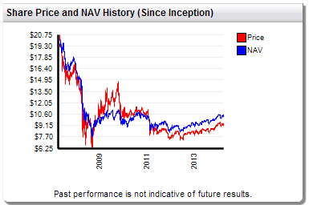
Even more curious things from financial markets

Slide 24
Even more curious things from financial markets

Slide 25









Descending down the rabbit hole
http://www.sec.gov/Archives/edgar/data/1403275/000144554609000266/0001445546-09-000266.txt

Slide 26
Descending down the rabbit hole
http://www.sec.gov/Archives/edgar/data/1403275/000144554609000266/0001445546-09-000266.txt

Slide 27
Descending down the rabbit hole
http://www.sec.gov/Archives/edgar/data/1403275/000144554609000266/0001445546-09-000266.txt
How do you get a dividend yield of 19.31%?!?!

Slide 28
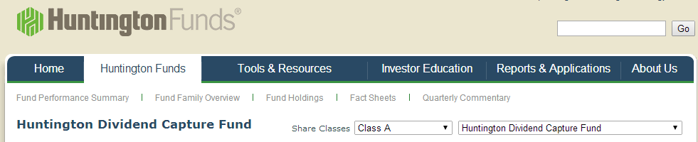


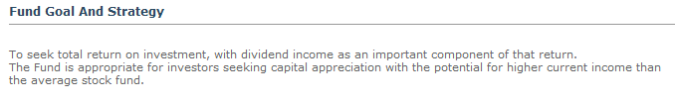
Descending down the rabbit hole

Slide 29

Descending down the rabbit hole

Slide 30
Descending down the rabbit hole

Slide 31
Reaching Rock Bottom

Slide 32
Reaching Rock Bottom
http://www.sec.gov/Archives/edgar/data/1403275/000144554609000266/0001445546-09-000266.txt
“May increase portfolio turnover”

Slide 33
Reaching Rock Bottom
Surely nobody is actually buying this fund, right?

Slide 34
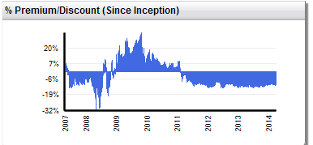
Reaching Rock Bottom
Surely nobody is actually buying this fund, right?

Slide 35
Reaching Rock Bottom
Surely nobody is actually buying this fund, right?
?!?!
Trading at a premium to NAV!!!

Slide 36
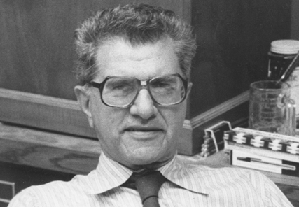

Reaching Rock Bottom
Surely nobody is actually buying this fund, right?
?!?!
Trading at a premium to NAV!!!
Did you muppets not learn anything?
All this rolling in my grave is making me nauseous

Slide 37
Conclusion
Interesting evidence that demand for dividends is higher in low interest rate environments
Consistent with financing consumption streams, but also consistent with other mistakes too
Best evidence: Retirees demanding high dividend stocks, Retirees consuming dividends
Probably both explanations. Hard to tell apart, and other papers don’t do a much better job

