Slide 1
Discussion of “﻿Does Market Selection Eliminate Unskilled Investors? Evidence from Chinese Brokerage Account Records”
Paper by:
Neil Pearson (Univ. of Illinois)
﻿Zhishu Yang (﻿Tsinghua University) ﻿Qi Zhang (﻿Shanghai Jiaotong University)
Discussion by:
David Solomon (Boston College)
CFRN Conference, April 7th 2024

Slide 2
Why Might Markets Make Individuals Smart?
Market Selection – markets tend to reward people who make rational choices, so the smart money drives out the dumb.
Friedman (1953) – Often cited, rarely quoted!

Slide 3
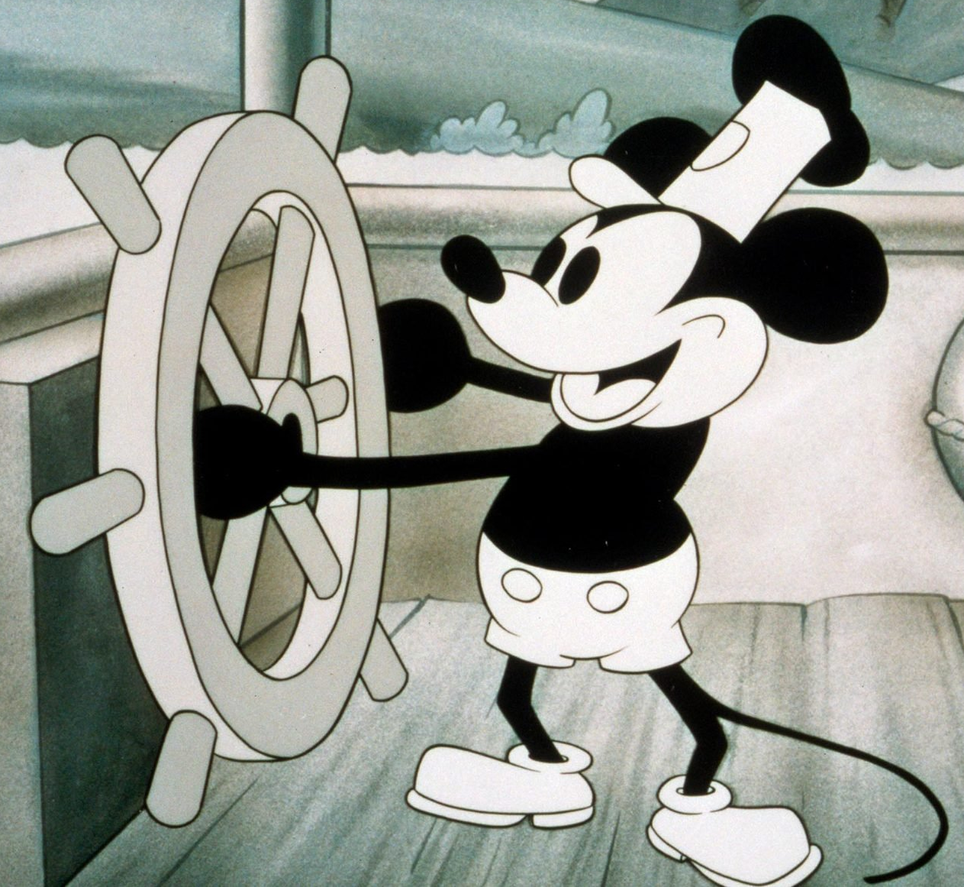
Why Might Markets Make Individuals Smart?
Market Selection – markets tend to reward people who make rational choices, so the smart money drives out the dumb.
Friedman (1953) – Often cited, rarely quoted!
“Friedman is smarter than you think, so make sure you read the original, not just attributions!

Slide 4
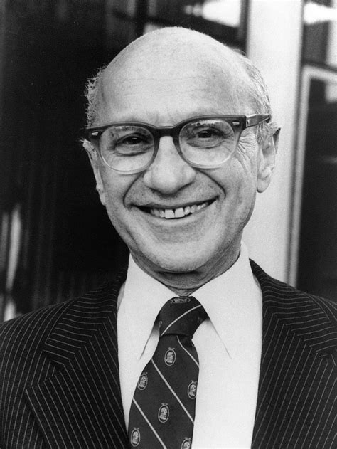
Why Might Markets Make Individuals Smart?
Market Selection – markets tend to reward people who make rational choices, so the smart money drives out the dumb.
Friedman (1953) – Often cited, rarely quoted!
“[U]nless the behavior of businessmen in some way or other approximated behavior consistent with the maximization of returns, it seems unlikely that they would remain in business for long. Let the apparent immediate determinant of business behavior be anything at all – habitual reaction, random chance, or whatnot. Whenever this determinant happens to lead to behavior consistent with rational and informed maximization of returns, the business will prosper and acquire resources with which to expand; whenever it does not, the business will tend to lose resources and can be kept in existence only by the addition of resources from outside.

Slide 5
What Friedman Did and Didn’t Say
Argument is originally about firms acting in a maximizing way
Firms consume resources on an ongoing basis (so die easily)
Firms mostly act in product or service markets
Disciplined by consumers, who care about price and quality (they care about price even if random – Becker 1963)
How exactly should this apply to traders in financial markets?

Slide 6
Friedman in Financial Markets
Should we expect unskilled traders to shrink, or disappear?
Is being skilled about being able to generate high returns? High IQ? Being able to assess the fundamental value of firms?
Returns
IQ
Fundamentals
Shrink
Die

Slide 7
Friedman in Financial Markets
Should we expect unskilled traders to shrink, or disappear?
Is being skilled about being able to generate high returns? High IQ? Being able to assess the fundamental value of firms?
Returns
IQ
Fundamentals
Shrink
Tautological
Very Likely
Not obvious
Die

Slide 8
Friedman in Financial Markets
Should we expect unskilled traders to shrink, or disappear?
Is being skilled about being able to generate high returns? High IQ? Being able to assess the fundamental value of firms?
Returns
IQ
Fundamentals
Shrink
Tautological
Very Likely
Not obvious
Die
This Paper
Not obvious
Not obvious
Not obvious

Slide 9
Friedman in Financial Markets
Should we expect unskilled traders to shrink, or disappear?
Is being skilled about being able to generate high returns? High IQ? Being able to assess the fundamental value of firms?
Returns
IQ
Fundamentals
Shrink
Tautological
Very Likely
Not obvious
Run out of Money
Quit by Choice

Slide 10
Friedman in Financial Markets
Should we expect unskilled traders to shrink, or disappear?
Is being skilled about being able to generate high returns? High IQ? Being able to assess the fundamental value of firms?
Returns
IQ
Fundamentals
Shrink
Tautological
Very Likely
Not obvious
Run out of Money
No
No
No
Quit by Choice

Slide 11
Friedman in Financial Markets
Should we expect unskilled traders to shrink, or disappear?
Is being skilled about being able to generate high returns? High IQ? Being able to assess the fundamental value of firms?
Returns
IQ
Fundamentals
Shrink
Tautological
Very Likely
Not obvious
Run out of Money
*Options? Yes
Stocks? No
No*
No
No
Quit by Choice

Slide 12
Friedman in Financial Markets
Should we expect unskilled traders to shrink, or disappear?
Is being skilled about being able to generate high returns? High IQ? Being able to assess the fundamental value of firms?
Returns
IQ
Fundamentals
Shrink
Tautological
Very Likely
Not obvious
Run out of Money
No
No
No
Quit by Choice
This Paper
Not obvious
Not obvious
Not obvious

Slide 13
Individual Selection, Not Market Selection
Not properly described as market selection, because market doesn’t force you to leave!
Other question: Do you end up affecting aggregate prices
Why might you quit by choice? Several reasons:
You (rationally) realize you’re not very good at trading
You (rationally?) decide it’s not fun
You (irrationally) follow some behavioral rule of participation
Worth honing in on these questions directly

Slide 14
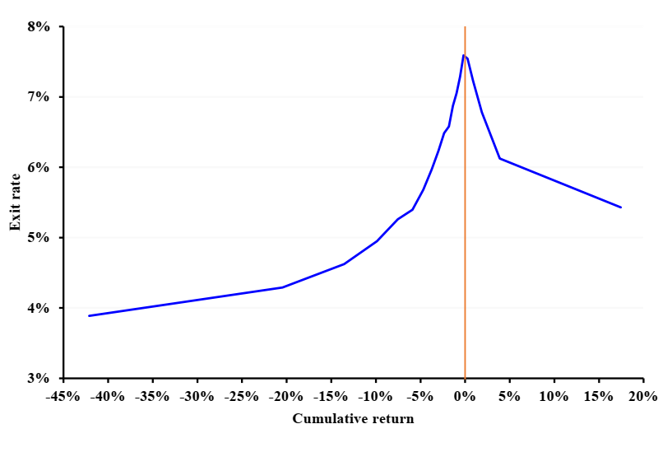
The Paper in One Picture

Slide 15
The Paper in One Picture
You (rationally) realize you’re not very good at trading
Simplest version of #1.

Slide 16
You (rationally) realize you’re not very good at trading
Other, sharper tests of #1 relate to seeing if people are using any reasonable estimate of skill
Results show large effects of market returns. So what do both i) shapes, and ii) levels look like if you split out exit as a function of market returns, and deviations from market?
If large effects of common, short term market returns, very unlikely to be skill (shouldn’t even update much on E(R))
If predictions still not downward sloping with market-adjusted returns, even harder to argue for skill story

Slide 17
You (rationally) realize you’re not very good at trading
Do traders evaluate actual returns, or just price changes?
Hartzmark and Solomon (2019): Dividends treated as separate category, rarely included in a total performance calculation
If effects are mostly based on portfolio value minus dividends, even harder to argue it’s a rational skill inference question

Slide 18
2. You (rationally?) decide it’s not fun
Shape of graph also potentially consistent with #2!
Problem: Variance of cumulative returns strongly tied to how long you’ve been trading
Alternative: People have some (unknown at first) baseline level of how fun they’ll find trading equities
Open up account, trade a little, learn over time about type.
What would this predict?

Slide 19
2. You (rationally?) decide it’s not fun
Those who really hate it find out quickly, and quit quickly. Cumulative returns are close to zero
Those who like it stay in, their volatility grows over time, they end up in both tails of returns and have low exit probabilities
How to rule out?
Use hazard rates, control for duration already in the market
Use annual average returns, instead of cumulative
Year and cohort fixed effects don’t solve fully

Slide 20
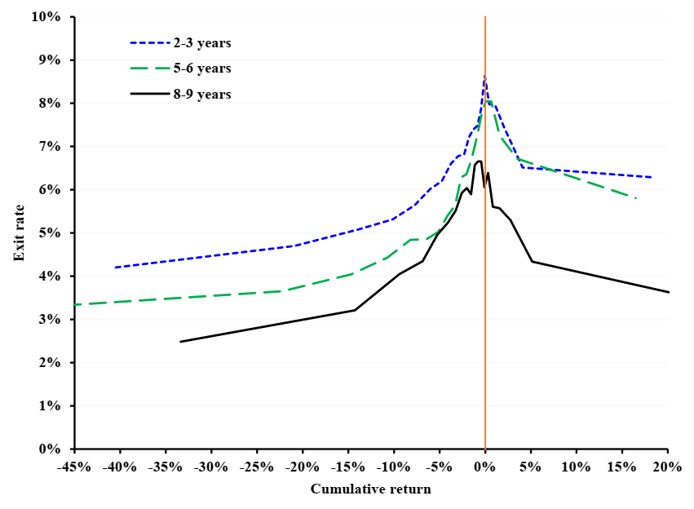
2. You (rationally?) decide it’s not fun
Probably not whole story, but should test explicitly (also, is “experience” measured years, or self-reported experience?)

Slide 21
3. You (irrationally) follow some behavioral rule of participation
Evidence on Barberis (2012) casino model is interesting, credible
Full relationship to disposition effect (selling gains more than losses) and its drivers is tough
Version #1: Disposition effect is about when you sell
Barberis (2012), Barberis and Xiong (2012), Ben-David and Hirshleifer (2012)
Version #2: DE is about what you sell, conditional on a sale
Odean (1998), Chang, Solomon and Westerfield (2016), most others

Slide 22
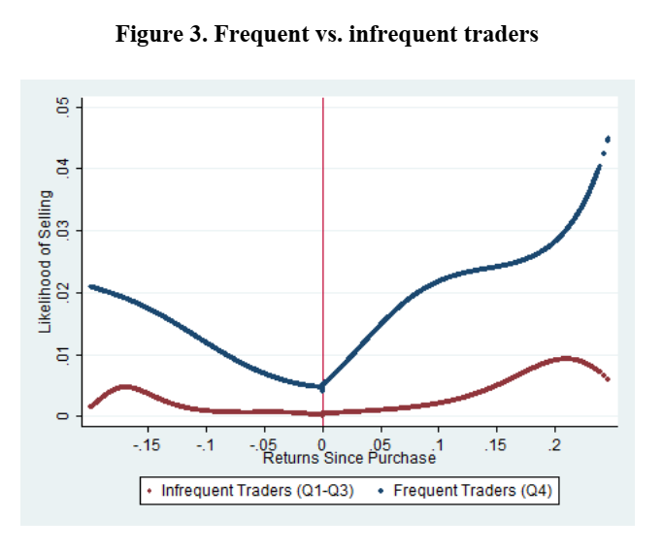
3. You (irrationally) follow some behavioral rule of participation
“When you quit” is conceptually closer to “When you sell”
Ben-David & Hirshleifer (2012) find v-shape selling propensity
Consistent explanation?
“At the stock level, I wait for something to happen before selling.” “At the account level, if nothing happens, I get bored and quit”
Different from Barberis (2012), worth pondering

Slide 23
3. You (irrationally) follow some behavioral rule of participation
Odean (1998) DE measure shows large, puzzling negative effect
Worth pondering why that is.
Cognitive dissonance (Chang, Solomon and Westerfield (2016)?
I sell winners more than losers because I hate admitting I screwed up
If I rarely admit I screwed up, I’m less likely to learn that I’m unskilled and quit
Not the only answer, but could make sense here (but different from Barberis (2012)

Slide 24
Conclusion
Neat paper, makes great use of novel dataset
Simple version of low-skilled guys get driven out seems wrong, but what actually is the driver of these choices?
Market selection versus individual selection as framing is less clear
Really interesting to read and think about

